Slide 1
Bell Work
Buddha
The Four Noble Truths
Judaism
Covenant
Patriarch

Slide 2
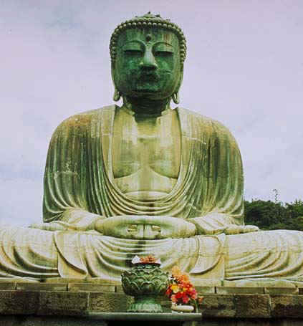
Buddhism

Slide 3
Main Idea
Buddhism, which teaches people that they can escape the suffering of the world through the Buddha’s teachings, developed in India and spread to other parts of Asia and the world.

Slide 4
Key Terms and People
Buddhism
Buddha
Four Noble Truths
Eightfold Path
Nirvana
Middle Way

Slide 5
The Life of Buddha
Buddhism, like Hinduism, was founded in Ancient India.
Unlike Hinduism, Buddhism can be traced back to the teachings of a single founder, Siddhartha Gautama- AKA Buddha
Much of what is know about Buddha is from written text, many of which were written centuries after his death.
According to the written sources, Buddha was born in the 500’s BC.
He was a prince of a small kingdom in the very northern part of the Indian subcontinent in what is now Nepal.
He lived a sheltered life, free of any hardship or suffering. Upon learning that people grew old, got sick and died, his life was transformed. He resolved to find a way to overcome age and sickness, to keep people from suffering.
His first step was giving up all of his worldly possessions and leaving his palace.

Slide 7
Buddha’s Enlightenment
Sought enlightenment, or spiritual understanding, for six years.
He began his search by living in the forest and begging for food.
He studied with teachers called gurus and with monks who denied themselves food, drink, and other necessities. After awhile, he decided that he could not find the way to enlightenment by talking with the guru’s and monks.
Left alone with no teacher and companions, Gautama sat under a tree, determined not to arise until he found the way to end human suffering. Stories say that he mediated all night, his resolve tested by violent storms and earthly temptations. When dawn broke, Gautama had been transformed.
From then on he was to be known as Buddha or Enlightened one.
The spot where Buddha is believed to have sat in meditation is called Bodh Gaya.

Slide 8
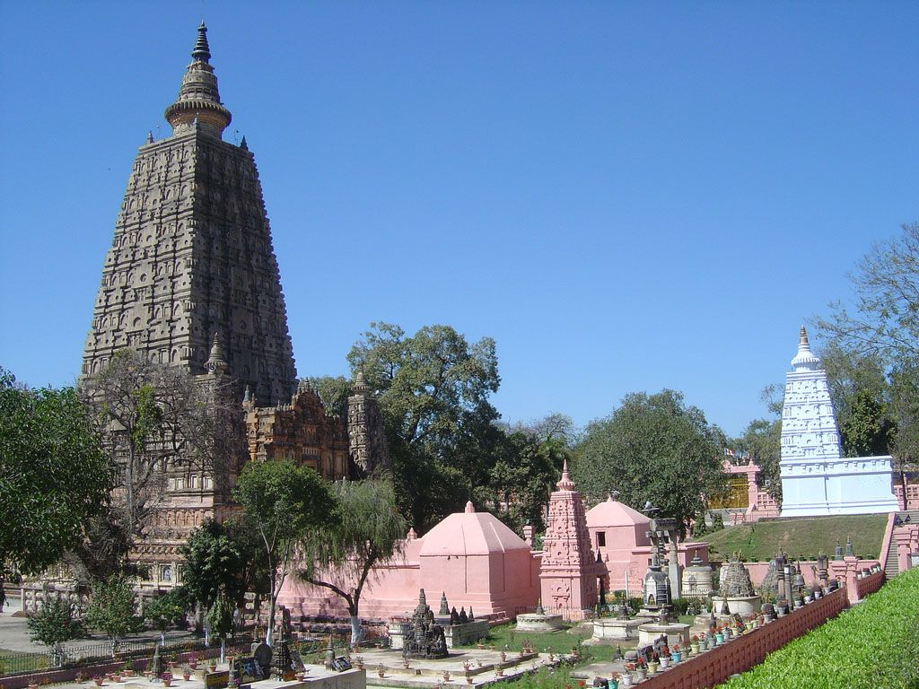
Bodh Gaya

Slide 9
The Teachings of Buddhism
After meditating for 7 weeks at Bodh Gaya, Buddha set out to teach what he had learned. His lessons became the basic teachings of Buddhism.
The Four Noble Truths
Suffering is part of human life. No one can escape from suffering while alive.
Suffering comes from people’s desires for pleasure and material goods.
Overcoming these desires during life eventually brings suffering to an end.
Desires can be overcome by following the Eightfold Path.

Slide 10
Eightfold Path
Eightfold path is a series of steps that Buddhists believe leads to enlightenment and salvation. It includes the following:
Right view, or accepting the reality of the four noble truths.
Right attitude, or striving for moderation in all things.
Right speech, or avoiding lies, boasts, and hurtful words.
Right action, or treating others fairly.
Right livelihood, or avoiding jobs that could bring harm to others.
Right effort, or constantly trying to improve oneself.
Right mindfulness, or remaining aware of the world around one.
Right concentration, or ignoring temptation and discomfort while meditating.

Slide 11
Nirvana
Buddha taught that those who followed the Eightfold path could attain nirvana.
Nirvana- a state of perfect peace in which the soul would be free from suffering forever. Those who do not attain Nirvana will be reborn to live through the cycle of suffering again.
The basic teachings of the Eightfold Path can also be expressed as the Middle Way. The Middle Way advises people to live in moderation, avoiding extremes of either comfort or discomfort.

Slide 12
Divisions of Buddhism
After Buddha’s death, three main traditions formed- Theravada, Mahayana, and Tibetan Buddhism. Each believed they were the way of Buddha.
Theravada-means Way of the Elders, is the oldest.
Mahayana teaches that people can help each other find enlightenment. According to these teachings, you do not have to be a monk or nun to reach nirvana. Anyone can do it with some help. Those that help have found nirvana but not traveled on and are call Bodhisattvas.
The third is tradition is Tibetan Buddhism and it shares many teachings with Mahayana. Tibetan Buddhists believe that they can reach Nirvana in a single lifetime.

Slide 14
Buddhism
Where: Northeastern India
When: 520 BC
Founder: Siddhartha Gautama
Sacred Laws/Duties: Eightfold Path/5 precepts
Place of Worship: Temple/Meditation Hall
Name of Followers: Buddhist
World Rank: 4th
Practicing: 350 Millions Plus

