Slide 1
World War II and the Holocaust
Chapter 17
Section 1
World War II Begins

Slide 2
Objective
Students will be able to describe Hitler’s actions before WWII.
Video Question: Name a cause of WWII
Causes of WWII

Slide 3
Background
Dictatorships arose in countries that were dissatisfied with the results of World War I (and had suffered from economic hardships due to the Great Depression). The Treaty of Versailles became a flashpoint for conflict. Germany, Italy, and Japan took aggressive actions to regain lost power. Neither the League of Nations nor the democratic countries were able or willing to stop them.

Slide 4
Question
Who was the dictator of Germany prior to WWII? Of Italy? Of the Soviet Union?
All of these dictators became major players prior to WWII.
Notes:
Adolf Hitler; Benito Mussolini; Stalin.

Slide 5
Vocab
Demilitarized: elimination or prohibition of weapons, fortifications, and other military installations.
Appeasement: satisfying reasonable demands of dissatisfied powers in an effort to maintain peace and stability.

Slide 6
DBQ
“One race needs one country. The German nation will not be able to compete in global politics and empire building until it has all German people in one state. We will bring all oppressed (treated badly) German people to a common country, not with protests (talking) but with the sword (war).”
Questions:
What did Hitler suggest was needed for Germany?
How would that lead to war?
Notes:
Possibly have students compare answers with the members of their group.

Slide 7
Answer

Slide 8
The German Path to War
Hitler believed that Germans were members of a superior “Aryan” race (over all other races and nationalities) and were meant to build a great German civilization.
**The German path to World War II emerged from Adolf Hitler’s conviction that a superior “Aryan” race of Germans must conquer other nations to build a great German civilization.**

Slide 9
German Aggression
Hitler Violates the Treaty of Versailles:
*Germany violated the Treaty by creating an air force, expanding his army, and sending troops into the demilitarized Rhineland (German area separating Germany and France).*

Slide 10
DBQ (German Perspective)
HITLER SENDS GERMAN TROOPS INTO THE RHINELAND. Berlin, March 7th- Germany, today, got rid of the chains put on her by the Treaty of Versailles when Adolf Hitler, as head of the army of the Reich (the German empire), sent his new army into the Rhineland’s demilitarized zone (an area between Germany and France that was supposed to be free of soldiers)... “After 3 years of constant fighting,” Hitler concluded, “I look on this day as the end of German’s struggle for equality and with that newly won equality, Germany can now be an equal partner with Europe.”
Notes:
QUESTION: What action did Hitler take in defiance of the Versailles Treaty? How did he explain his action?

Slide 11
DBQ (French Perspective)
PARIS APPEALS TO LEAGUE. Paris, March 7- France has brought Germany’s latest violation of the Treaty of Versailles to the League of Nations (an international group created to solve problems between countries peacefully). AT the same time the French government made it quite clear it would not negotiate with Germany… as long as a single German soldiers remained in the Rhineland as a violation of German’s previous agreements.
The main point in the French View, is that Germany should be forced to honor their agreements, first by diplomacy (talking it out), then by stronger means, to leave the Rhineland.
Notes:
Question: What was the reaction in France? How might this have led to war?

Slide 12
Answer
Notes:
Note: Hitler ordered his troops to retreat if France intervened. The French overestimated German troop strength, and French politicians insisted on waiting for support from Britain before using force.

Slide 13
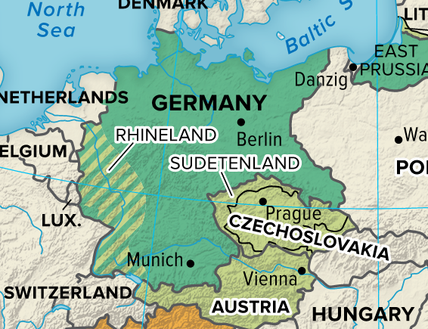

Slide 14
Austria
Hitler was convinced that France and Britain would not intervene in his expansion plans. So ,in 1938, he annexed Austria to Germany without force.

Slide 15
Czechoslovakia and the Munich Agreement (Group)
What area of Czechoslovakia did Hitler demand be given to Germany?
What was Britain’s and France’s response?
What was Neville Chamberlain’s reaction to the Munich Agreement? Winston Churchill’s?

Slide 16
Czechoslovakia and the Munich Agreement (Group)
What area of Czechoslovakia did Hitler demand be given to Germany? Sudetenland (home of 3 million Germans)
What was Britain’s and France’s response? Appeasement; Munich Conference, where UK and FR met all of Hitler’s demands, hoping that German expansion would end.
What was Neville Chamberlain’s reaction to the Munich Agreement? Believed he avoided a war.
Winston Churchill’s reaction? “Disaster”

Slide 17
Appeasement
Britain's Appeasement
Appeasement is the policy of making concessions (allowances; compromises) to the dictatorial powers in order to avoid conflict.

Slide 18
Hitler, the Soviets, and Poland
In March 1939, Hitler took over the rest of Czechoslovakia. Months later, to prevent Western Europe from getting help from the Soviet Union in the event of a German attack on Poland, Hitler and Stalin signed the Nazi-Soviet Nonaggression Pact (hey agreed not to fight if the other went to war). **This paved the way for Germany’s invasion of Poland in September of 1939, which set off World War II.**

Slide 19
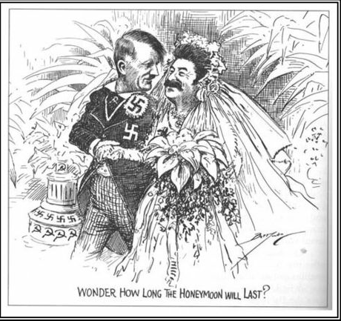
Cartoon
Notes:
Question: Who is being depicted in this cartoon? What is the meaning behind it?

Slide 20
Assessment
1) What was Hitler’s goal/plan for the German race?
2) What resulted from the Munich Conference?
3) What event set off WWII?
Notes:
Answers:
1) Conquer other nations to build a great German civilization;
2) Appeasement; annexation of Sudetenland;
3) Germany’s invasion of Poland;

Slide 21
Summary

