Slide 1
World War II
chapter 17
SECTION 1
DAY 2
World War II Begins

Slide 2
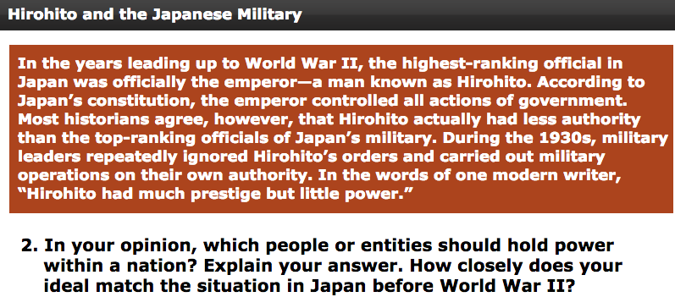
Starter

Slide 3
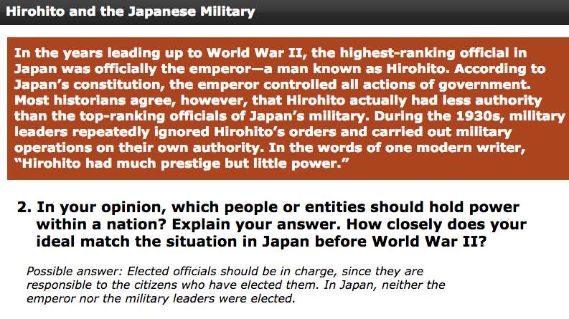
Possible Answer

Slide 4
Objective
Students will be able to
Explain why Japan wanted to seize other countries; and
Describe the “Rape of Nanking.”

Slide 5
Background
In the 1930s, Japan’s economy was becoming increasingly industrialized and the Japanese population was booming. However, as a small island nation, Japan’s access to natural resources was too limited to sustain this growth. Japan’s mountainous terrain was not suited for agriculture, and the amount of land that could be used to cultivate food for the growing population was limited.
In addition, Japan lacked the natural deposits of minerals and fossil fuels that were necessary to support its industrial economy and military machine.

Slide 6
Background
**The Japanese believed that the solution to their economic issues was to use military force to gain control of lands that were rich in resources. **

Slide 7
Japanese Path to War
In 1931, Japan took over the Chinese province of Manchuria to gain access to its extensive natural resources.
Worldwide protest against Japan’s seizure of Manchuria led the League of Nations to condemn Japan’s actions.

Slide 8
Japanese Path to War
Japan responded to criticism from the League of Nations by withdrawing from the League. It continued its expansion, seizing territory in northern China and Inner Mongolia.

Slide 9
Japan’s War With China
China tried to avoid conflict with Japan. However, Japan began to move southward into China, and the two clashed. In 1937, Japan moved to seize the Chinese capital of Nanjing.

Slide 10
Group Questions
DBQ – Rape of Nanking

Slide 11
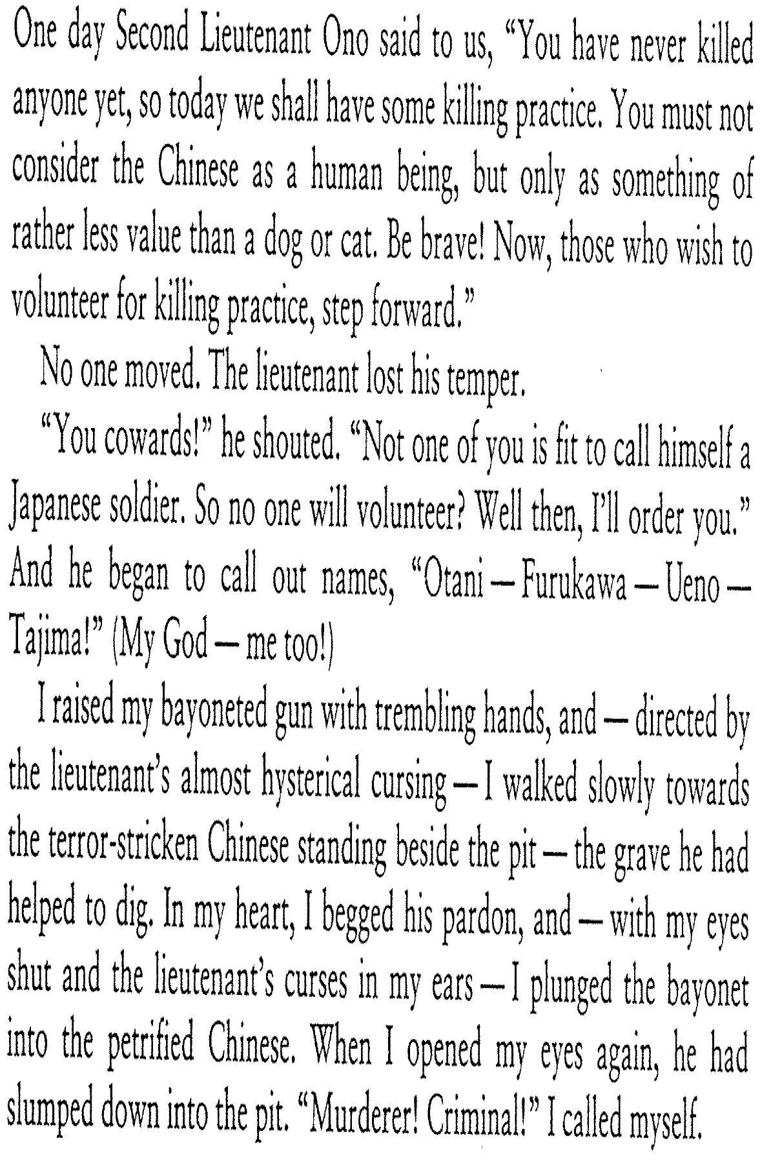
Notes:
1) Who is the speaker in this excerpt? (Tajima, a Japanese soldier); what’s the author’s point of view? (1st person)
2) Why do you think the Second Lieutenant Ono would want to subject the soldiers to a killing practice?
3) Think of one “I wonder” question that you could ask about the excerpt that are not answered in the writing.

Slide 12
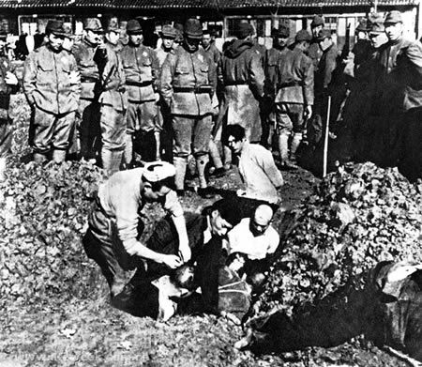
Notes:
Prisoners being buried alive.

Slide 13
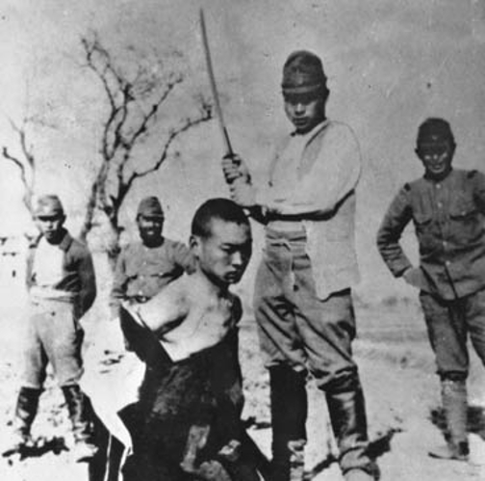

Slide 14
Question
How do you think the Rape of Nanking affected Japan’s reputation around the world?
**Rape of Nanking: It is estimated that the Imperial Japanese Army murdered 40,000 to over 300,000 Chinese civilians and disarmed combatants, and perpetrated widespread rape and looting.
Notes:
Answer: It probably caused distrust and anger toward the Japanese.

Slide 15
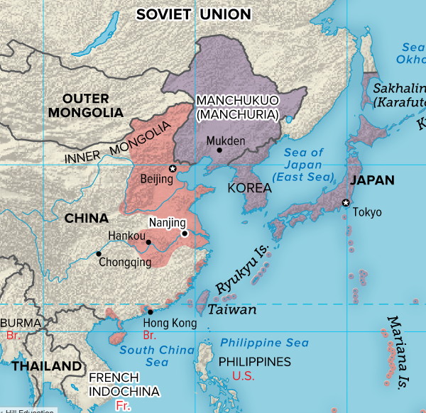
Japanese Expansion 1933 - 1941

Slide 16
Japan New Order in East Asia
Japan desired to establish a New Asian Order; it hoped to join with China to seize the Siberia region of the USSR, which had vast mineral resources.
When Japan's ally, Nazi Germany, signed a nonaggression agreement with the Soviet Union, Japan's hopes of seizing Siberia were dashed.
The Japanese next looked to Southeast Asia for raw materials, running the risk of war w/ European powers and the U.S.

Slide 17
Japan in French Indochina
**In 1940, Japan demanded the right to resources in French Indochina. The United States objected to this demand and threatened Japan with economic sanctions (restrictions intended to enforce international law).**
Why was the threat of economic sanctions a concern to Japan? Because, Japan had limited natural resources and relied on oil and scrap iron from the United States. If sanctions were enforced, the Japanese would lose those resources.
Notes:
Later, we will learn Japan’s response the U.S.’s threat of sanctions (i.e., Pearl Harbor)

Slide 18
Exit Question
What was a key motivation for Japan's plans to expand into China, the Soviet Union, and French Indochina?

Slide 19
Answer
The need for natural resources to support its expanding economy and military.

