Slide 1
World War II
Chapter 17
Lesson 2

Slide 2
Objective
Students will be able to the major events and leaders of WWII.

Slide 3
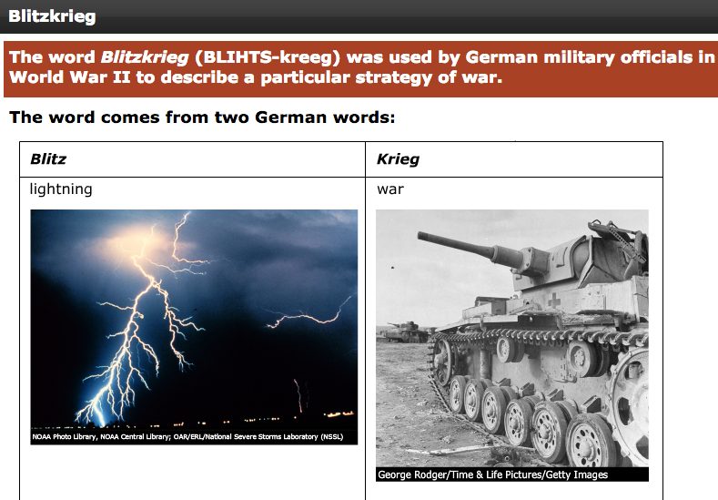
Notes:
Question: Judging by the words blitz and Krieg, what do you think a blitzkrieg might be?
Answer: blitzkrieg literally means "lightning war." It refers to a war fought very quickly, like a flash of lightning, probably with lots of resources being used at once to bring about a sudden victory.

Slide 4
Europe at War
Days after Hitler and Stalin agreed to the Nazi-Soviet Nonaggression Pact, Germany attacks Poland.
German forces used a new tactic in their assault, known as blitzkrieg (“lightening war”), which emphasized speed and close coordination b/w planes in the air and fast-moving forces on the ground.
Poland fell to Germany after 4 weeks of the invasion.

Slide 5
Hitler’s Early Victories
Following Poland, Germany quickly captured Denmark and Norway, and geared up for the long-expected attack on France.
The German assault on France slammed first into the Netherlands and Belgium, countries that lay b/w Germany and France. Then, Germany moved into France, taking the country in little over a month.

Slide 6
Hitler’s Early Victories
From the invasion of Poland on September 1, 1939, to the surrender of France on June 22, 1940, Germany took over all of central and western Europe, but Britain was still in the fight.
Germany was soon to send (October 1940) thousands of war planes to Britain.

Slide 7
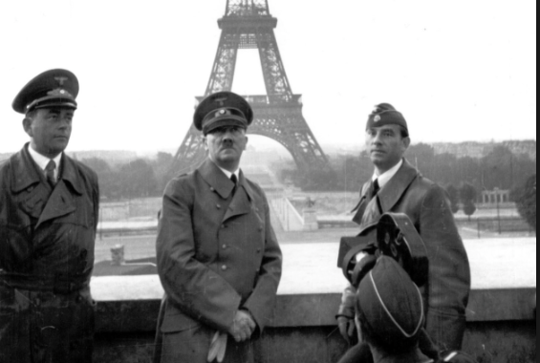
Hitler in Paris
Notes:
What country is this in?

Slide 8
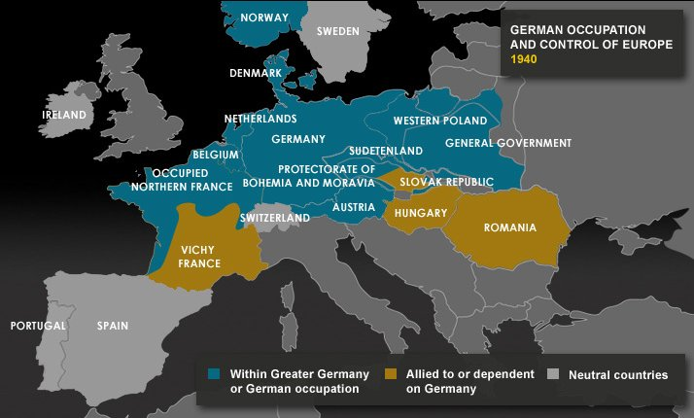

Slide 9
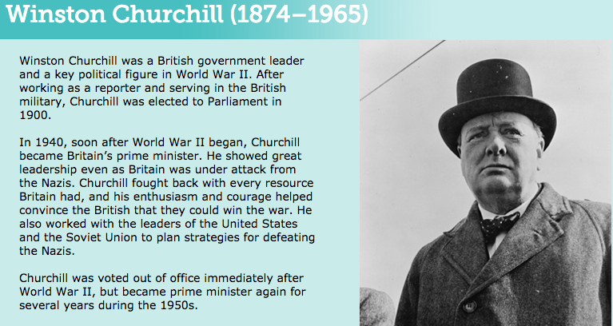
Notes:
How did Churchill’s willingness to fight with every resource Britain had differ from the foreign policy of his predecessor, Neville Chamberlain? (Chamberlain was an appeaser; he did not want to fight).

Slide 10
Churchill Speech
To what struggle is Churchill referring to in this speech?
Does Churchill believe that surrender is an option for Britain?
Churchill Speech
Mini Bio
Notes:
The fight against Germany
No

Slide 11
Battle of Britain
After the fall of France to the Nazis, Britain stood alone to what appeared to be an unstoppable German war machine.
Hitler realized that a land-sea invasion of Britain could only be possible if Germany controlled the air. Therefore, b/w Aug. – Oct. 1940, he sent thousands of planes over the English Channel to bomb the country.

Slide 12
Battle of Britain
However, the British military acquired a new technology, radar, and was now able to defend its skies much more effectively.
Eventually, the Nazis suffered heavy loses, and coupled with Britain’s refusal to give up, Hitler postponed the invasion of Britain indefinitely in early 1941.
For the first time in the war, the Germans failed to defeat a nation; Britain won the Battle of Britain.

Slide 13
DBQ
“The gratitude of every home in our Island, in our Empire, and indeed throughout the world, except in the abodes of the guilty, goes out to the British airmen who, undaunted by odds, unwearied in their constant challenge and mortal danger, are turning the tide of the World War by their prowess and their devotion. Never in the field of human conflict was so much owed by so many to so few.”
—Winston Churchill, August 20, 1940
Question: What does Churchill mean when he says, “Never in the field of human conflict was so much owed by so many to so few”?
Notes:
Vastly outnumbered—2600 German aircraft versus 640 British aircraft— Great Britain’s Royal Air Force proved the superiority of its planes and pilots’ skills. Frustrated, the Germans switched the attacks to civilian targets, especially the city of London. The Royal Air Force stubbornly defended their land by repeatedly destroying German aircraft. By the end of September 1940, the Germans broke off the attacks. The British had won the Battle of Britain and turned the tide of the war.

Slide 14
Attack on the Soviet Union
In June 1941, Hitler turns his sights on to the USSR, and sends 3 million troops into the country, breaking his pact w/ Stalin.
Hitler believed the Russians could be defeated before winter. German troops advanced quickly through the nation, capturing 2 million Russian soldiers.

Slide 15
Attack on the Soviet Union
However, an early winter halted Germany’s advance. Germany did not prepare for the Soviet winter (they lacked adequate clothing). For the first time, in the Soviet Union, German armies had been stopped.
Once the winter set in, the Soviets were able to regroup and counterattack the German troops.

Slide 16
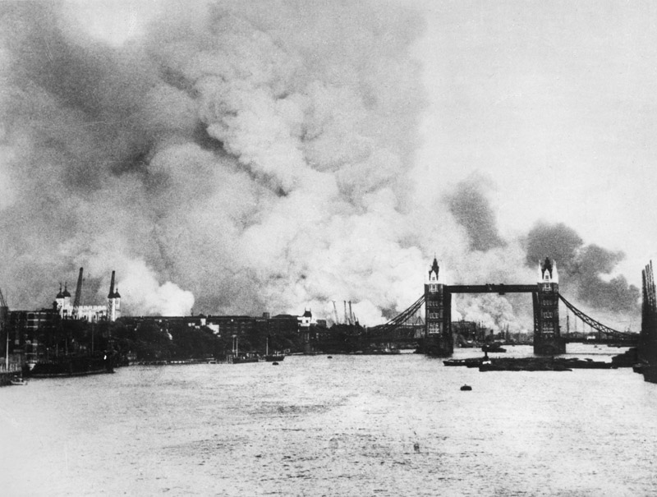
Notes:
Battle of Britain; London; Germany bombing civilian targets to inflict fear and terror.

Slide 17
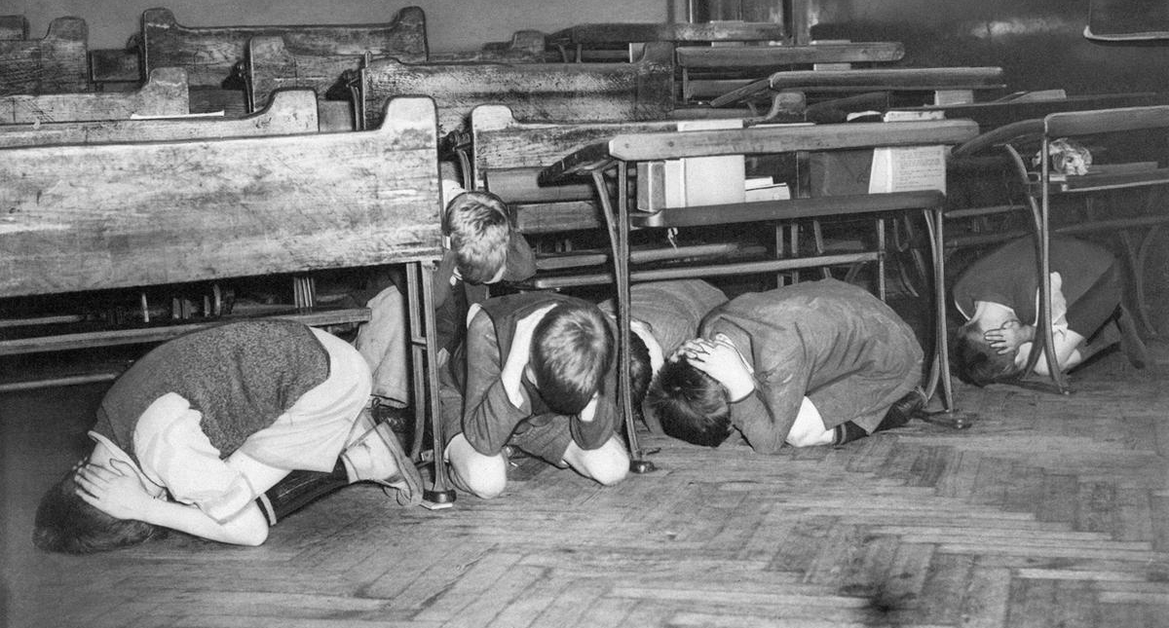
Battle of Britain

Slide 18
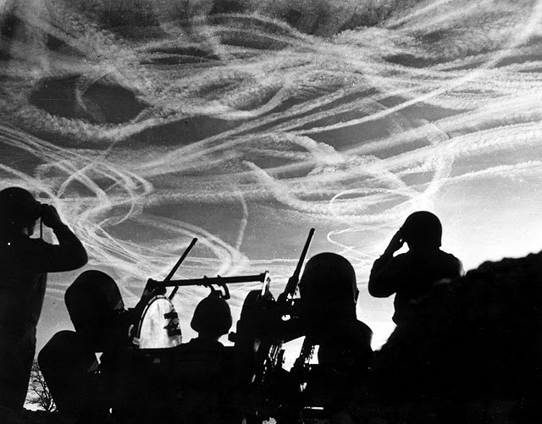
Notes:
Contrail webs after a dog fight

Slide 19
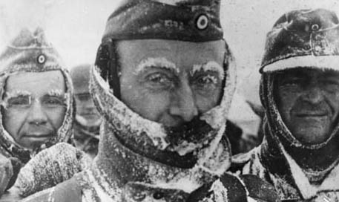
German Soldiers

