Slide 1
World War II Ends
Chapter 17
Lesson 5
(Day 1)

Slide 2
Video
Notes:
Saving Private Ryan - Omaha Beach Scene

Slide 3
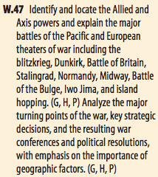
Objective/Standard
Students will be able to
Describe how WWII ended in Europe and the Pacific; and
Understand what led to the Cold War.

Slide 4
Soviet Victories
Recall that the Soviets defeated Germany at Stalingrad in 1943.
In 1944, the Soviets ended the Siege of Leningrad, leading to 800,000 German casualties and starting the drive of Axis forces from the Soviet Union.
The Soviets were now advancing westward towards the German capital of Berlin.

Slide 5
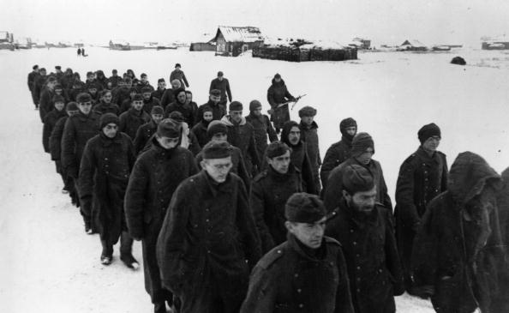
After Stalingrad, the Red Army drove Hitler’s forces out of the Soviet Union.
By early 1944, Soviet troops were advancing into Eastern Europe toward Germany.
German prisoners marched to Stalingrad after their defeat by the Soviet army.

Slide 7
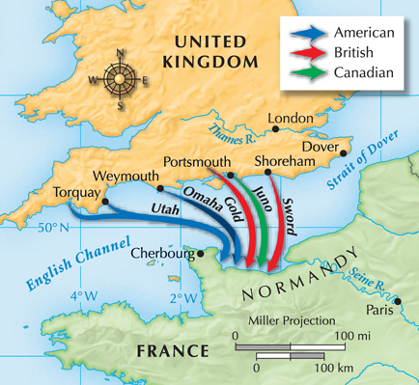
By 1944, the Allies were ready to invade France.
On June 6, 1944, ships ferried 156,000 Allied troops across the English Channel to the beaches of Normandy.

Slide 8
Background
The Normandy invasion had long been planned, since the Soviets were continually pressuring its allies to open a front in western Europe to force Hitler to fight two wars.
The Germans had built heavy fortifications on the French coast, expecting an assault staged from England. The Allies tricked the Nazis into believing another army was invading France at a different location.
Bad weather threatened the invasion and pushed troops past their designated landing beaches, particularly at Omaha. The beaches were littered with 4 million land mines, anti-tank barriers, and numerous gun positions. An armada of 3,000 landing craft, 3,000 support ships, and 13,000 airplanes made up the invasion force. More than 2,000 soldiers died at Omaha Beach.

Slide 9
*D-DAY*
**June 6, 1944 – D-Day – Allied forces, under U.S. general Dwight D. Eisenhower, went across the English Channel and invaded the beaches of Normand, France.**
Over 150,000 troops landed that day in history’s greatest naval invasion.

Slide 10
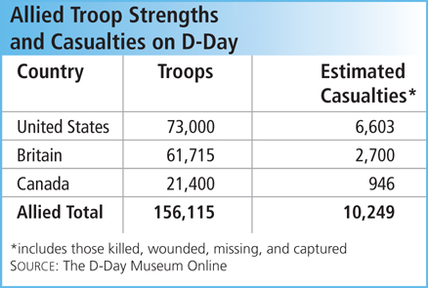
Despite heavy German defenses on the beach and heavy losses, the D-Day landing was a success.
Allied troops broke through the German lines and advanced toward Paris.
Within a month, all of France was liberated.

Slide 11
Invasion of Omaha Beach

Slide 13
*Battle of the Bulge*
Hitler was not yet finished. In December, 1944, he ordered one last, massive counterattack in Belgium.
At first, the Germans made solid advances, but by January 1945, the Allies had crushed the offensive.
*Germany’s defeat marked the end of major German resistance.*
The Allies began racing East toward Berlin.

Slide 14
Liberating the Concentration Camps
• As Allied forces drove the Nazi army out of occupied countries in 1944 and 1945, they liberated concentration camps and death camps.
• Camps liberated by Soviet troops included the Auschwitz and Majdanek death camps.
• Camps liberated by U.S. and British forces included Buchenwald and Bergen-Belsen.
• The soldiers who liberated the camps provided eyewitness accounts of the details of the Holocaust.
• Millions of Jews had died in the camps before the camps were liberated.

Slide 15
The Germans Surrender
The Soviets were the first to reach Berlin. On May 2, 1945, the found Hitler’s body in a bunker; he had taken his own life.
With Hitler dead and Berlin in Allied hands, Germany surrendered on May 7, 1945. The war in Europe had ended.
V-E Day is known as Victory in Europe Day

Slide 16
Notes:
• In what country did the Allied troops assemble and prepare for the invasion of France? (United Kingdom)
• What geographical barrier did the Allies have to cross to reach France? (English Channel)
• Where did the D-Day battle take place? (Normandy, France)
• What was the outcome of the battle of Normandy? (victory for the Allies, Allies quickly conquered most of France)
What city was the goal of allied advances in 1945? (Berlin)

Slide 17
Question 1
Notes:
B

Slide 18
Question 2
Notes:
B

Slide 19
Question 3
Notes:
A

Slide 20
DBQ
“Above all I charge the leaders of the nation and those under them to scrupulous observance of the laws of race and to merciless opposition to the universal poisoner of all peoples, international Jewry.”
- Hitler’s Final Will, April 29, 1945
Question: Who is Hitler blaming for WWII?
Notes:
Jews

