Slide 1
World War II Ends
Chapter 17
Lesson 5
Day 2

Slide 2
Starter

Slide 3
Answer

Slide 4
Objective / Standard
Students will be able to
Describe how WWII ended in Europe and the Pacific; and
Understand what led to the Cold War.
W.51 – Analyze the decision to use nuclear weapons to end WWII.
Video: Battle of Okinawa

Slide 5
Quick Summary - How did the Allies finally defeat the Axis powers?
By 1945, the war in Europe was nearing its end. Germany was being attacked from east and west, and Axis armies were surrendering.
In the Pacific, a series of bloody battles continued on the islands as Allied military leaders planned a land invasion of Japan. World War II finally ended when the United States dropped atomic bombs on two Japanese cities.

Slide 6
In the spring of 1945, the Nazis were surrounded and defeated.
From the west the Allies surged into Germany, and from the east Soviet troops closed in on Berlin.
In Italy, guerrillas captured and executed Mussolini. Hitler committed suicide.
The Allies proclaimed May 8, 1945, V-E Day – Victory in Europe Day.

Slide 7
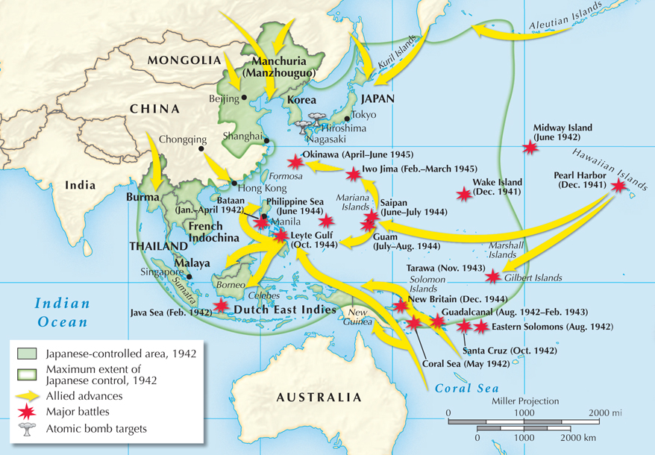
The Allied advance toward Japan

Slide 8
The Pacific
America needed military bases for their air war against Japan. B/c the Japanese refused to surrender, the U.S. planned an invasion of Japan.
In 1945, the Allies continued their island hoping campaign, acquiring Iwo Jima and Okinawa in brutal battles, costing 19,000 American lives and over 120,000 Japanese lives.
After Okinawa, the next step was to take Japan itself.

Slide 9
The Pacific
The Japanese were relentless in their fighting, mostly all fighting to the death.
The allies dreaded the idea of invading the Japanese mainland after their experiences at Iwo Jima and Okinawa.
With this, America concluded that an invasion of Japan would be too costly (estimated that over 1 million Allied soldier deaths or wounded).

Slide 10
The Pacific
American leaders considered another option: the atomic bomb.
In July 1945, the Manhattan Project successfully tested the first atomic bomb in New Mexico.
Harry Truman, who had become president after the death of Roosevelt, realized that it was a terrible new force for destruction, but decided to use it.
Question: Should he use the bomb on Japan?

Slide 11
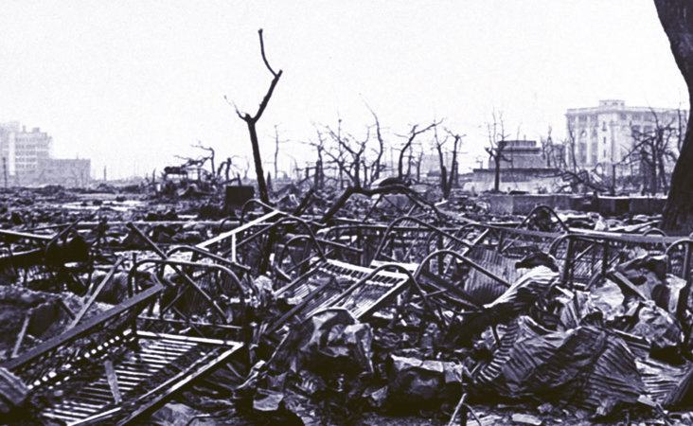
Allied leaders warned Japan to surrender or face destruction. Japan ignored the warning.
On August 6, 1945, U.S. planes dropped the first atomic bomb on Hiroshima, instantly killing more than 70,000 people.
The Japanese still did not surrender.

Slide 12
August 8: The Soviet Union invaded Manchuria. The Japanese did not respond.
August 9: The United States dropped a second atomic bomb on Nagasaki. This time, more than 40,000 people were killed.
August 10: Emperor Hirohito intervened and forced the government to surrender.
September 2, 1945: A formal peace treaty was signed.

Slide 13
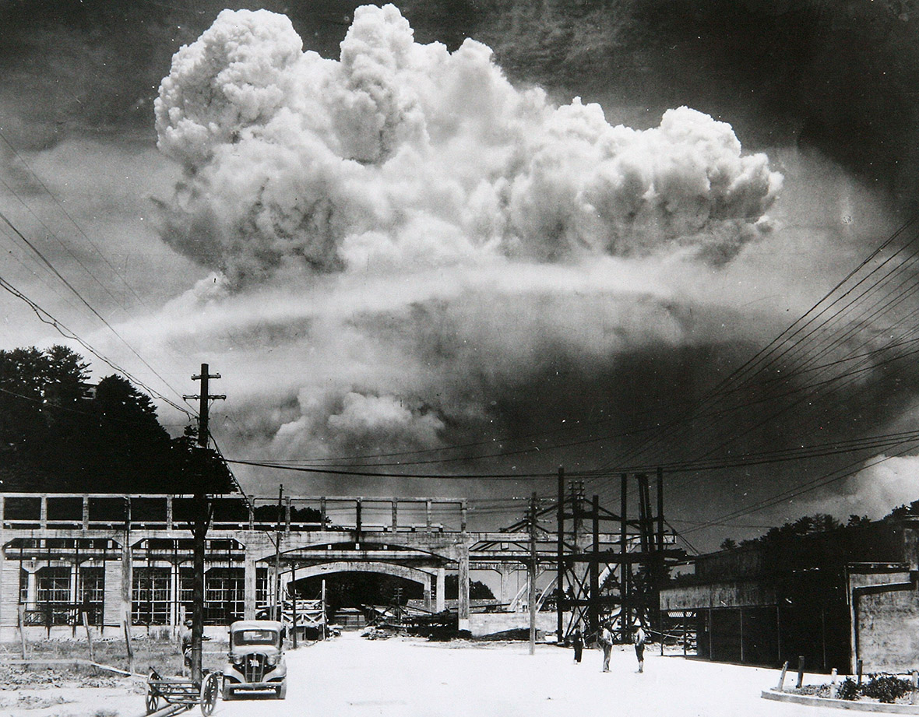
Notes:
Mushroom cloud rises over Nagasaki

Slide 14
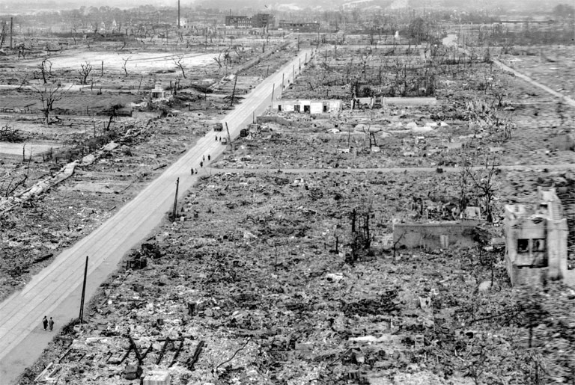

Slide 15
Notes:
A

Slide 17
DBQ
1. How is the Japanese soldier depicted in this poster?
2.) What effect do you think this poster had on its intended audience in the United States?

Slide 18
DBQ
Question: To what killing was Tibbets referring when he said, “We were determined to stop the killing”? What is ironic about his statement?
Did Tibbets’s description of the destruction to Hiroshima reflect what
The previous photograph shows? Explain.
Notes:
Tibbet is the pilot of the plane that dropped the bomb on Hiroshima
Answer: 1) He was referring to the fact that the United States had already sustained heavy casualties resulting from the battles of Iwo Jima and Okinawa and to the likelihood that if they were forced to continue waging a conventional war by invading Japan there would be more casualties.
2) Yes. The city has been flattened; the landscape appears scorched. The remains of a few buildings can be seen on the fringe near the mountains. Other than what appear to be some military personnel walking near a tank, there is no sign of humanity, that is, ordinary people going about their business.

Slide 19
DBQ
“Floating there were scores of dead bodies, faces swollen to twice their normal size and trouser-encased legs stiff as logs. . . . The sight chilled us to the bone . . . It began to rain. Black stains spotted shirts. The multicolored smoke generated at the time of the blast had become a cloud of dirty brown and black hanging like a pall over the city. It was a demonic ceiling, a malediction.”
—Shibayama Hiroshi, 1945, as quoted in The Atomic Bomb: Voices from Hiroshima and Nagasaki
Question: How did the bombings affect Japanese civilians?
Notes:
Shibayama Hiroshi, a survivor of the bombing, describes what he saw when he crossed the Kyobashi River hours after the bomb was dropped.
Answer: Tens of thousands died, and more than half of Hiroshima was obliterated. Nagasaki also had to cope with damaged or destroyed buildings. The effects of radiation were felt for decades after the bombings.

Slide 20
Exit Ticket
Determining Cause and Effect
Question: What impact did the bombing of Hiroshima and Nagasaki have on the course of the war?
Notes:
It forced Japan to surrender, bringing a quicker end to the war.

