Slide 1
World War II Ends
Chapter 17
Lesson 5
Day 3

Slide 2
Starter
Cold War: the period of political tension following WWII and ending with the fall of Communism in the Soviet Union at the end of the 1980s.

Slide 3
Objective / Standard
Students will be able to
Describe how WWII ended in Europe and the Pacific; and
Understand what led to the Cold War.
W.53 - Evaluate the goals, leadership, and postwar plans of the principal allied leaders: the Atlantic Conference; Yalta Conference; and the Postdam Conference.

Slide 4
Truman Worksheet
Holt – Truman Worksheet

Slide 5
Truman Worksheet
Harry S Truman Activity Answers:
1. Roosevelt had died suddenly, and Truman had met with him only twice without discussing ending the war or plans for peace.
2. Students’ responses will vary; possible responses: yes; while the human cost of using the atomic bomb was high, it ended the war quickly and prevented even greater casualties, especially on the American side, which would have resulted from an invasion and possibly prolonged war on land and sea; no; killing innocent civilians and causing toxic damage to two major Japanese cities was not justified

Slide 6
Notes:
Who suffered the most military deaths on the Allied side? (Soviet Union)
Who suffered the most military deaths on the Axis side? (Germany)
Who suffered the least military deaths on the Allied side? (U.S.) Why do you think that is? They got into the war later than others.

Slide 7
Notes:
Why do you think Allied civilians suffered the most deaths? Because Germany was invading and fighting and in Allied territory. Bombing of cities.

Slide 8
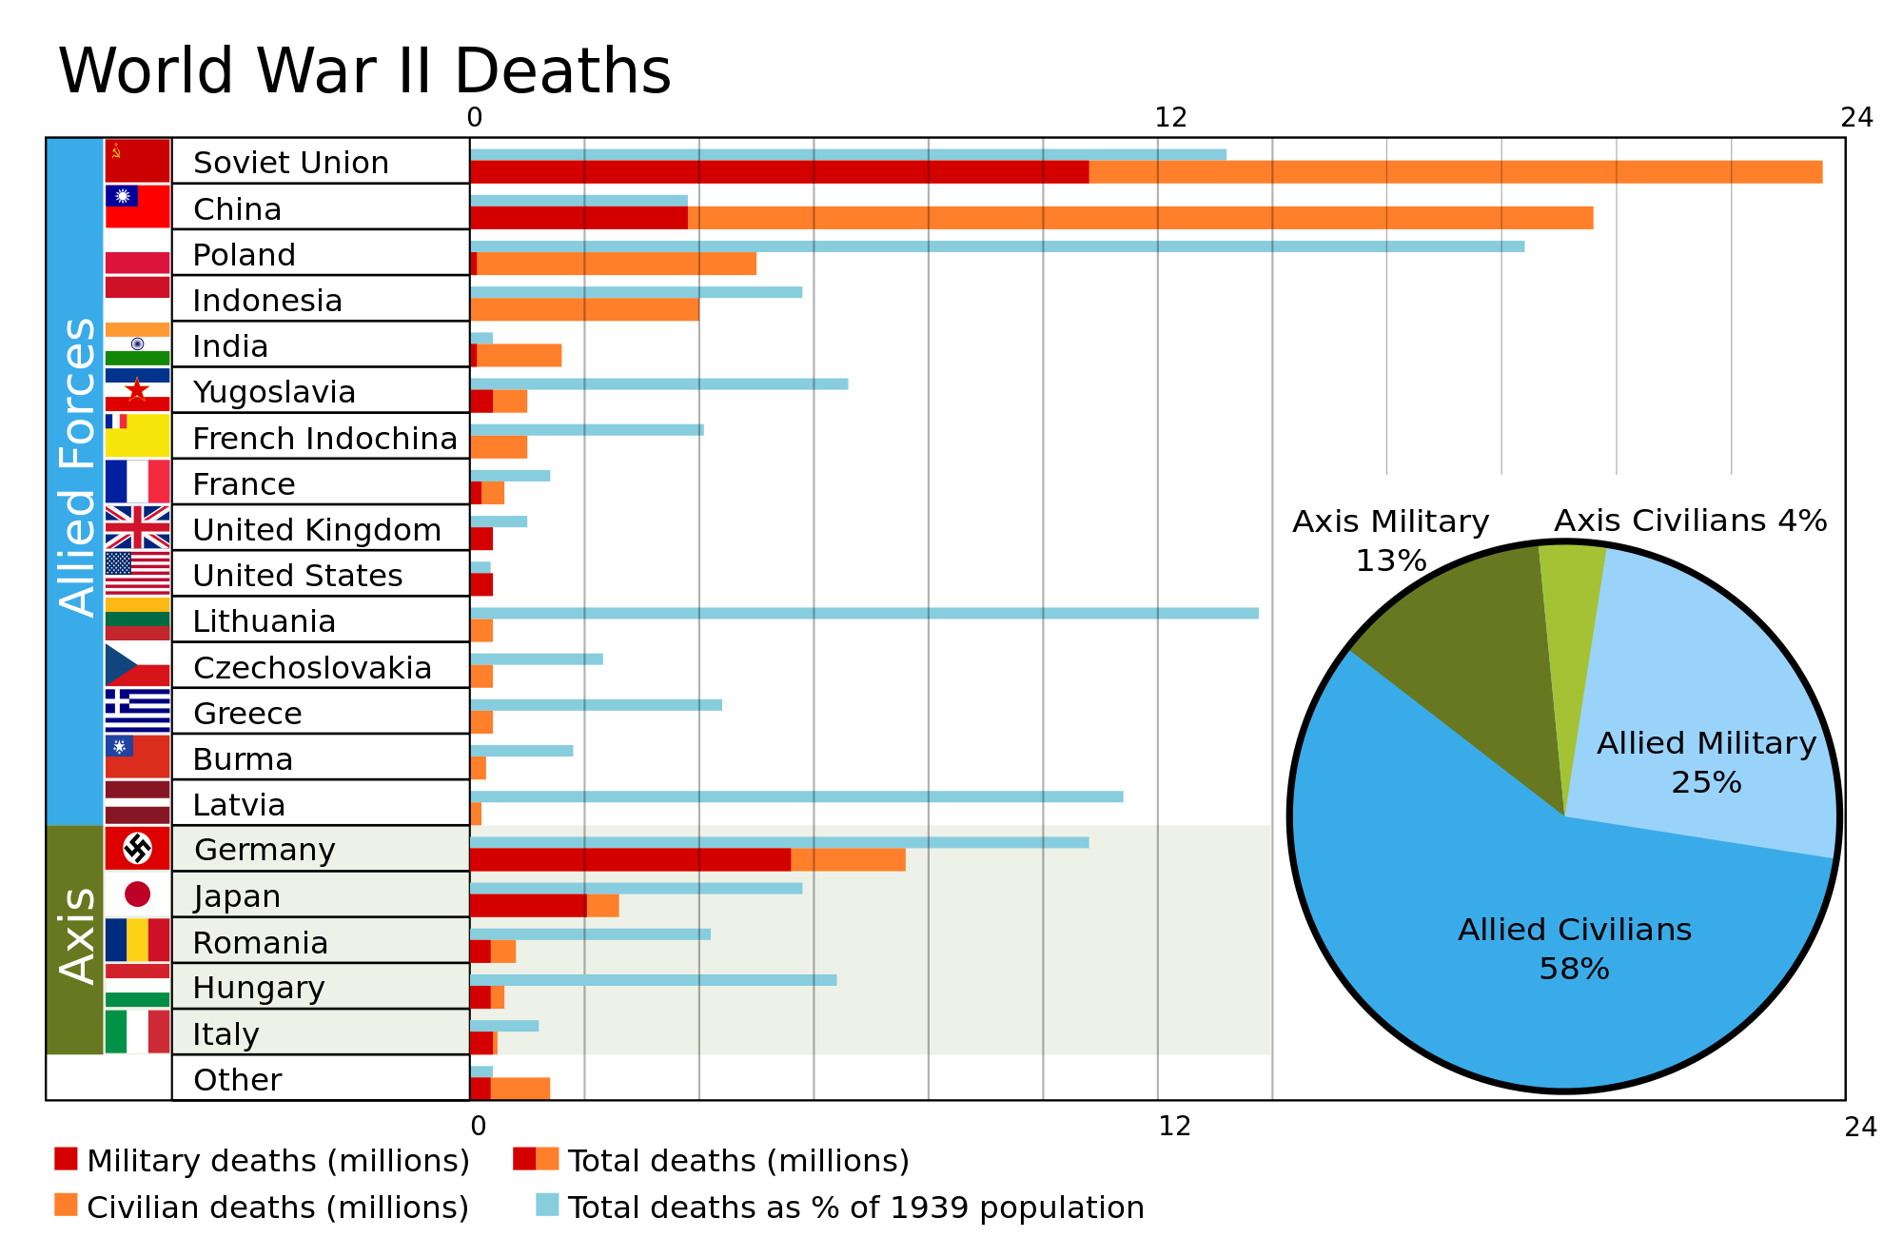

Slide 9
Planning for the War’s End
*In 1941, U.S. and Great Britain met and issued the Atlantic Charter, outlining the purpose of the war and stating that they sought no territorial gains.
In 1943, Roosevelt, Churchill, and Stalin met in Tehran, Iran to agree on a schedule for D-Day as well as agreeing to work together in the peace after the war.

Slide 10
Planning for the War’s End
In early 1945, when the Allies were on the brink of victory, the Big Three met at the Yalta Conference for the primary purpose of deciding what to do with postwar Europe.
Here, Stalin agreed to join the fight against Japan as well as join the U.N.; it was also decided that Germany would be divided up.

Slide 11
Big Three at Yalta

Slide 12
Potsdam Conference
Amid growing ill will and suspicion b/w the Soviet Union and the other Allies, in July 1945, the Allies met again in Germany at the Potsdam Conference to decide what to do with Eastern Europe.
At the Conference, Truman demanded free elections in Eastern Europe. Stalin believed that free elections would threaten the security of the Soviet Union; he wanted control over Eastern Europe to use as a buffer zone b/w the West and the Soviet Union.

Slide 13
Cold War
Following the Allied victory, Stalin’s major goal was to establish a buffer zone of Soviet-friendly countries in Eastern Europe.
FDR wanted E. European countries to create democratic institutions of their choice.
Both sides quickly became suspicious of the other’s motives. Western countries feared an international Communist conspiracy. Soviet Union feared global domination by capitalist countries.

Slide 14
WWII Statistics
17 million soldiers on both sides were killed in battle, as were 20 million civilians, many of whom were children.
In the Russian city of Leningrad, 1.5 million people died when Germans besieged the city for 900 days. In the United States, 110,000 Japanese on the West Coast were sent to internment camps.
In Britain, 6 million children were moved due to the German bombing of London, and some never saw their parents again.
Half a million German civilians died when the Allies bombed German cities.
German children as young as 14 or 15 fought in the last years of World War II.
The Nazis murdered six million Jews and caused the deaths of nine to ten million non-Jews; three to four million Poles, Ukrainians, and Belorussians died as slave laborers.
Three to four million Soviet prisoners of war were killed.
In Vietnam, one million people starved due to the Japanese confiscating rice grown by native people.
The U.S. destroyed the JP cities of Hiroshima and Nagasaki with atomic bombs, which resulted in the immediate deaths of thousands, and thousands more died later from radiation.

Slide 15
“A shadow has fallen upon the lands just lit by the Allied victory. Nobody knows what Soviet Russia and its Communist international organization intends to do in the immediate future, or what are the limits, if any, to their desire to expand.
We do understand the Russian need to be secure on her western frontiers by the removal of all possibility of German aggression. But…An iron curtain has descended across Europe. Behind the line of that iron curtain lie all the capitals of the ancient states of Central and Eastern Europe. All these famous cities and the populations around them lie in what I must call the Soviet sphere, and all are subject in some form to Soviet influence and a very high degree of Soviet control…
Except in Britain and the United States, Communist parties are a growing challenge and danger to Christian civilization.
I do not believe that Soviet Russia desires war. What they desire are the fruits of war and the expansion of their power and ideas. But what we have to consider is the permanent prevention of war and the establishment of conditions of freedom and democracy as quickly as possible in all countries.”
- Winston Churchill, 1946
Questions:
What does Churchill Say has descended across Europe?
What two things does Churchill argue must be established in all countries?
Notes:
Exit Ticket DBQ Answers
Iron curtain;
“permanent prevention of war and the establishment of conditions of freedom and democracy as quickly as possible in all countries”

