Slide 1
The Cold War Begins
Chapter 18
Lesson 1
Day 1

Slide 2
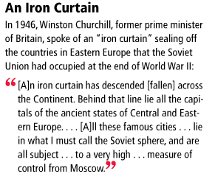
Starter
According to Churchill, who controls the states of Central and Eastern Europe?
Notes:
Answer: The Soviet Union
Question: what metaphor does he use to describe the separation across the continent of Europe? (iron curtain)
Question: from the passage, what country can you infer dropped the iron curtain, sealing off Eastern Europe? (Soviet Union)

Slide 3
Objectives/Standards
Students will be able to understand how the struggle following WWII led to the Cold War.
W.58 – Compare the economic and military power shifts caused by the war.
W.60 – Trace Soviet aggression in Eastern Europe.

Slide 4
Quiz
The struggle b/w the U.S. and the Soviet Union was a struggle b/w two different economic systems, forms of government, and lifestyles. This was known as what?
The U.S. pledge to provide military and economic aid to prevent the spread of communism was known as what?
How many temporary zones was Germany divided into after WWII?
Notes:
The cold war; Truman Doctrine; 4

Slide 5
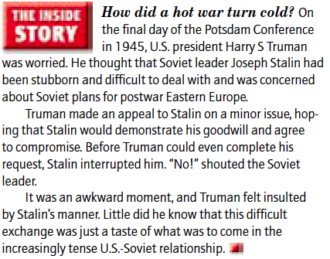
Intro

Slide 6
Main Idea
Once partners in war, the Soviet Union and the other former Allies found it much more difficult to cooperate in peace. The result was an era of conflict and confrontation called the Cold War.
Video
Notes:
Video Question to think about:
What were the main causes of the Cold War (the U.S. and the Soviets did not trust each other. As a result, both nations feared for their security at the end of WWII).

Slide 7
Balance of Power After WWII
After the Axis had been defeated, the differences b/w the U.S. and the Soviet Union began to come out.
**Soviet Union feared the capitalist West; U.S./Western leaders feared communism.**
So, the Soviet Union was not prepared to give up control of Eastern Europe after the WWII.

Slide 8
Eastern Europe
Remember, the Soviet Union was invaded by Germany during both world wars, causing mass casualties and destruction.
The Soviet leaders believed they needed a buffer zone of friendly governments in Eastern Europe to guard against another attack. In other words, they believed that controlling Eastern Europe would prevent invasions and keep them secure.

Slide 9
Eastern Europe
However, the U.S. and GB wanted the liberated countries of Eastern Europe to freely determine their own governments, and not be Stalin’s puppets.
Stalin feared that these countries would by anti-Soviet if they were permitted to have free elections, so he opposed the West’s plan.
Thus, tensions b/w the West and the Soviet increased, leading both Truman and Stalin to believe war was imminent.

Slide 10
Worksheet
Pearson – Comparing Competing Economic Systems Worksheet

Slide 11
Answers
the Council of Ministers of the USSR and the Soviet State Planning Commission;
consumers; and
Possible answers: Arakelian would say a capitalist economy has no leadership or uniform plan and is based on the whims of consumers; von Mises would say the consumer has no say or power in the socialist economy. In the Soviet system, a strength is that the state can shape the economy in the way it wants; in the U.S. system, a strength is that consumers can buy whatever they want because they direct businesses to produce what they want.
Notes:
If being evaluated: have them trade answers with the person next to them to compare and see if they agree/disagree with the responses.

Slide 12
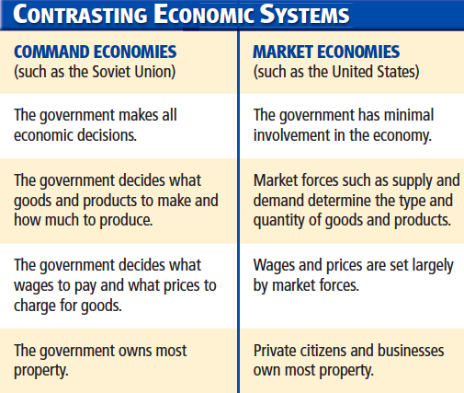
Communism v. Capitalism
Notes:
Know the first two points.

Slide 13
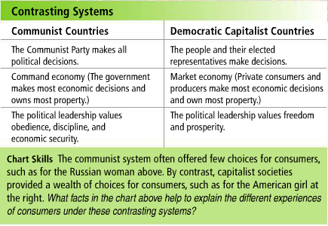
Communism v. Capitalism

Slide 14
The Struggle Begins
The Cold War was more than a military rivalry. It was a struggle for power and control b/w two nations w/ very different forms of government, economic systems, and ways of life.
In short, the Cold War was a conflict b/w communism and capitalist democracy.

Slide 15
Exit Ticket
After WWII, what did the Soviets fear; what did the U.S. fear?
This era is known as the Cold War. How do you think both the U.S. and Soviet Union will fight the Cold War?

