Slide 1
The Cold War Begins
Chapter 18
Lesson 1
Day 3

Slide 2
Starter
Questions:
In 1947, President Truman announced that the United States would provide economic and military aid to oppose the spread of communism. This pledge was known as the _________.
The _________ provided $13 billion for rebuilding Europe after World War II.
The West’s policy of ________ involved resisting Soviet aggression in order to contain the spread of communism.
In June 1948, Western leaders organized the _______ to provide supplies to West Berlin, which was cut off by the Soviets.
Notes:
1) Truman Doctrine; 2) Marshall Plan; 3) containment; 4) Berlin Airlift

Slide 3
Objectives / Standards
Students will be able to
Describe the new military alliances that were formed during the the Cold War; and
Understand the arms race.
W.57 - Summarize the functions of the Warsaw Pact and NATO
W.65 – Explain the impact of the defense buildups.

Slide 4
Opposing Military Alliances
After the Berlin airlift in 1949, the U.S., Canada, and most Western European countries joined together in a military alliance known as NATO (North Atlantic Treaty Organization) for the purpose of countering Soviet power in Europe.
In 1955, the Soviet Union and the Communist nations of Eastern Europe formed their own military alliance, known as the Warsaw Pact.
Europe is now divided into hostile alliances, just as it had been before WWI.

Slide 5
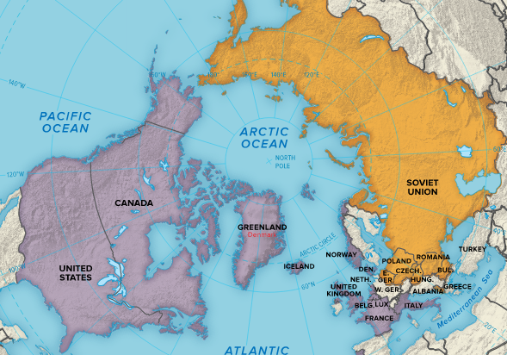

Slide 6
The Arms Race Begins
In 1949, the West was shaken by news that the Soviets successfully tested an atomic bomb.
Immediately, the U.S. sought to develop even more powerful and farther-reaching weapons.
By the mid 1950s, an arms race, building up armies and stores of weapons to keep up with an enemy, had begun b/w the U.S. and Soviet Union.

Slide 7
Arms Race
Both countries had developed the much deadlier fusion-powered hydrogen bomb. And by the late 1950s, both had intercontinental ballistic missiles, which made them capable of sending bombs anywhere on Earth.

Slide 8
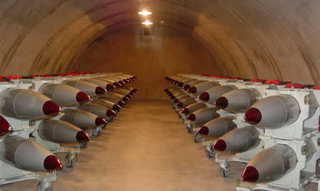
Nuclear Stockpiles

Slide 9
Deterrence
Increased stockpiles of nuclear weapons by the Soviet Union and U.S., led to the defense strategy of deterrence. This policy held that huge arsenals of nuclear weapons on both side prevented war.
The belief was that neither side would launch a nuclear attack, because both knew that the other side would be able to strike back with devastating power.
MAD – Mutual Assured Destruction

Slide 10
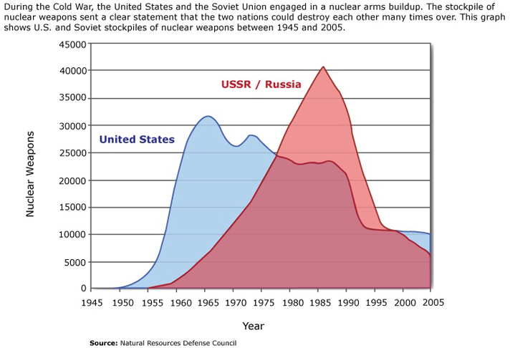
Notes:
Which nation appeared to be winning the arms race? (the U.S.)
Which nation had more nuclear weapons in a single year? (USSR)
What do you think happened in the late 80s earl 90s? (Both nations cut the number of weapons; end of the Cold War)

Slide 11
*Sputnik I*
In 1957, the Soviets successfully launched in orbit the first artificial satellite.
Americans feared that the Soviets now had a technological advantage.
U.S. responds by establishing NASA IN 1958.

Slide 12
Berlin Wall
Nikita Khrushchev, the Soviet leader succeeding Stalin, aimed to halt the flow of refugees from East Germany into West Germany.
He built the Berlin Wall separating West Berlin from East Berlin, symbolizing the division b/w the two superpowers.

Slide 13
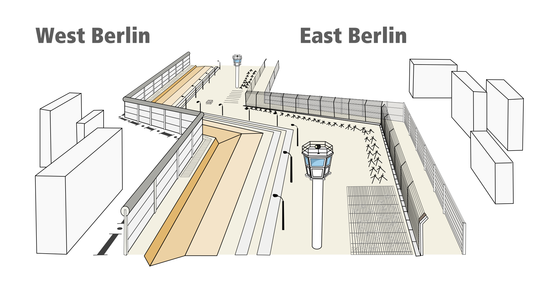
Berlin Wall

Slide 14
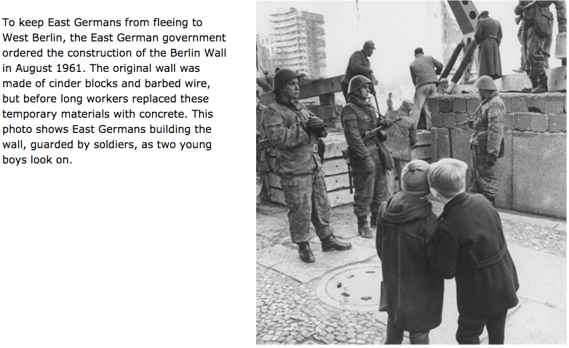
Berlin Wall

Slide 15
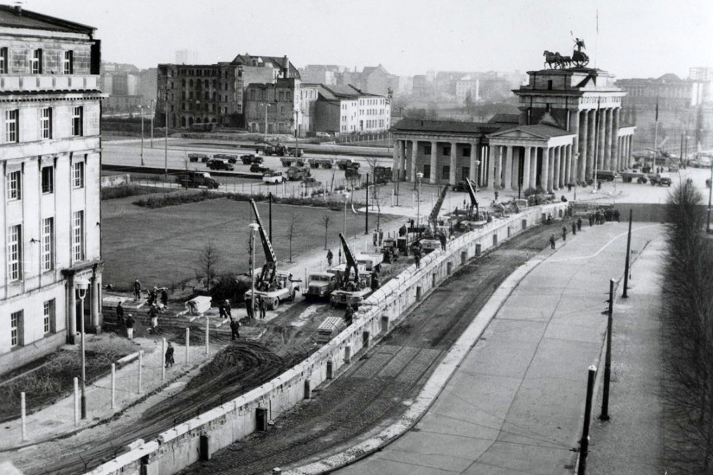

Slide 16
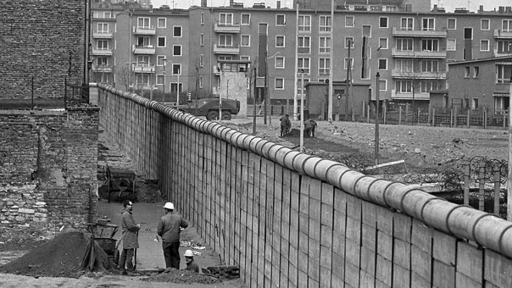

Slide 17
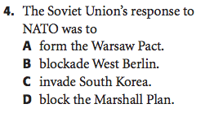
Exit Ticket
Notes:
A

Slide 18
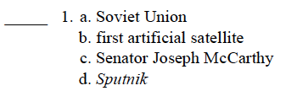
Exit Ticket
Write the letter belonging to the phrase that does not belong with the others.
Notes:
C

Slide 19
