Slide 1
Cold War China
Chapter 18
Lesson 2

Slide 2
Starter
Which government do you think the U.S. supported? Why?
Notes:
A civil war would occur b/c the two governments would have a hard time sharing powers.
The Nationalist government because it was not communist.

Slide 3
Objective/Standard
Students will be able to
Identify how Communism came to rule Chin; and
Understand China’s relationship with both the U.S. and Soviet Union during the Cold War.
W.59 – Analyze the Chinese Civil War, the rise of Mao Zedong, and the triumph of the Communist Revolution in China.

Slide 4
Civil War in China
After the end of WWII, the Chinese Nationalists and Communists (led by Mao Zedong) failed to form a coalition government. Thus, a civil war broke out.
The Communists gained strength as peasants (whom were promised land) and the urban middle class joined their side. After Mao's forces occupied Beijing and Shanghai, the Nationalists fled to the island of Taiwan, where they continue to occupy to this day. The Chinese Communists had won the civil war.
On October 1, 1949, Mao Zedong announced the formation of the communist People’s Republic of China.

Slide 5
Biography
Notes:
Why do you think it important that Mao focused on the revolutionary potential among the peasants in rural China rather than the factory workers in the cities? (Most Chinese lived in rural areas, giving Mao access to more converts there. His message appealed to peasants, who were dissatisfied with previous rulers and Nationalists.
Mao Zedong was raised on his family’s farm in Hunan. How might his background have affected his later political philosophies? (Sample answer: Mao’s political philosophy focused on revolutionary potential among peasants in rural China. As Mao grew up in a rural village, he was probably more aware of the issues facing rural China than the issues facing those living in cities.)

Slide 6
Notes:
China since 1945

Slide 7
Mao’s leadership led to major changes in China.
China became a one-party totalitarian state.
Mao led a program known as the Great Leap Forward, which was designed to increase China’s industrial and agricultural output. People were organized into communes and urged to increase industrial and agricultural productivity. This failed miserably, leading to millions of people dying of starvation.
In 1966, Mao launched the Cultural Revolution, which sought to rid China of its old ways and create a society in which peasants and physical labor were the ideal. This meant intellectuals, educators, artists, and skilled workers were eliminated for fear that they would bring back the “old ways.”

Slide 8
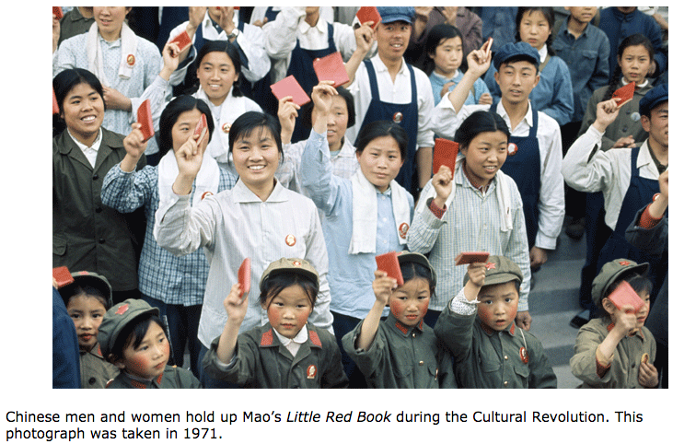
Notes:
Mao's ideas were circulated in what came to be called his Little Red Book. Nearly all Chinese people carried the book.

Slide 9
Cultural Revolution
Mao shut down China’s schools and encouraged militant high school and college students known as Red Guards to carry out the work of the Cultural Revolution by criticizing intellectuals and traditional values (“old ways”).
Red Guards traveled throughout China looking for possible offenders, destroying property, and torturing/killings hundred of thousands of peoples.
Mao would eventually disband the Red Guards.

Slide 11
Notes:
1) He is depicted as large, watchful, content; 2) to further Mao’s ideas

Slide 12
Notes:
a) Speaking and acting incorrectly, which is considered a crime against the people; b) they assumed the words were an admission of guilt

Slide 13
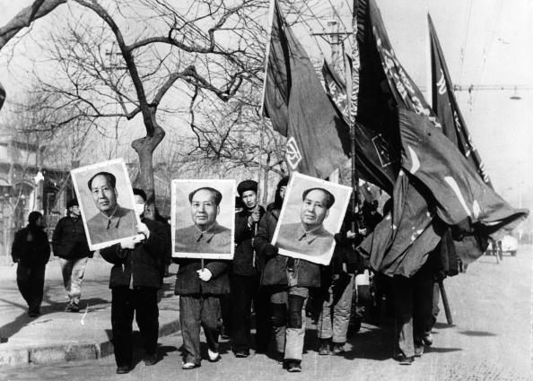
Mao Zedong was a ruthless ruler.
He did not hesitate to have his critics killed or sent away to do manual labor.
His failed Great Leap Forward led to the deaths of as many as 55 million people from starvation between 1959 and 1961.
Members of Mao’s Red Guard carry his picture in a parade during the Cultural Revolution.

Slide 14
Mao’s Death
As a result of the excesses of the Cultural Revolution, Mao lost support in key groups, including many military officers and some members of the Communist Party.
After he died in 1976, leadership passed to Deng Xiaoping, who ended the Cultural Revolution and implemented reforms.

Slide 15
China’s conversion to communism seemed like a victory for the Soviet Union and a defeat for the West.
In fact, the two were uneasy allies. The Chinese wanted the Soviets to go on the offensive in spreading communism worldwide, which included attacking Taiwan. The Soviets refused, wanting to improve their relations with the West.
The Soviets withdrew all aid from China in 1960 due to border clashes and other disputes.
The United States saw some value in cooperating with China and set up formal diplomatic relations with the communist nation in 1979.

Slide 16
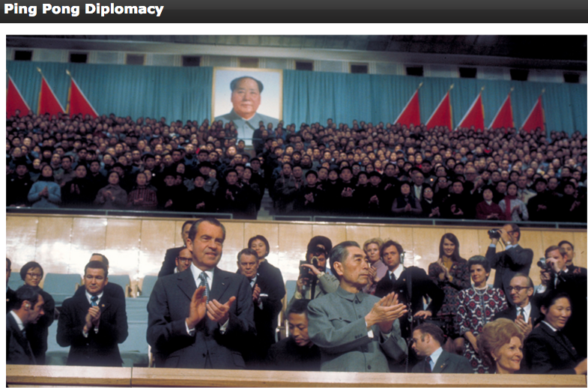
**President Nixon’s state visit to China in the 1970s improved relations b/w the U.S.
and China.**
Notes:
When disputes with the Soviet Union escalated to the point of minor military altercations, Chinese leaders decided to pursue better relations with the United States. This culminated in the establishment of diplomatic relations between the two countries in 1979.

Slide 17
Holt - Red Guard Worksheet

Slide 18
Exit Ticket
1) Which statement is False.
a. China’s Great Leap Forward was a successful plan to create thousands of communes that would each produce food and have a small-scale industry.
b. China’s Great Leap Forward was an unsuccessful plan to create thousands of communes that would each produce food and have a small-scale industry.
Notes:
1) B

Slide 19
Exit Ticket
2) True or False: Mao Zedong, the leader of the Communists in China’s civil war, was victorious in the civil war.
3) True or False: The Red Guards’ purpose was to force the Chinese people to obey the new ideas and eliminate the old ones.
4) Which event led to improved relations between the United States and China?
a. the end of the war in Vietnam
b. President Richard Nixon’s state visit to China
c. the election of Deng Xiaoping
d. the end of Communist Party rule in China
Notes:
2) True; 3) True; 4) B

