Slide 1
Cold War Conflicts
Chapter 18
Lesson 3
Day 1

Slide 2
Starter
Notes:
Students may say that a proxy war is a war in which one or both sides are acting as substitutes for another country or group.
In this lesson, students will learn how the US and the Soviet Union fought a series of proxy wars during the Cold War.

Slide 3
Objectives/Standards
Students will be able to identify the causes of the Korean War and Cuban Missile crisis.
W.62 – Describe the Soviet – U.S. competition in Asia with particular attention to the Korean War and Vietnam War.
W.64 – Analyze multiple perspectives on the U.S. and Soviet conflicts involving Latin America, including the Cuban Missile Crisis.

Slide 4
Background
As the Cold War b/w the world’s two superpowers – the U.S. and the Soviet Union – grew stronger, the rest of the world started to be divided into two armed camps dependent upon one or the other of these two major powers.
With their growing nuclear arsenals as well as tension, the U.S. and the Soviet Union literally held the survival of the world in their hands.

Slide 5
Proxy Wars
The U.S. and Soviet Union each wanted to make their political and economic systems dominant.
They engaged in proxy wars, each supporting the side with a matching political orientation. Proxy wars occur when two powers in conflict use substitutes instead of fighting each other directly.
Proxy wars were common during the Cold War as the U.S. and Soviet Union never wanted to fight one another on account of MAD. But, both nations were willing to support opposing sides in local wars.

Slide 6
The Korean War
After Japan surrendered, the Allies gained control of the Korean Peninsula.
The Soviet Union and U.S. agreed to temporarily divide the country in half at the 38th parallel, with hopes of later holding elections to reunify Korea.
The Soviets quickly established a communist government in the North; the U.S. supported the non-communist South.

Slide 7
The Korean War
In June 1950, the North Koreans invaded South Korea to unite the country under one communist government.
**Fearing Communist expansion (containment policy), the U.S. appealed to the UN for approval to repel the invaders.**
The UN soon sent a military force with troops from 17 nations to Korea. Most of the troops were from the U.S.

Slide 8
The Korean War

Slide 9
The Korean War
The UN force, led by American general Douglas MacArthur, pushed the NKs out of SK all the way near the Chinese border.
This alarmed communist China, who sent hundreds of thousands of troops to NK and pushed the UN force back across the 38th parallel.

Slide 10
Korean War

Slide 11
Korean War
After three years of fighting and some 4 million causalities, the Korean War war ended in a stalemate with the two sides reaffirming the division of Korea b/w North and South at the 38th parallel.
Today, little has changed since the war began: communist North; South an ally of the West; and the 38th parallel is the boundary b/w the two.

Slide 12
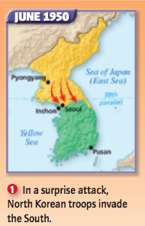
DBQ
At the start of the war, how would you describe the distribution of land between North and South Korea?
Notes:
Answer: About split evenly Where did the troops come from? North Korea

Slide 13
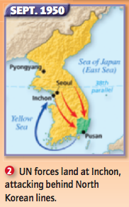
DBQ
What was the land distribution like? How did South Korea fight back?
Notes:
Answer: North Korea controlled most of the peninsula; The UN helped South Korea by landing troops at Inchon.

Slide 14
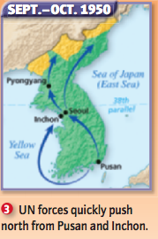
DBQ
What was the land distribution like?
Notes:
South Korea controlled much of the peninsula.

Slide 15
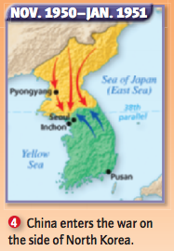
DBQ
What was the land distribution like? What caused the change in territories from Map 3?
Notes:
Answer: About split evenly; China entered the war to help North Korea

Slide 16
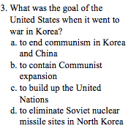
Exit Ticket Questions
Question:
Communist Chinese troops fought on the side of ________ in the Korean War.
Question:
Notes:
1) The North; 2) A

Slide 17
Exit Ticket Questions
The Soviet Union and the United States were involved in _____ when they used substitutes to fight each other.
In 1945 the original agreement between the Soviet Union and the United States was to
a. keep China out of Korea.
b. let the United Nations decide Korea’s fate.
c. hold elections to reunify Korea.
d. divide Korea permanently at the 38th parallel.
Notes:
3) Proxy wars; 4) C

