Slide 1
Cold War Conflicts
Chapter 18
Lesson 3
Day 2

Slide 2
Starter
What was the result of the Korean War?
Notes:
Answer: The Korean War war ended in a stalemate with the two sides reaffirming the division of Korea b/w North and South at the 38th parallel.

Slide 3
Objectives/Standards
Students will be able to identify the causes of the Vietnam War and Cuban Missile Crisis.
W.62 – Describe the Soviet – U.S. competition in Asia with particular attention to the Korean War and Vietnam War.
W.64 – Analyze multiple perspectives on the U.S. and Soviet conflicts involving Latin America, including the Cuban Missile Crisis.

Slide 4
Communism in Cuba
In 1959, a socialist revolutionary named Fidel Castro overthrew Cuban dictator Fulgencio Batista and set up a totalitarian regime. The United States considered the communist regime in Cuba, supported by the Soviet Union and close to the U.S. mainland, a threat to national security.
Why did the U.S. government see Castro as a threat to national security?
Notes:
Castro had ties with the enemy, Soviet Union. Also, the close proximity of Cuba to the U.S. made the U.S. feel more insecure, believing that the Soviets could launch an attack from Cuba targeting the U.S. mainland.

Slide 5
*Bay of Pigs Invasion*
The CIA proposed a plan to overthrow Castro whereby anti-Castro Cuban exiles, who were trained by the U.S., would invade at the Bay of Pigs in Cuba with goal of starting a revolt against Castro.
The plan failed and the invaders were quickly defeated.

Slide 6
Cuban Missile Crisis
After the Bay of Pigs, Soviets sent advisors to Cuba.
In 1962 came the Cuban Missile Crisis a confrontation b/w the U.S. and the Soviet Union over the installation of Soviet nuclear missiles in Cuba.
After a two-week standoff, the Soviets agreed to remove the missiles from Cuba if the U.S. removed its missiles from Turkey and pledged not to invade Cuba. Kennedy agreed.
Realizing how close they had come to nuclear war, the two countries set up a hotline between Moscow and Washington to facilitate communications.

Slide 7
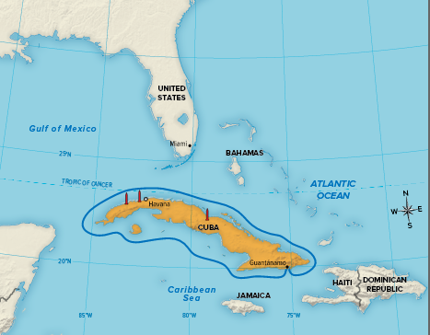
Cuban Missile Crisis

Slide 8
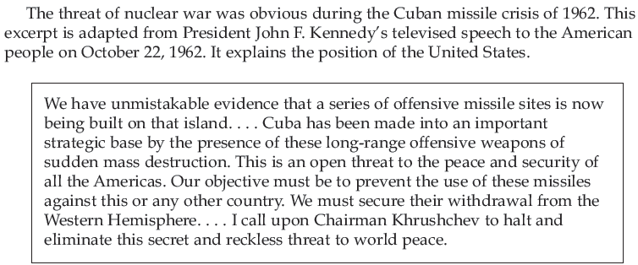
Cuban Missile Crisis DBQ

Slide 9

Answer

Slide 10
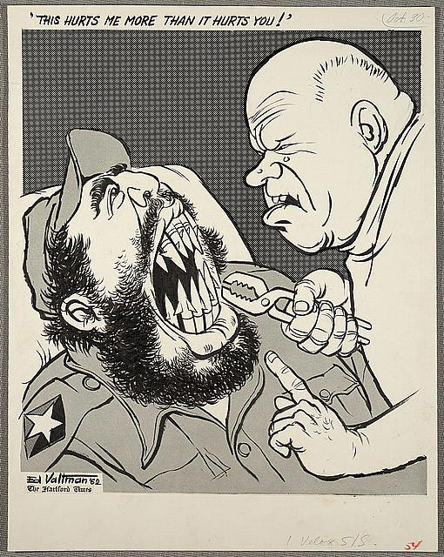
Notes:
Khrushchev is depicted as a dentist removing Castro’s teeth, which appear as missiles.
Question: What point is the cartoonist making about the Cuban Missile Crisis? Answer: suggesting that Khrushchev wanted missiles in Cuba more than Castro did.

Slide 11
Video
Cuban Missile Crisis

Slide 12
Vietnam War
Background: In 1954, Vietnam was divided into two parts with the North under the control of Communists (led by Ho Chi Minh) and the South under non-Communists. They would remain divided until the end of the Vietnam War.
In 1965, President Lyndon Johnson sent troops to Vietnam to prevent the Communist regime in the North from invading and gaining control of non-communist South Vietnam.

Slide 13
Vietnam War
During the course of the conflict, neither side made significant gains. In 1973, President Richard Nixon reached an agreement with North Vietnam and withdrew U.S. troops.
Within two years, the Communists controlled all of Vietnam.

Slide 14
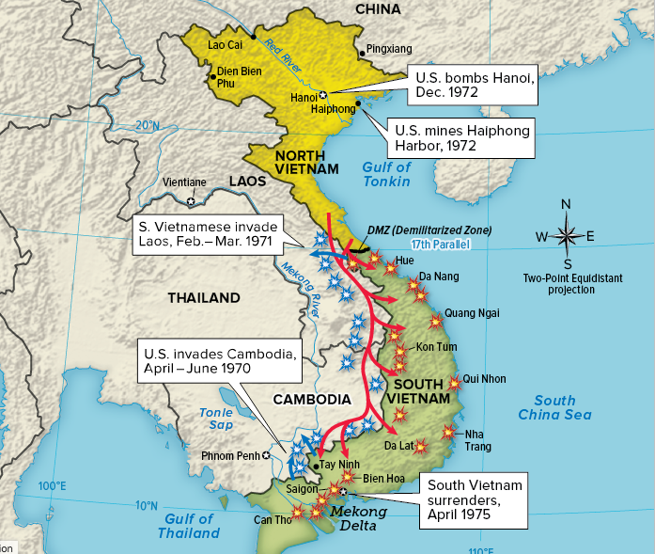

Slide 15
Vietnam War
Why did the U.S. get involved in Vietnam?
The United States government feared that other Asian countries would fall like dominoes to communism if communists succeeded in taking over South Vietnam. This "domino theory" had a strong influence on U.S. foreign policy in the 1950s and 1960s.
Domino Theory: idea that if one country falls to communism, neighboring countries will also fall.

Slide 16
Exit Ticket
Exiled Cuban fighters invaded Cuba at the _____.
The United States sent troops to Vietnam to
a. stop the south from controlling the north.
b. drive the French out of Vietnam.
c. stop the north from controlling the south.
d. gain the support of the American public.
Notes:
Bay of Pigs; 2) C

Slide 17
Exit Ticket
3) The United States considered Cuba a threat because
a. Cuban exiles had informed the U.S. government about missiles in Cuba.
b. the Cuban government had been overthrown and was unstable.
c. Castro and Kennedy did not trust each other.
d. Cuba, which was only 90 miles away, had ties with the Soviets.
4) The U.S. government believed that if they lost South Vietnam to communism,
a. other Asian countries would come to the aid of South Vietnam.
b. other Asian countries would also fall to communism.
c. North Vietnam would become communist too.
d. U.S. citizens would turn against the war.
Notes:
3) D; 4) B

Slide 18
