Slide 1
Independence and Nationalism in the Developing World
Chapter 19
Lesson 1
South and Southeast asia

Slide 2
Theme of this Chapter
Richie Havens
What do you think the following lyrics mean: “sometimes I feel like a motherless child.”
Notes:
Listen to the song and tell me the theme of this Chapter. (Freedom)
Answer: a person without a country; a second-class citizen (a person systematically discriminated against) in his/her own country

Slide 3
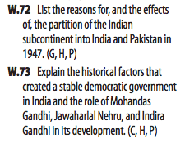
Objective
Students will be able to describe how India was divided once it gained independence and its effects, including the conflict over Kashmir.

Slide 4
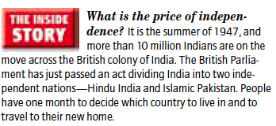
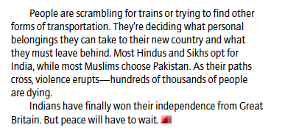
India
s
Notes:
Which country partitioned (divided) India? Great Britain
Was the journey described above safe? No; violent

Slide 5
South and Southeast Asia
Notes:
Dates when they received their freedom

Slide 6
Holt – Partition of India Geography Worksheet
Holt - Partition of India Geography Worksheet
Partner with the person next to you. Complete the handout.

Slide 7
Notes:
Millions traveled across India on overcrowded trains.

Slide 8
India Divided
Muslim and Hindu violence increased in India during the early 1940s.
The peoples of British India gained their independence from Britain in August 1947.
Because of the religious violence, to ensure stability, Britain partitioned (divided) India into two separate countries: India (Hindu) and Pakistan (Muslim). Pakistan consisted of two sections, West and East.
In 1947, Jawaharlal Nehru became India’s first prime minister

Slide 9
India Divided
**After the new nations of India and Pakistan had been created, millions of Muslims fled India for Pakistan. Likewise, millions of Hindus fled to India.
The mass migrations led to violence, and more than a million people were killed, including Mohandas Gandhi.
Main Idea here: India gained its independence from Great Britain, but the region entered an era of conflict and challenges.

Slide 10
Infer (informed/educated guess) what you think happened before the moment of the
image; what do you think is happening during it; and what do you think happens next?
Notes:
Example of inference: if you see your mom’s bag on the table, you might infer that she’s home
When you make an inference, consider prior facts or knowledge that you may have on the topic; a combination of what you know and what you learn from reading or listening can help you draw inferences.

Slide 11
Gandhi
Video
Notes:
Pause the video at the 3:25 mark, showing the image of Gandhi. Ask the class to write a first-person monologue (solo speech; what he is thinking in his head) of what that person is thinking in the moment of the visual.
Activity: In the center of a posterboard or piece of paper, draw or paste an image of Gandhi. Surround his picture with words, phrases, or illustrations that convey his life and beliefs.

Slide 12
Notes:
Where do most Hindus live? (India)
Where do most Muslims live? (Pakistan)

Slide 13
The New India
India became the world’s largest democracy when the nation won its independence in 1947.
During the Cold War, India followed the principle of nonalignment, meaning that it refused to align itself (take sides) with either the Soviets or the U.S. out of concern

Slide 14
War over Kashmir
India and Pakistan still today clash over the territory of Kashmir.

Slide 15
The Conflict in Kashmir
Notes:
Answer: Because both India and Pakistan claim the territory.

Slide 16
Kashmir
India and Pakistan have fought wars over Kashmir, a state with Muslim and Hindu populations.
When India developed nuclear weapons, Pakistan began its own nuclear weapons program, becoming a nuclear state soon after.

Slide 17
Video
Kashmir
Question: How has the dispute over Kashmir affected the relationship b/w India and Pakistan?
Notes:
Increased tensions; made the situation worse.

Slide 18
Civil War in Pakistan
When Pakistan was created in 1947, it had two parts: East and West Pakistan.
The government of Pakistan was based in West Pakistan, and people in East Pakistan complained that they did not receive equal treatment from their rulers.
In 1971, East Pakistan declared its independence. A brief civil war between West Pakistan and East Pakistan ensued. As a result, East Pakistan became the separate nation of Bangladesh, which is now one of the poorest countries in the world.
Notes:
Both countries have remained very poor. They have a problem with establishing stable governments.
India and Pakistan are both in the nuclear club.

Slide 20
Disputes in India

Slide 22
Creation of Pakistan Exercise (Handout)
Directions:
Read your assigned speech regarding the creation of a separate Pakistan;
Write down and describe your author’s arguments for or against the creation of a separate Pakistan;
Once finished, explain to your partner your author’s position.
Together, explain which argument you both find most compelling (convincing; persuasive)
Notes:
What are the authors’ purpose here? (Persuade/Inform)

Slide 23
Summary

Slide 24
Exit Ticket
1) After British India was split into three independent nations, violence erupted as most Hindus migrated to ________ and most Muslims to ________ .
2) When Pakistan was created it was divided into what two parts: ______ and ______.
3) In 1971, East Pakistan declared its independence and, after a brief _______ , became the new nation of _______ .
4) Today, tensions are high b/w India and Pakistan over the unresolved border dispute of _________.
Notes:
India; Pakistan
2) East Pakistan and West Pakistan
3) Civil war; Bangladesh
4) Kashmir

