Slide 1
The Middle East
Chapter 19
Lesson 2
Day 1

Slide 2
Starter Quiz
Notes:
1) C; 2) A; 3)

Slide 3
Starter Quiz
Notes:
3) C

Slide 4
Starter Quiz Bonus
Notes:
4) B

Slide 5
Objective/Standard
Students will be able to understand the establishment of the State of Israel and its effects.
W.56 – Explain the origins, significance, and effect of the establishment of the State of Israel.

Slide 6
Israel
Question: Most citizens of Israel are of what religion?
Question: The Middle East is mostly what religion?
Notes:
Answer: Judaism; 34% of the world’s Jewish population lies in Israel.
Answer: Muslim

Slide 7
Notes:
French mandate: Lebanon and Syria; British: Palestine, Iraq, and Jordan

Slide 8
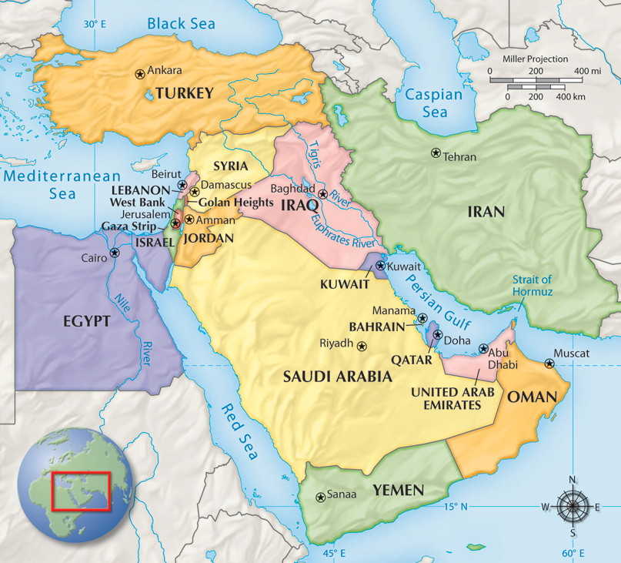
Britain and France carved much of the Middle East into mandates after World War I.
During the 1930s and 1940s these became Israel, Iraq, Lebanon, Syria, and Jordan.

Slide 9
Palestine Mandate
In the years between the two world wars, many Jews immigrated to the Palestine Mandate, which was governed by Great Britain under a League of Nations mandate.
Tensions between Jews and Arabs increased because the Jews wanted their historic homeland and religious center to become a home for the Jewish people.

Slide 10
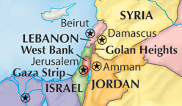
Israel was established as a Jewish homeland.
The Nazi Holocaust created worldwide support for an independent Jewish state.
In 1947, after WWII, the UN drew up a plan to divide the Palestine Mandate into an Arab and a Jewish state.
Jewish settlers accepted the plan, but Arab states rejected it.

Slide 11
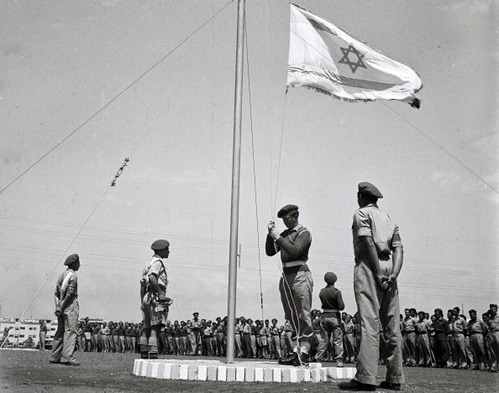
Israel proclaimed its independence in 1948.
Some Arab states, believing that all of Palestine belonged to its Arab residents, immediately invaded Israel, launching the first of several Arab-Israeli war.
One result of this first Arab-
Israeli war was that the Arab
State proposed by the UN did
not come into existence.
Arab states attacked several more times over the next 25 years. Israel won each war and gained more territory.

Slide 12
Question
So, why was Israel founded?
**Israel was founded after WWII to reestablish a Jewish state in the ancient homeland and to provide a safe homeland for Jews who survived the Holocaust.**

Slide 13
Arab-Israeli Dispute
**Most Middle Eastern countries have refused to recognize Israel’s right to exist.**
A serious of wars with its neighbors has led to the expansion of Israel, which controls more land than it did in 1948; it has also forced 700,000 Palestinians from their homes.
**Palestinian Arabs live under Israeli control, another source of tension and conflict in the region.*

Slide 14
Notes:
What do you notice is different about the UN Partition Plan and what Israel actual occupies?
[Think aloud: I am first going to look at the colored portion of the map on the left and see what the UN’s plan was. Then, I am going to compare (for differences) that to the map on the right and see whether Israel occupies areas that they were not supposed to occupy under the UN plan]

Slide 16
DBQ
Notes:
B

Slide 17
Section Summary Worksheet
Holt - Middle East Section Summary Worksheet

