Slide 1
Iran, Iraq, and Afghanistan
Chapter 19
Lesson 2
Day 2

Slide 2
Video
Questions:
1)What event preceded the return of Ayatollah Khomeini to Iran on February 1, 1979?
2) Describe the crowds that welcomed Khomeini at his return to Iran.
3) Summarize the goals Khomeini stated upon his return to Iran.
Iran Revolution

Slide 3
Responses
1. The Shah had fled Iran and his government had collapsed just weeks before the return of Khomeini.
2. The crowds were large and joyous upon the return of their religious leader.
3. Khomeini stated that he wanted to remove all foreign influence that had supported the Shah and destroy any remaining parts of the Shah's regime.

Slide 4
Objectives/Standards
Students will be able to
1) Summarize the Iranian Revolution; and
2) Understand both the Iran-Iraq War and Persian Gulf War
W.95 – Summarize the Iranian Revolution of 1978 – 1979 after Khomeini.
W.101 – Explain and discuss the origins of the Persian Gulf War.

Slide 6
Iran’s oil made it a focus of Western interest. In 1951 Mohammad Mosaddeq became prime minister and tried to nationalize the oil fields.
The shah, who favored the West, ousted Mosaddeq and gave the oil fields back to Western owners.
Iranian nationalists were enraged. Islamic clerics also opposed the shah.

Slide 7
Iran
Oil revenue brought prosperity to Iran when the shah, Mohammad Reza Pahlavi, led the country.
The shah had close ties to Western governments and oil companies. With their support, Iran westernized and foreign influence grew.
Many Muslims resented the shah. They believed he had created a society too focused on materialism and too connected to the West.

Slide 8
Over the following decades Shah Mohammad Reza Pahlavi continued to anger Muslim clerics.
He used oil wealth to build industry and redistributed land.
He continued to Westernize Iran.
His secret police terrorized his critics.

Slide 9
Background
The shah would repress political expression. Protestors against the shah often met with censorship, harassment, or illegal detention and torture.
Iranian intellectuals were unhappy with the shah's repressive policies and began to listen to Ayatollah Khomeini, who had been exiled in 1964 after speaking against the shah.
The shah's dependence on the US, his close ties with Israel, and Iran's hostilities with other Muslim Arab states led to unrest and an interest in the Ayatollah.

Slide 10
In 1979, an Islamic revolution drove the shah from power.
It was led by the Ayatollah Khomeini, a religious leader who condemned Western influence.
He set up and led a theocratic republic based on Islamic law, enforcing strict religious and social values. He silenced critics in the same manner as the Shah had done.
Anti-American feelings erupted when militants took 52 Americans hostage in the US embassy in Tehran. They were held for more than a year.

Slide 11
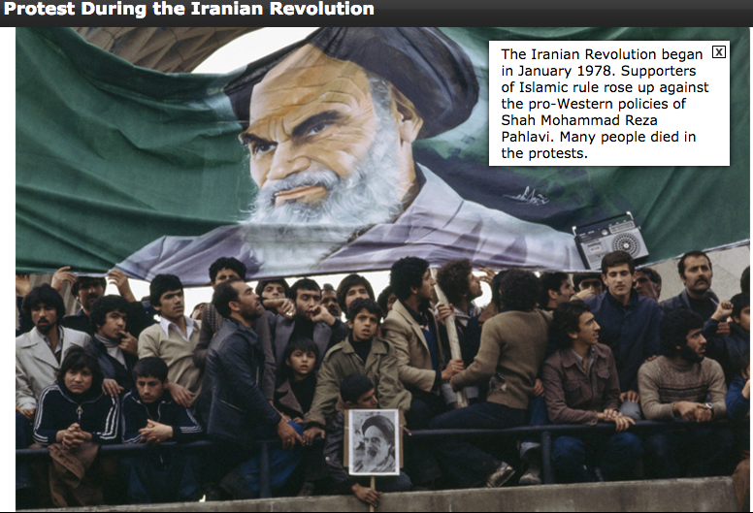

Slide 12
The Iran-Iraq War
Iraq and Iran have had a long history of disputes fueled by religious differences between Shia (Iran) and Sunni Muslims (Iraq).
They have also fought over territory.

Slide 13
*Iran-Iraq War*
In 1980, Iraqi leader Saddam Hussein launched a brutal war against Iran over border disputes and b/c Iran’s new government called for revolution of Iraq’s Shiite population.
The war lasted 8 years and killed 500,000 people. Hussein used chemical weapons against Iranian troops.
In 1988, Iran and Iraq agreed to a cease-fire.

Slide 14
Saddam Hussein

Slide 15
*Persian-Gulf War*
Iraq had the largest army in the Arab world during the 90s.
In 1990, Saddam Hussein sent troops to seize Kuwait, an oil-rich neighbor of Iraq on the Persian Gulf.
The United States led international forces to free Kuwait, and the allies imposed harsh economic sanctions against Iraq.
This war is known in the U.S. as Operation Desert Storm.

Slide 16
Video
Desert Storm

Slide 17
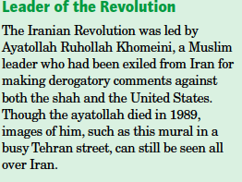
DBQ
Notes:
Answer: He is seen as a great leader who brought Iran its current form of government; b. that they continue to agree with his views.

Slide 18
DBQ
Notes:
Question:
1) How does the author characterize the shah’s reign?
2) Why does Ware think the shah's government was overthrown.

Slide 19
Answer

Slide 20
Exit Ticket
Notes:
c

