Slide 1
Post-Colonial Africa
Chapter 19
Lesson 3
Day 2

Slide 2
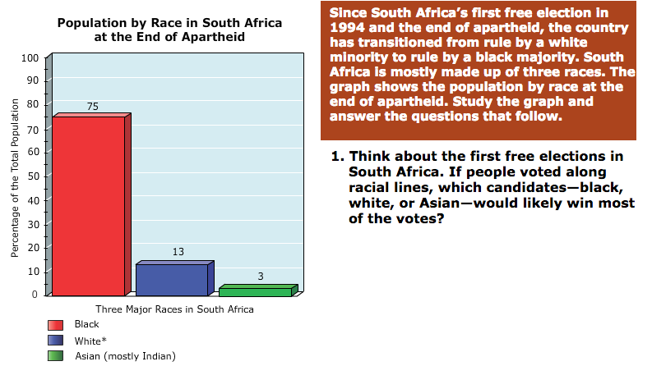
Starter
Notes:
Answer: Black
What challenges do you think South Africans of different races encountered as the country transitioned from minority rule to majority rule? (Students may suggest that black South Africans might have felt the burden of governing, that white South Africans might have felt anxious about their loss of power and might have feared reprisals from the black majority.)

Slide 3
Objective/Standard
Students will be able to describe the challenges that Africans faced after achieving their independence.
W.70 – Evaluate the challenges in Africa.

Slide 4
DBQ – Nelson Mandela
“During my lifetime I have dedicated myself to this struggle of the African people. I have fought against white domination, and I have fought against black domination. I have cherished the ideal of a democratic and free society in which all persons live together in harmony and with equal opportunities. It is an ideal which I hope to live for and to achieve. But if needs be, it is an ideal for which I am prepared to die.”
1) To what cause does Mandela say he is committed?
2) What impact do you think Mandela’s speech had on his cause?
Notes:
A democratic and free society in which people of all races have equal opportunities.
He probably inspired followers with his dedication.

Slide 5
Biography Questions
Pearson – Nelson Mandela Biography Handout

Slide 6
Challenges of Post-Colonial Africa
The end of colonialism left many African nations unprepared.
**They lacked stable economies and governments.
**Also, many nations' boundaries had been drawn across ethnic territories, causing conflict.

Slide 7
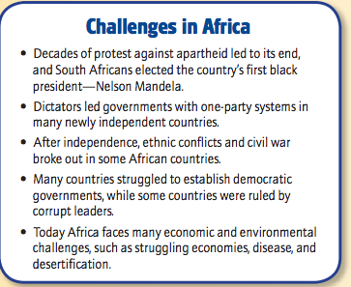

Slide 8
Military Dictatorships
By the end of the 1960s, in almost all of the newly independent African nations, strong leaders seized power and formed a one-party system (where a single political party controls the government and there is little to no political opposition) or a military dictatorship.
These governments would rob their countries of their wealth.
Notes:
Democracy is the opposite of a one-party system

Slide 9
Ethnic Conflicts
Western counties had established colonial boundaries that showed little regard for traditional boundaries. Colonial states included widely different ethnic, linguistic, territorial groups.
After independence, rival ethnic groups competed for control, leading to ethnic conflicts and many civil wars.

Slide 10
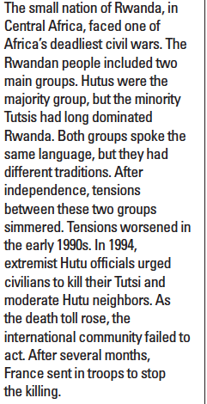
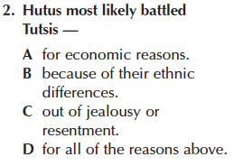
Question
Notes:
D; Describes the Rwandan genocide (estimated that 800k Rwandans slaughtered over a 100-day period)

Slide 11
Struggling Economies
After independence, the economies of most African nations were weak b/c they depended on only one or two exports for their support, leading to an economic dependence on financial aid from developed countries.
African nations were not industrialized; they depended on farming or mining of raw materials. Ghana depended on coco, and Nigeria, on oil.

Slide 12
Disease
African nations have also been challenged by disease.
Malaria is the number one killer in Africa today.
Diseases such as AIDS have seriously impacted African societies, with countries' lack of resources hampering efforts to deal with them. Among the regions of the world, Africa has been particularly hard hit by HIV and AIDS.

Slide 13
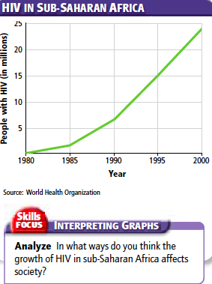
Question
Notes:
Possible Answers: many deaths; leaves children orphaned; makes people fearful

Slide 14
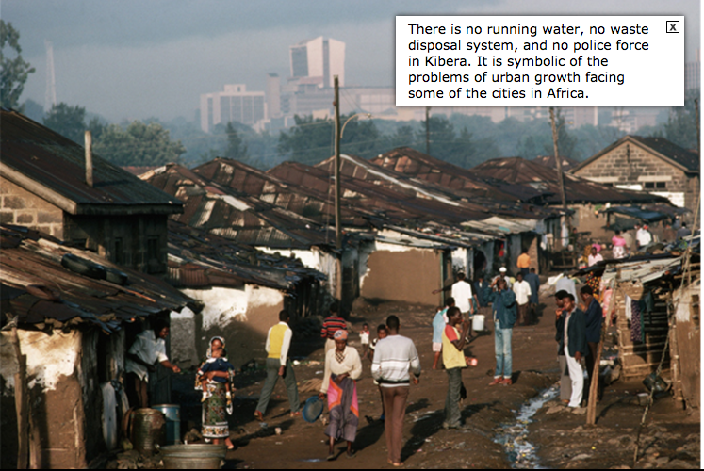

Slide 15
Exit Ticket
Why were civil wars common in post-colonial Africa?
What caused African economies to struggle and depend on outside aid?
True or False: By the end of the 1960s, almost all independent African countries had adopted multi-party systems.
Notes:
Rival ethnic groups would compete for control; colonies had been divided without regard to cultures or ethnic groups
Few exports supported their economies
False

Slide 16
Question
How do you think the ethnic conflicts could have been avoided in post-colonial Africa
Notes:
Students may say that a possible solution was redrawing borders with consideration for ethnic homelands.

Slide 17
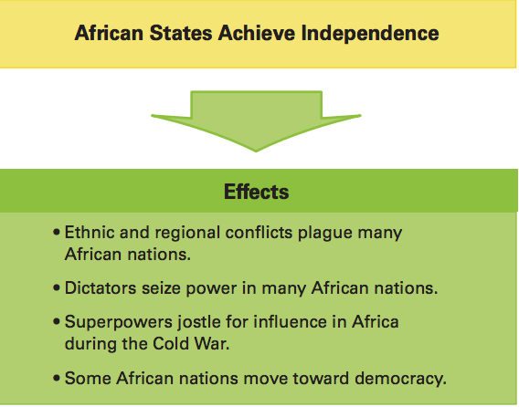
Summary

Slide 18
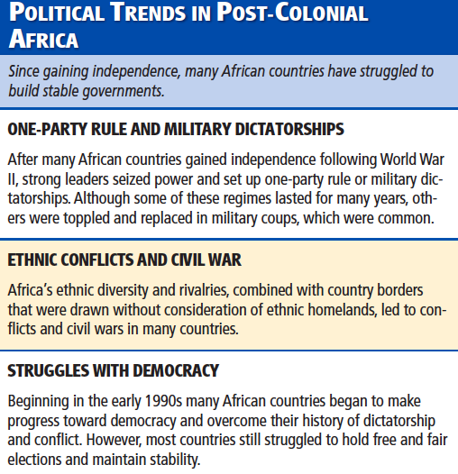
Summary

Slide 19
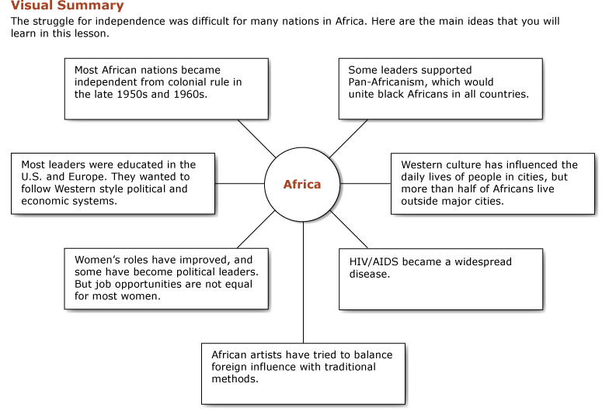
Summary

