Slide 1
Eastern Europe and the Soviet Union
Chapter 20
Lesson 2

Slide 2
Starter 1
Recall: Which dictator ruled the Soviet Union during and immediately after WWII?
Notes:
Joseph Stalin

Slide 3
Starter 2
“You are as blind as kittens. What would you do without me? This country will perish because you don’t know how to recognize enemies.”
Joseph Stalin to Communist Party leaders, 1953
Question: What do you think this quote reveals about Stalin’s personality?
Notes:
Stalin seems to feel superior to the other Party leaders; he feels his country cannot function without him. He reveals his paranoia in that he sees enemies around him that his associates cannot.

Slide 4
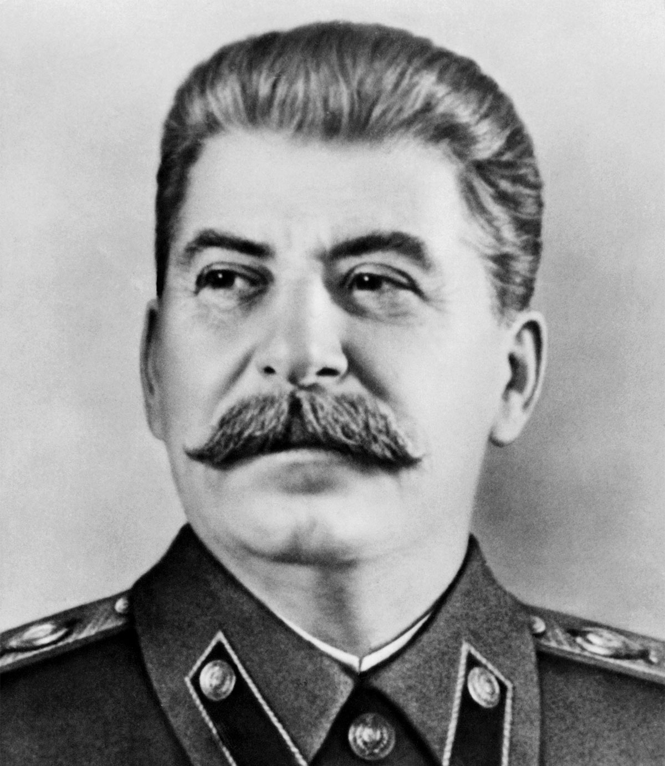
Notes:
Drawing inferences, answer question 2. (Students may mention that such a leader might neglect the wishes of the country's political assemblies, ignore laws and judicial processes, and act on his or her own irrational impulses)
What do you think the term trumped-up means in the text? (deliberately created to make someone appear guilty; falsely accuse)

Slide 5
Objective
Students will be able to understand
1) How Western Europe recovered economically in the postwar era;
2) The major social changes taking place in America after WWII; and
3) How the Soviet Union and Eastern Europe changed after WWII.
The past few days, we analyzed how Western Europe and the U.S. recovered and evolved after WWII. Now we are going to discuss how the Soviet Union changed after the War. Later on, we will analyze how Japan transformed after WWII.

Slide 6
Intro
Remember, the Soviet Union suffered tens of millions of civilian casualties, and the nation’s cities, farms, and industries had suffered heavy damage during WWII..
However, the country emerged from the War as a superpower with a sphere of influence over Eastern Europe.

Slide 7
Postwar Soviet Union
Stalin rebuilt his country quickly by focusing on production of goods for export, and the Soviet Union was soon producing goods at prewar levels.
However, the Soviet people saw few returns/rewards during the recovery. Stalin would continue his ruthless policies. He filled labor camps with “enemies of the state” and seemed ready to launch new purges when he died in 1953.

Slide 8
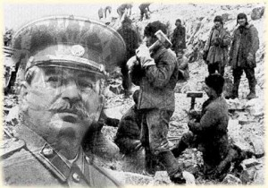
The Rule of Stalin
Stalin was the undisputed leader of the SU. He distrusted others. This distrust added to his regime’s increasing repression.
Stalin would purge intellectuals and political dissenters.

Slide 9
Snow covers the ground 10 months a year; temperatures could reach 58 below zero.
Notes:
Gulag = forced labor camp; from the 1920s to the 1950s, the Soviets held political prisoners and criminals in the camps. After Stalin’s death in 1953, the gulag was gradually phased out.
Question:
Why do you think the Soviets chose to locate labor camps in these conditions? (to isolate; remove all hope; to punish)
What do you think life was like living, working, and dying in a Siberian labor camp?

Slide 10
Notes:
Write a first-person (“I”) monologue (speech; solo) of what the person is thinking in the moment of this visual.
Share and compare with a partner.

Slide 11
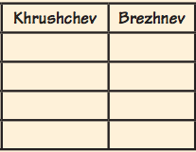
Khrushchev v. Brezhnev
With your group, complete the chart below, comparing the policies of two Soviet leaders, Khrushchev and Brezhnev.
Notes:
Write answers on the board.

Slide 12
Group Document Activity
Within your groups of 4, have each member view 1 of the 4 images posted around the classroom. Write down in your own words what the image is portraying. Bring that information back to your group
As a group, identify the event occurring in the image and name the Soviet leader responsible for that event.
Notes:
Cuban Missle Crisis - Khrushchev
De Stalinization – Khrushchev
Nuclear Disarmament - Brezhnev
Soviet-Afghan war - Brezhnev

Slide 13
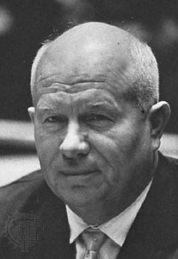
Khrushchev v. Brezhnev
Khrushchev – focused on increasing production of consumer and farm goods; loosened government controls on literacy and artistic works; increased military spending; engaged in de-Stalinization (the process of eliminating Stalin’s more ruthless policies).
I was Russian to make a name for myself
Notes:
Forced to retire in 1964
Question: Why is that image in your book an example of de-Stalinization?

Slide 14
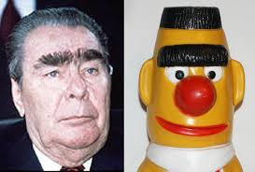
Khrushchev v. Brezhnev
Brezhnev – pursued détente (a phase of relaxation of tensions and improved relations b/w the US and SU); emphasized heavy industry; punished dissidents (a person who speaks out against the regime in power); invaded Afghanistan, ending détente.

Slide 15
The Brezhnev Era
Also note, during the Brezhnev Era, in the 1970s, the U.S. and SU signed SALT I and SALT II (Strategic Arms Limitation Treaties) and the Anti-Ballistic Missile (ABM) Treaty to limit nuclear weapons.
Compare: Using evidence, tell me how U.S.-Soviet relations were different during the Khrushchev and Brezhnev regimes.
Notes:
Under Khrushchev, there was increasing tension with the U.S. (Cuban missile crisis), while under Brezhnev, there was détente and more cooperation (SALT).

Slide 16
Who is the most/least repressive? Explain.
Notes:
Using evidence from the chart, rank the three leaders from most repressive to least repressive and explain. (Students should consider Stalin the most)

Slide 17
Exit Ticket
In a sentence, tell me one thing that you learned today.

