Slide 1
The U.S.
Chapter 20
Section 1
Day 2

Slide 2
Starter
Main Idea: The Cold War brought tremendous economic and social change to North
America, Western Europe, and Eastern Europe and the Soviet Union.
Notes:
Question: Describe what this image reveals about American life and culture in the 1950s?
- Predict how America will prosper and change in the Cold War years.

Slide 3
Objective/Standard
Students will be able to understand
1) How Western Europe recovered economically in the postwar era;
2) The major social changes taking place in America after WWII; and
3) How Eastern Europe and the Soviet Union changed after WWII.
W.81 – Explore the role of various leaders who helped lead the collapse of communism and transformation of Eastern Europe.
Video

Slide 4
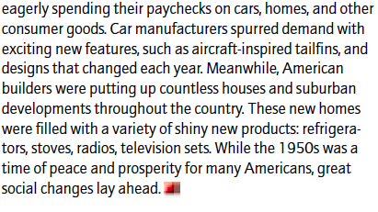
Notes:
What does this story tell us about American life after WWII? Economy poor? People struggle for jobs?

Slide 5
Intro
The postwar U.S. was a land of tremendous prosperity. At the same time, the country was undergoing rapid social change.

Slide 6
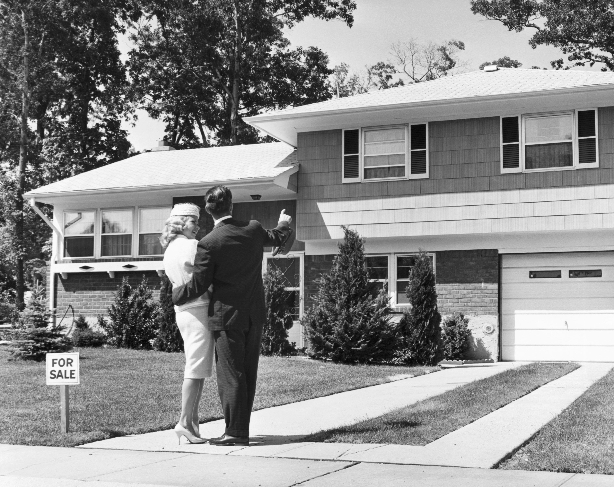
Postwar American Boom
An economic boom followed WWII.

Slide 7
What caused the economic boom?
**America’s economy was undamaged in WWII. This allowed it to produce goods much needed by recovering nations.**
Foreign trade also helped fund huge economic expansion.
**A shortage of consumer goods during WWII left Americans with extra income and the desire to buy goods after the war.**

Slide 8
Postwar American Boom
As Americans became more affluent, they began moving from cities to the suburbs.
The movement to communities outside an urban core is known as suburbanization.
Typically have a single-family home and access to good schools

Slide 9
Suburbs
Why might suburbs such as this attract families from cities?
Notes:
Answer: because of the additional living space and the opportunity to own land.

Slide 10
Family Life During the 1950s

Slide 11
Economic Boom
The U.S. government contributed to the boom
Eisenhower approved government funding to create the interstate highway system;
Government programs made it easier for people to buy homes;
G.I. Bill helping veterans attend college.

Slide 12
Social Change
The prosperity of the postwar years failed to benefit all Americans equally.
Many states denied equality to African Americans and other minorities.
**These groups faced legal segregation, or forced separation in education and housing. Minorities also suffered discrimination, or unequal treatment or barriers, in jobs and voting.**

Slide 13
Desegregation
In 1948, President Truman issued an executive order ending segregation in the armed forces.
In 1954, the U.S. Supreme Court ruled in Brown v. Board of Education that segregated schools were unconstitutional.

Slide 14
Notes:
What are some thoughts that come to mind when viewing this image?
Put yourself in this woman’s shoes. What would be going through your mind as your were about to enter the school?
What would be an appropriate title/caption for this image? (Desegregation); Why did you chose that title?

Slide 16
Notes:
He continually put his life and freedom at risk for his beliefs.

Slide 17
Civil Rights
By 1956, Dr. Martin Luther King Jr. emerged as the leader of the civil rights movement (a mass protest movement against racial segregation and discrimination in the United States).
His efforts led to Congressional passage of laws in the 1960s that ended segregation, protected voting rights, and outlawed discrimination in housing and jobs.

Slide 18
Counterculture
In the 1960s, the counterculture – a rebellion of teenagers and young adults against mainstream American society, spread across the country.

Slide 19
Video
King
Rosa Parks Handout

Slide 20
Exit Ticket
1) The postwar period in the United States was a time of
a. depression; b. declining birthrates; c. prosperity; d. conflict.
2) Racial segregation in U.S. military forces was ended by
a. the G.I. Bill of Rights; b. President Truman in 1948;
c. the Supreme Court in 1954; d. the Civil Rights Act of 1964.
3) Brown v. Board of Education was a ruling against racial
segregation in
a. professional sports; b. restaurants and hotels;
c. public schools; d. the armed forces.
4) A mass protest against racial segregation and discrimination in the U.S was known as
a. integration b. civil rights movement
c. counterculture d. conformity
Notes:
C; B; C; B
Question 5: The movement to communities outside an urban core is known as what? (suburbanization)

Slide 21
Summary

