Slide 1
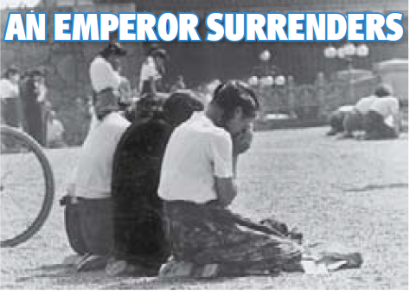
The Asian Rim
Chapter 20
Lesson3
Notes:
Three girls weeping after they find out that Japan surrenders in WWII.

Slide 2
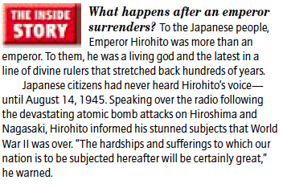
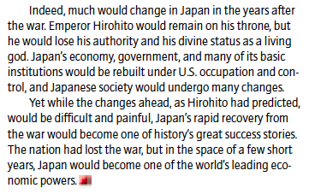

Slide 3
Objective
Students will be able to understand how Japan and the four “Asian tigers” changed economically, socially, and culturally after WWII.

Slide 4
Intro
Japan suffered major destruction after WWII. After the war, the nation needed to rebuild its government and economy.

Slide 5
American Occupation
**After WWII, U.S. troops occupied (held by a foreign power) Japan, and American general Douglas MacArthur took control of the Allied efforts to rebuild the country.
Japanese society would soon be remodeled along Western lines.

Slide 6
American Occupation
The rebuilding process had three basic steps:
1) demilitarizing Japan (their armed forces were dismantled);
2) building a democratic government ; and
3) establishing a strong economy (some large corporations were broken up and land was redistributed from wealthy landlords to small farmers)

Slide 7
Building a Democratic Government
A new constitution was created.
It established universal suffrage and a parliamentary democracy, emphasizing human rights and freedoms of speech, assembly, and religion.
The constitution forbade Japan from building a military capable of attacking other countries.
The Japanese emperor lost all political power.

Slide 8
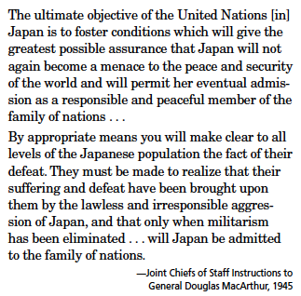
Who or what does the authors blame for the war?
In this “family of nations,” who is the child and who is the parent?
Notes:
1) Japan; 2) Japan is the child and the UN is the parent

Slide 9
Occupation’s End
Occupation would end in 1952.
America still maintains military bases in Japan and has close economic ties.

Slide 11
The Asian Tigers
Japan was building one of the world’s strongest economies after the war. Other countries in Asia also saw great economic success.

Slide 12
The “Asian Tigers” Group Questions
What nations are known as the “Asian tigers”?
What were two key areas of industrial production for South Korea after the election of Park Chung Hee?
Why was Taiwan able to focus on economic growth without worries about a Communist invasion?
How did Taiwan change after World War II?
When did Great Britain return control of Hong Kong to mainland China?

Slide 13
Answers
1. South Korea, Taiwan, Singapore, Hong Kong
2. The key areas for industrial development were chemicals, textiles, shipbuilding, and automobile production.
3. American military forces protected Taiwan.
4. After the war, Taiwan built a modern industrialized society, instituted a land-reform program, which put farmland in the hands of peasants, doubled food production, and expanded local manufacturing and commerce.
5. 1997

Slide 14
Exit Ticket
After WWII, what changes and reforms did the Allied occupation administration lead Japan to make?

