Slide 1
A New Era Begins
1989-Present
chapter 21
LESSON 1
End of the cold war
Day1
http://chnm.gmu.edu/1989/
Notes:
Great website regarding history of 1989 in Eastern Europe

Slide 2
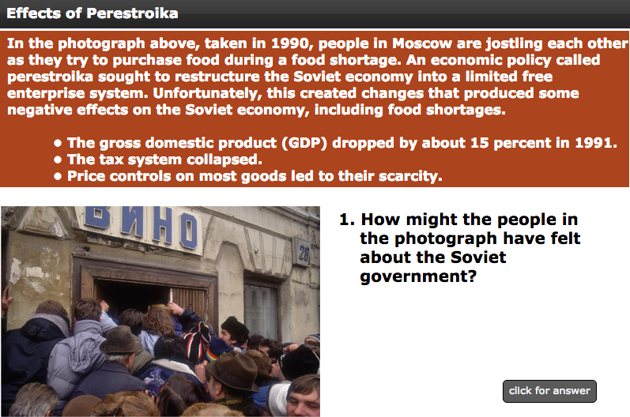
Starter
Notes:
Answer: The people might have blamed the government for their economic problems.

Slide 3
Objectives
Students will be able to
Understand how the Soviet Union collapsed;
Trace the impact of the fall of the Soviet Union on other nations; and
Identify the factors that led to conflict in Yugoslavia.

Slide 4
Main Idea
The Soviet Union collapsed in 1991 and the Cold War came to an end, bringing changes to Europe and leaving the U.S as the world’s only superpower.

Slide 5
Intro
The Soviet Union emerged from WWII as a superpower with control over 15 Eastern European countries.
The Soviet Union had a command style economy whereby the government made all the economic decisions and owned most of the means of production (e.g., factories).

Slide 6
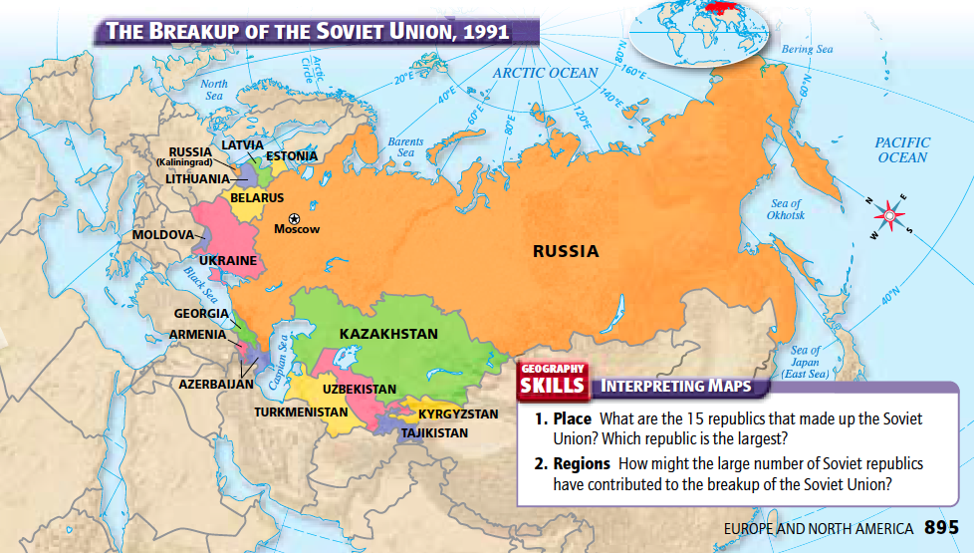
Notes:
Russia is the largest

Slide 7
Question
What led to the Soviet Union’s collapse?

Slide 8
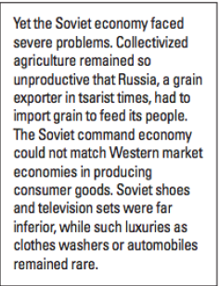
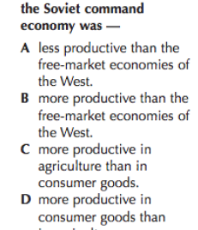
Question
Notes:
A

Slide 9
Command Economy Stagnates
Soviet Union’s economy began to slow in the 1960s:
  By the 1980s, there was inefficiency and waste, and industry had grown too large for the government to control; and
  The Soviet command economy could not match Western market economies in producing consumer goods.

Slide 10
Arms Race
Despite these economic problems, the Soviet Union kept up its military commitments and tried to match the United States in the arms race, further straining its economy.
  The production of all this military hardware and technology left few resources for improving the day-to-day lives of the Soviet people

Slide 11
Afghanistan
The Soviets conflict in Afghanistan against the American-supported mujahedin led to several years of casualties, high costs, and few successes.
This war in Afghanistan provoked a crisis in morale for the Soviets at home, producing another blow to the Soviet empire.

Slide 12
Mikhail Gorbachev
Mikhail Gorbachev became the leader of the Soviet Union in 1985; he was eager to bring about reforms.
He pulled Soviet troops out of Afghanistan and signed treaties w/ the U.S. to slow the arms race.

Slide 13
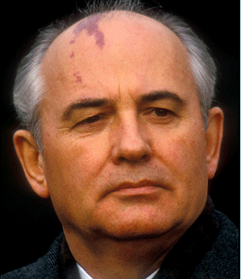
Mikhail Gorbachev
He proposed two radical concepts:
1) Glasnost: means “openness;” he encouraged people to discuss the countries problems openly;
2) Perestroika: means “restructuring;” he called for reform of the Soviet economic and political system.

Slide 14
*Perestroika*
Gorbachev:
pursued arms control agreements w/ the U.S.;
backed limited private enterprise and free-market mechanisms (e.g., allowed farmers to sell produce on the free market);
stopped giving Soviet military support to Communist governments in Eastern Europe.

Slide 15
Revolutions in Eastern Europe
Gorbachev’s policies led to unrest across the Soviet empire.
  Citizens of Eastern European countries, longing for freedom, began to rise up and overthrew their Soviet-backed leaders. Gorbachev, no longer willing to keep Eastern Europe under control, did nothing to interfere.

Slide 16
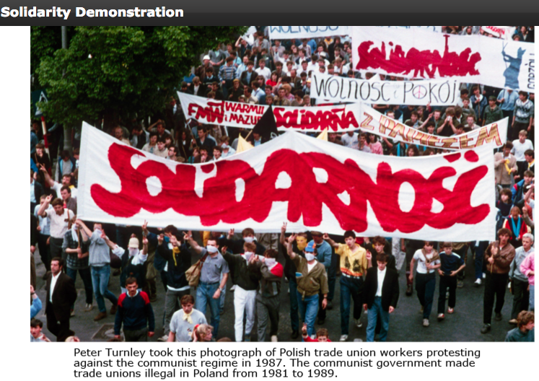

Slide 17
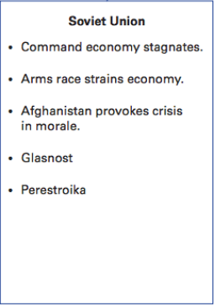
Summary

