Slide 1
End of the Cold War
Chapter 21
Lesson 1
Day 2

Slide 2
Starter
Name the causes of the collapse of the Soviet Union.
Notes:
Arms race; Command economy stagnated; War in Afghanistan; Glasnost and Perestroika; Revolutions in Eastern Europe

Slide 3
Review
1. What was Gorbachev’s initial restructuring of economic policy.
2. What was Gorbachev’s policy of encouraging open discussion.
3. By 1980 the Soviet Union was experiencing
a. a declining economy.
b. a rapidly falling infant mortality rate.
c. extensive political reforms.
d. substantial improvement in working conditions.
Notes:
1) perestroika; 2) glasnost; 3) a

Slide 4
Objectives
Students will be able to
Understand how the Soviet Union collapsed;
Trace the impact of the fall of the Soviet Union on other nations; and
Identify the factors that led to conflict in Yugoslavia.

Slide 5
Revolutions in Eastern Europe
The Soviet Union had maintained Eastern Europe by force.
When Gorbachev introduced glasnost and perestroika in the Soviet Union, Eastern Europeans began to seek greater freedom in their own countries.
As the Soviet Union crumbled, Eastern Europeans demanded an end to Soviet domination.

Slide 6
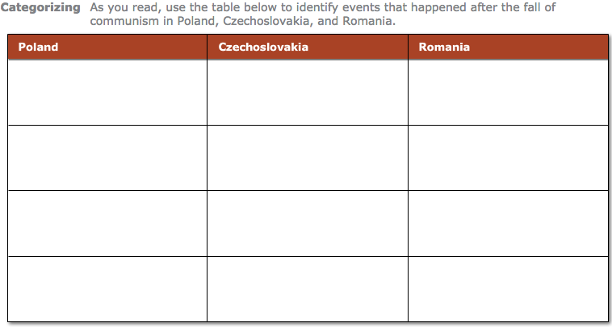
Notes:
Answers on p. 432 of TM

Slide 7
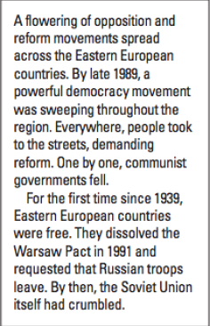
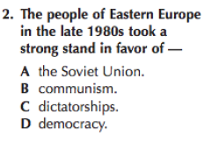
Question
Notes:
D

Slide 8
End of the Soviet Union
The Soviet Union was made up of 15 separate republics that included 92 ethnic groups and 112 different languages.
As Gorbachev ended strict Communist control, nationalist independence movements began.
Conservative leaders arrested Gorbachev in an attempt to restore order, but the coup failed due to resistance from thousands of Russians.

Slide 9
End of the Soviet Union
Individual republics moved quickly to vote for independence. Democracy begins to sweep across Eastern Europe.
By 1991, the Soviet Union had broken up into 15 independent states.

Slide 10
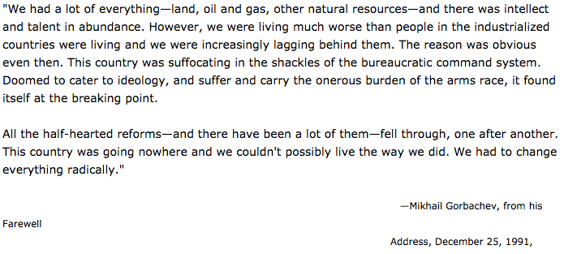
Gorbachev’s Farewell Address

Slide 11
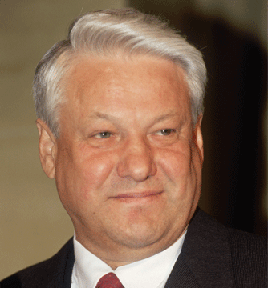
The New Russia
Boris Yeltsin, president of Russia during the fall of the Soviet Union, quickly introduced a free market economy in Russia.
Yeltsin was succeeded by
Vladimir Putin, Russia’s
current president. He would
strengthen Russia’s economy
from oil and gas exports.

Slide 12
Breakup of Yugoslavia Handout
Read the handout and answer the questions that follow in your notes.
Answer the guiding question: How did the fall of the Soviet Union impact Eastern Europe?
Notes:
Revolutions broke out and new governments were formed.

Slide 13
Answers
1. Genocide and ethnic cleansing have different goals. Genocide is aimed at the total destruction of a group, and ethnic cleansing is aimed at creating ethnically homogeneous areas. Ethnic cleansing involves the forced removal of a targeted group and may or may not involve murder.
2. Bosnia and Herzegovina (20%); Macedonia (10%); Kosovo (4%)
3. Because a shatter belt is an area of instability between spheres of influence that have opposing values, it can lead to Balkanization as the various groups organize themselves into more ethnically homogeneous areas.
4. People are constantly moving around in their search for educational opportunities, jobs, and better living conditions. They don’t always settle next to neighbors of the same ethnicity. In the process, cultural identities change.

Slide 14
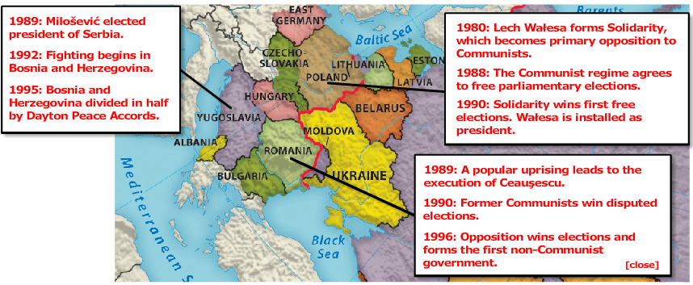
Revolutions in Eastern Europe

Slide 15
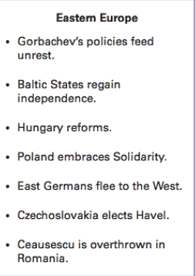
End of Cold War

