Slide 1
Western Europe and North America
Chapter 21
Lesson 2
Day 1

Slide 2
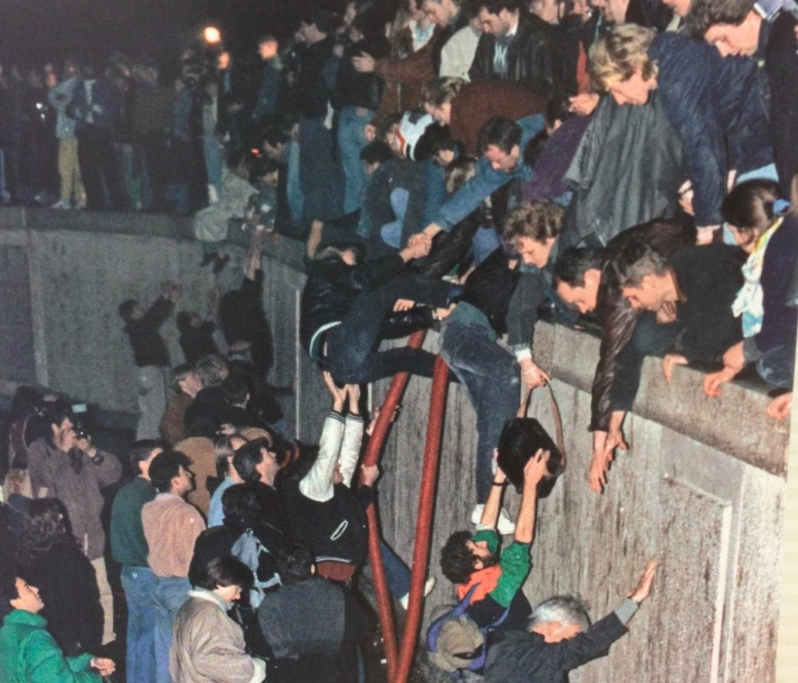
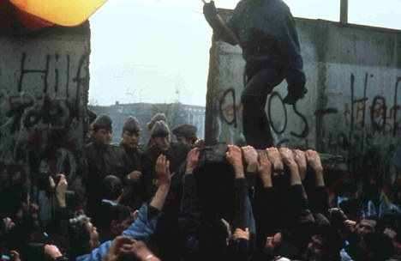
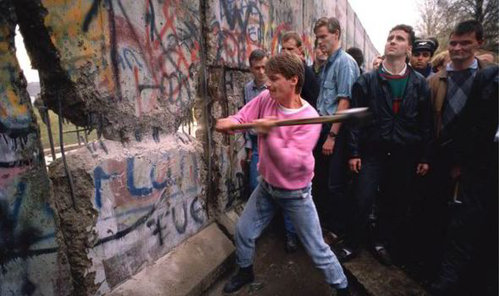
Starter
Notes:
1) What are these images depicting? (Fall of the Berlin Wall);
2) What was the symbolic meaning of the fall of the Berlin Wall? (Fall of Communism; Democracy overcomes Communism)

Slide 3
Objective
Students will be able to identify the political, social, and cultural trends in Western Europe and North America since the end of the Cold War.

Slide 4
Intro
The collapse of communism ended decades of division b/w Eastern and Western Europe. Trade, business, travel, and communications across the continent became easier.

Slide 5
Berlin Wall Background
After Communist East Germany and democratic West Germany formed in 1949, tens of thousands of East Germans left their country by crossing from East Berlin into West Berlin.
To stop this exodus, East Germany built the Berlin Wall.
This wall symbolized the brutality of the Communist system.

Slide 6
Germany Reunifies
In 1989, the Berlin Wall was torn down.
After more than 45 years of division East and West Germany were reunited in 1990.
East Germany’s economy and infrastructure were weak and had to be modernized - West Germans paid higher taxes to finance the rebuilding of the eastern part of the country.

Slide 7
Germany Reunifies
The cost of rebuilding the former East Germany led to economic problems, which in turn led to political changes and increasing anti-immigrant activities by a segment of the German population such as the neo-Nazis.
Despite these problems, the new Germany became a leading power in Europe.

Slide 8
European Union
In 1993, the European Economic Community became known as the European Union (EU), a group of nations that work together to promote a freer flow of capital, labor, services, and goods.
EU members cooperate on social and economic policies and on security issues.
After the Cold War ends, EU adds countries from Eastern Europe.

Slide 9
European Union
In 2002, the euro became the common currency for some EU nations.
Today, the eurozone, or countries using the euro, include 17 of the EU’s 27 members.

Slide 10
Trend
Trend of Europe after the Cold War – closer ties among countries in Europe, including a reunified Germany

Slide 11
United States
After the fall of the Soviet Union, the U.S. emerged as the world’s only superpower.

Slide 12
U.S.
Ronald Reagan reduced welfare spending while massively increasing military spending, creating huge budget deficits, the state that exists when a government spends more than it collects in revenues.

Slide 13
U.S.
After Regan’s successor, George H. W. Bush, failed to deal effectively with economic problems, Bill Clinton was elected.
The economy improved during Clinton’s administration, but his personal scandals contributed to the election of the Republican George W. Bush as his successor.
The growing unpopularity of the Bush-advocated war on Iraq, along with severe new economic problems, resulted in the election of the first U.S. African American president, Barack Obama, in 2008.

Slide 16
Canada
In 1993, Canada approves the North American Free Trade Agreement (NAFTA), along with the U.S. and Mexico, to make trade easier and more profitable b/w the countries.

Slide 17
Video

