Slide 1
China
Chapter 21
Lesson 3

Slide 2
Objective
Students will be able to identify the political and economic changes that China has undergone after 1989.

Slide 3
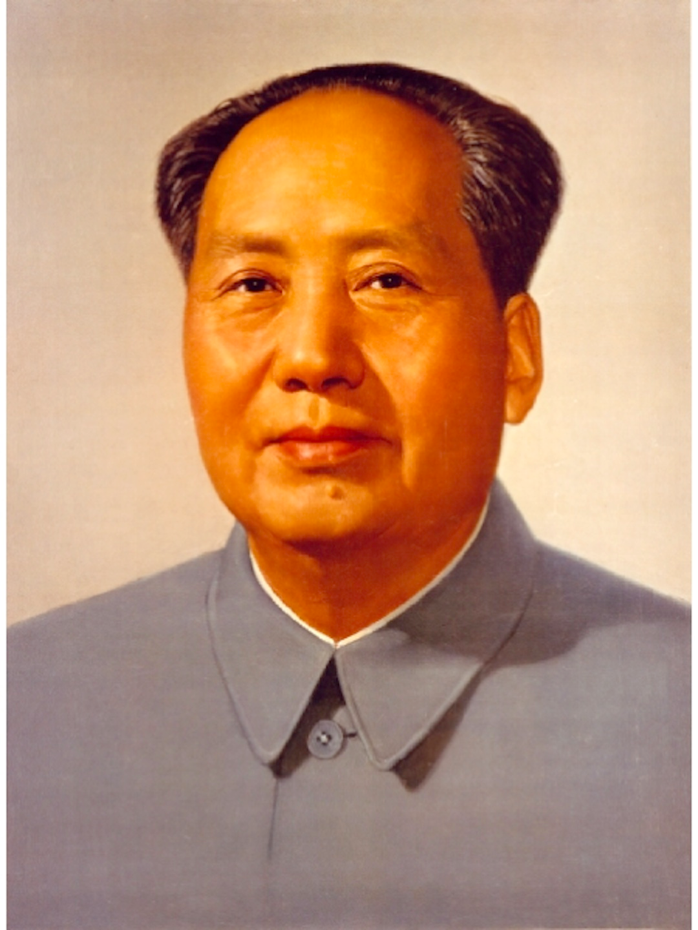
China After Mao
Mao Zedong, China’s communist revolutionary leader, dies in 1976.
After Mao’s death, more moderate leaders took control of China. Deng Xiaoping (dung show ping) moved to modernize the economy.
His plan allowed for some free market features.
He refused to all for democratic reforms.

Slide 4
Deng Xiaoping

Slide 5
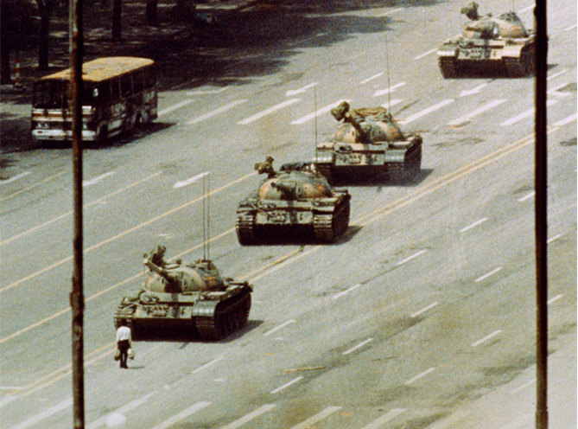
China After Mao
Deng Xiaoping reforms brought a surge of growth to China, an improved standard of living, and increased foreign investment.
However, he refused to allow democratic reforms.

Slide 6
Tiananmen Square
**In 1989, thousands of protesters, many of them students, occupied Tiananmen Square, a huge public plaza in Beijing. They raised banners calling for democracy.**
The government ordered the protesters to disperse. When they refused, the gov. sent in troops and tanks. Thousands of demonstrators were killed or wounded. Many others were imprisoned or tortured.
The crackdown showed the communist government was determined to keep control.

Slide 7
China Limits Population Growth
China’s population, at more than 1.3 billion, is the largest in the world.
In the 1980s, the gov. imposed a one-child policy, which limited urban families to a single child, and rural families to two children. [The goal was to keep population growth from hurting the economy]
Notes:
The policy was enforced with fines and forced abortions.

Slide 8
Notes:
Chinese Family

Slide 9
Review

Slide 10
Summary
Overall, after the death of Mao, China has reformed its economy, but has limited freedom to keep the communist government in control.

Slide 11
Question
Notes:
B

Slide 12
Pearson – China Human Rights Handout

