Slide 1
Contemporary Global Issues
Chapter 22
Lesson 1
Day 1
Political Challenges in the modern world

Slide 2
Starter
Question: What is the event shown in the photo? How should America respond to
this event? How can future attacks like these be prevented?
Notes:
Answer: Destruction that occurred on 9/11/01
Point out that when a terrorist attack occurs in a country, the country under attack can necessarily declare war on another country b/c the terrorist often do not represent a specific country. Finding way s to deal w/ terrorism is one of the challenges countries face in the modern world.

Slide 3
Objective
Students will be able to
Explain how UN agencies work to solve problems;
Understand the threat of WMDs and terrorism; and
Describe how the U.S. and other nations have responded to the threat of terrorism.

Slide 4
Question
What challenges do countries face in the modern (today’s) world?
How will these problems be resolved?
Notes:
Examples: Climate change; poverty; natural disasters

Slide 5
United Nations
The formation of the UN was the second major attempt by the world's nations to create a body where nations could meet to resolve their differences rather than resort to war.
The first attempt, the League of Nations, failed after WWI.
The UN was panned at a meeting of the Big Four—Britain, U.S., Russia, and China—at Dumbarton Oaks in Washington, D.C.
It took another meeting at Yalta to include the idea of a security council to resolve matters of voting powers.

Slide 6
Notes:
Know the first three.
Question: Why might the Security Council have only five permanent members? Answer: Powerful nations may have demanded a bigger say in UN decisions

Slide 7
Notes:
UN General Assembly

Slide 8
Security Council

Slide 9
Question
How do the UN General Assembly and the UN Security Council differ?
The General Assembly includes all members and discusses global problems and solutions;
The Security Council includes 15 members that pass resolutions and can require the organization to act.

Slide 10
United Nations
**What are some of the goals of the United Nations?
To promote peace and human dignity.**
The UN has peacekeeping forces that settle conflicts and supervise truces around the world.
UN General Assembly

Slide 11
International Security
What kinds of threats to national and global security do nations face today?
Notes:
Terrorism; WMDs

Slide 12
Nuclear Nonproliferation Treaty
The purpose of the Nuclear Nonproliferation Treaty is to limit the proliferation, or spread, of nuclear weapons and technology.
Since the creation of the treaty in 1968, 189 nations have agreed to not develop or possess nuclear weapons.
Three nations have not signed the NPT: India, Israel, and Pakistan – all three have nuclear weapons

Slide 14
Weapons of Mass Destruction (WMDs)
Weapons of Mass Destruction include nuclear, biological, and chemical weapons.
Nuclear – include the atomic bomb;
Biological – refer mainly to germs that can be released into the air or into water supplies;
Chemical – are toxins, such as nerve and mustard gas
The danger of WMDs has grown as terrorist groups and “rouge states” – nations that ignore international law and threaten other nations – try to acquire them.

Slide 15
Question
Discuss the following issue:
Some nations say that, like the U.S., they want nuclear weapons for defense. Do individual nations have the right to decide to acquire nuclear weapons? Why or why not?

Slide 16
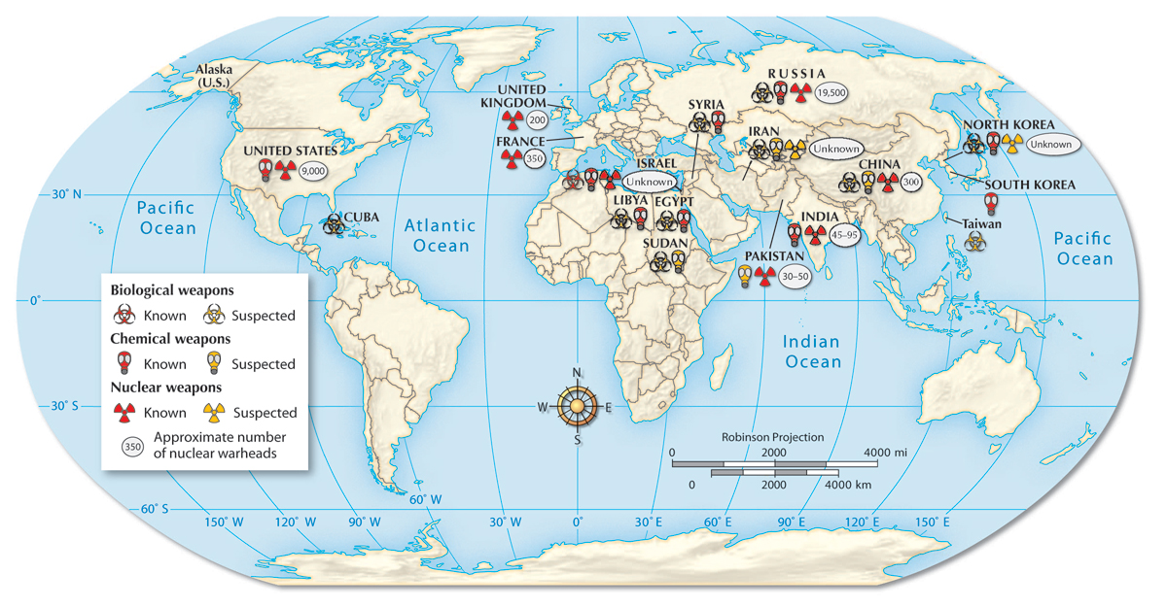
Nuclear, biological, and chemical weapons are located throughout the world.

Slide 17
UN Debate Article
Read the article and answer the questions that follow on a separate sheet of paper.
Question: Should the United Nations still exist? Cite evidence from the article to answer the question.

Slide 18
Einstein Bio Handout
Read the Bio and complete the questions.
Consider the positive and negative effects of Einstein’s work.

Slide 19
Exit Ticket
What are your concerns with WMDs?

Slide 20
Video
WMDs

