Slide 1
Contemporary Global Issues
Chapter 22
Lesson 1
Day 2
Political Challenges in the modern world

Slide 2
Objective
Students will be able to
Explain how UN agencies work to solve problems;
Understand the threat of WMDs and terrorism; and
Describe how the U.S. and other nations have responded to the threat of terrorism.

Slide 3
Starter
What is terrorism?
How does the spread of WMDs change the threat of terrorism?
Notes:
Write on the board student’s responses. As a class try to agree on a definition.

Slide 4
Terrorism
Since the 1990s, the world has seen a growing threat from terrorism – the use of violence by groups of extremists to achieve political goals.

Slide 5
Terrorism
What are terrorists’ goals? To make political demands, such as control of territory or freedom for prisoners, through the use of violence and to try to frighten nations into meeting those demands.
What tactics do they use? Headline-grabbing tactics to draw attention to their demands like suicide bombings, hostage executions, attacks on tourists.

Slide 6
Terrorism
**Terrorist rarely achieve their larger goals.**
They do inflict terrible damage and generate widespread fear.
Question: Why is terrorism so difficult to control?
Notes:
Answer: Terrorists can hide in the general population; they will use extreme measures to achieve their ends.

Slide 7
Terrorism
Consider the following: “Terrorists generally have failed to achieve their greater goals.”
Question: Why do you think terrorists continue their actions? How do they justify these actions?

Slide 8
Regional Terrorist Groups

Slide 9
IRA
Goal – force Britain out of Northern Ireland and unite it with the Irish Republic

Slide 10
ETA
Goal – wants the Spanish government to grant independence to the Basque region in
northern Spain

Slide 11
Shining Path
Goal – create a classless society in Peru

Slide 12
FARC

Slide 13
Al-Qaeda

Slide 14
Conflict in the Middle East has helped fuel terrorism.
The establishment of the state of Israel angered Arabs. Several terrorists groups were formed with the goal of destroying Israel and establishing an independent Palestinian state.
Many Muslims also resented American political, economic, and cultural influence in the region.
Beginning in the 1920s, the West invested in the Middle East oil industry, bringing wealth to the ruling families, where as most citizens remained poor.
Western investment also brought increased contact with the West. Some Muslims feared this contact would weaken their religion and way of life.

Slide 15
Islamic fundamentalism is a conservative movement that wants to revive Islamic values and install governments that follow strict Islamic law.
It is a response to secular governments in Muslim nations, foreign support for Israel, and the presence of foreign powers in the Middle East.
Islamic fundamentalists blame Israel and Western nations for their problems.
Note: most Muslims do not share this vision, do not support terrorism, and many are terror victims.

Slide 16
Osama bin Laden, a wealthy Saudi, founded and led the radical fundamentalist group al Qaeda.
He was determined to expel American business, military, and political influence from Saudi Arabia.
Al Qaeda launched terrorist attacks against two U.S. embassies in Africa in 1998 and an American naval vessel in an Arabian port in 2000.

Slide 17
September 11, 2001
On September 11, 2001, al Qaeda terrorists made a deadly terrorist strike within the United States.
They crashed two hijacked airplanes into the World Trade Center in New York City and another into the Pentagon in Washington.
A fourth plane crashed in a field in Pennsylvania when passengers fought back.

Slide 18
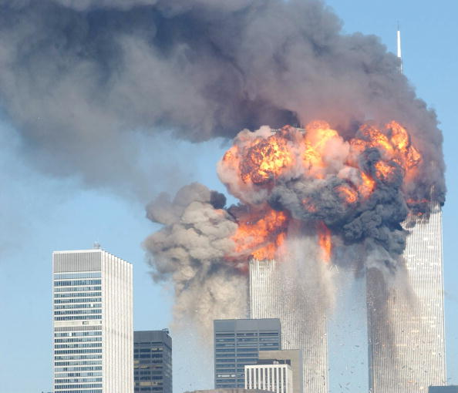
September 11, 2001
More than 2,500 people were murdered on September 11. It was the deadliest terrorist attack ever on American soil.
Notes:
https://www.youtube.com/watch?v=OtZKEjr-Sfg

Slide 19
U.S. Response to 9/11
President George W. Bush declared a “war on terror” after the 2001 attacks.
The United States strengthened its intelligence and security services, and launched an effort to cut off terrorist groups’ funding.
Some thought that antiterrorist measures violated civil rights and gave too much power to the government.
Others argued that the threat of terrorism justified strong measures.

Slide 20
Summary

