Slide 1
Contemporary Global Issues
Chapter 22
Lesson 1
Day 3
Political Challenges in the modern world

Slide 2
Objective
Students will be able to understand the internal threat of ethnic and religious conflicts to our world’s security.

Slide 3
Intro
High tech weapons are a threat to world security b/c of their power to destroy and kill.
Ethnic and religious conflicts are a threat b/c they create a willingness to destroy or kill.
These conflicts have led to suicide bombings, mass killings, and other abuses.

Slide 5
Causes of Ethnic Conflicts in Africa
After Africans gained independence, ethnic conflicts plagued several African nations.
The causes were complex:
Historic resentments divided ethnically diverse nations; and
Unjust government and regional rivalries fed ethnic violence.

Slide 6
Rwanda
Historic resentments and unjust governments fed ethnic violence in several African nations.
Power struggles b/w ethnic groups led to a deadly genocide in Rwanda, a small central African nation.

Slide 7
Rwanda
Hutus were the majority group, but Tutsis dominated the nation.
Tensions worsened b/w the groups until 1994 when Hutu officials urged civilians to murder their Tutsi neighbors.
Rwanda had two rival groups, the Hutus and the Tutsis.
At least 800,000 Tutsis and moderate Hutus were slaughtered. Millions were left homeless. Most of the dead were Tutsis.

Slide 8
Rwanda

Slide 10
Rwanda
With United Nations assistance, Rwanda began to rebuild.
Those responsible for the genocide were tried in the World Court.

Slide 11
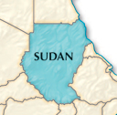
Sudan
In Sudan, Muslim Arabs from the north controlled the government.
They tried to impose Islamic law among non-Muslim groups and discriminated against those in the south, leading to rebellion.
Millions have died or been displaced in the north-south conflict.
In 2005 a ceasefire ended fighting in the south.

Slide 12
Darfur
The situation in Sudan worsened in the western province of Darfur.
Government-backed Arab militias destroyed villages, killed civilians, and terrorized farmers.
The US and other countries sent humanitarian aid. UN peacekeepers were unable to stop the violence.
By 2009, an estimated 300,000 people in Darfur were killed.
An international court charged Sudan’s president with crimes against humanity.

Slide 13
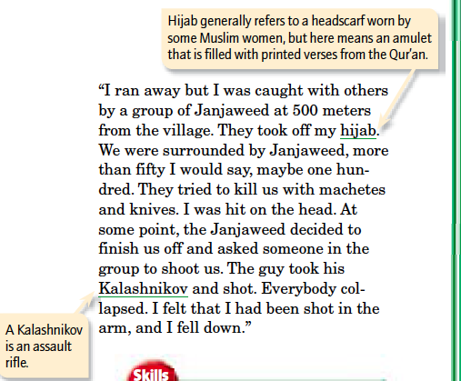
Notes:
Question: 1) What is the speaker describing; 2) According to the speaker, how did his fellow villagers die?

Slide 14
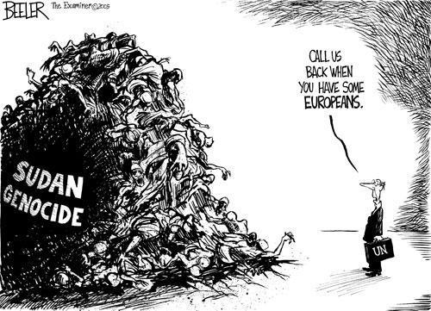

Slide 15
Question
In both Rwanda and the Sudan, the international community hesitated to intervene. Why do you think that was?
What qualities will it take for communities so torn apart by strife (conflict; bitter disagreement) to heal their wounds and live again as neighbors?

Slide 16
Exit Ticket
Identify three threats to the U.S.’s national security and rank them from least threatening to most threatening.

Slide 17
Summary

