Slide 1
The Rise of Dictatorial Regimes
Chapter 15
Lesson 2

Slide 2
Starter
How would you define these two terms in your own words?
Dictator; and
Totalitarian state

Slide 3
Possible Answers
Possible answers:
Dictator—a ruler who has absolute power
Totalitarian state—government aiming to control every aspect of daily life; to control the political, economic, social, intellectual, and cultural lives of citizens
In this lesson, you will learn about the rise of such regimes in the years following WWI.

Slide 4
Objective
Students will be able to
understand fascism; and
explain how fascist Mussolini created a dictatorial state in Italy.

Slide 5
Intro
By 1939, only two major European states remained democratic - Great Britain and France
Italy, the Soviet Union (Russia), and Germany adopted dictatorial regimes.

Slide 6
Totalitarian States
Totalitarianism is a form of government that holds total power over the people, controlling every aspect of daily life.
*The goal of totalitarian regimes was to conquer the minds and hearts of the people. They achieved this goal by using mass propaganda techniques and modern communications.*

Slide 7
Characteristics of Totalitarian States
New totalitarian states were formed in which a one-party dictatorship attempted to control every aspect of the lives of its citizens. Individual freedoms and equality were rejected.
What do you think is expected of citizens in a totalitarian state?
Notes:
Answer: citizens are expected to completely be loyal to their leader and to support the state’s goals.

Slide 8
Italy
Notes:
Questions:
Why do you think King Victor Emmanuel III named Mussolini prime minister? (Mussolini was very popular. No naming him might have led to a revolt)
How were Mussolini and Hitler alike? (Both dictators; fascists)

Slide 9
Rise of Fascism in Europe
Fascism glorifies the state above the individual by emphasizing a strong central government led by a dictator; is rooted in extreme nationalism; believes in militarism, discipline, and blind loyalty to the state
Fascism v. Communism
Led by dictator Mussolini, Italy became the first fascist state in Europe.
Notes:
Fascism is rooted in extreme nationalism. Fascists believe in action, violence, discipline, and blind loyalty to the state. They praise warfare. They are antidemocratic, rejecting equality and liberty. Fascists are nationalists who support a society with defined classes.

Slide 10
After World War I, Italian nationalists were outraged when Italy received just some of the territories promised by the Allies. Chaos ensued as peasants seized land, workers went on strike, veterans faced unemployment, trade declined, and taxes rose.
To gain popular support for his cause, Mussolini appealed to Italian anger over the peace treaty not giving more land to Italy. He later became dictator.

Slide 11
Mussolini Control
Mussolini used his secret police to control the general population. He suppressed rivals, muzzled the press, and replaced elected officials with Fascists, and rigged elections. His critics were jailed, forced into exile, or murdered.
Youth groups indoctrinated children into the fascist ideology.
On the other hand, Mussolini maintained traditional attitudes toward the family and the Catholic Church. Women were expected to focus on motherhood and homemaking.

Slide 12
Mussolini Control
He spread propaganda through the use of mass media, including newspapers and radio. (slogan: “Mussolini is Always Right;” “Believe! Obey! Fight!”)
These slogans were blasted on loudspeakers and placed on posters.

Slide 13
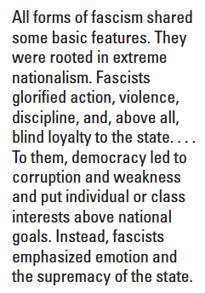
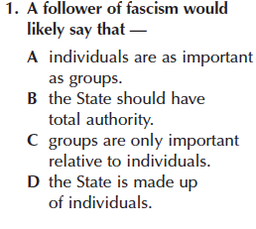
Quick Assessment on Fascism
Question

Slide 14
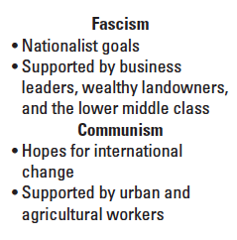
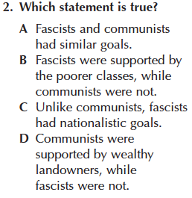
Quick Assessment on Fascism
Excerpt
Question

Slide 15
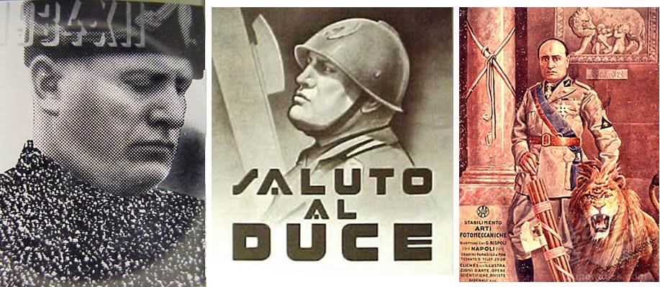
Propaganda
Notes:
The one on the left uses a crowd of hundreds to create the half-tone “dots” of Il Duce ’s body. This technique elevated the dictator to a God like status as Mussolini looks down at the crowd.

Slide 16
Worksheet
Visual Literacy Activity:
What is the significance of the engraving of Romulus and Remus in the background and the fasces in the foreground? What other symbols do you notice? What did the creators of this poster want the Italian people to think about Mussolini?
Review the key tools of propaganda mentioned in the first paragraph. Which of these tools did the creators of this poster use?
What might be some advantages of presenting propaganda in a visual form, such as posters and film? What media today might be most effective in spreading propaganda to the greatest number of people?

Slide 17
Video
Mussolini Speech

Slide 18
Exit Ticket
Question: Benito Mussolini’s political philosophy of ______ glorifies the _______ above the _______ and emphasizes the need for a strong central government.
Notes:
Answer: fascism; state; individual

