Slide 1
The Rise of Dictatorial Regimes
Chapter 15
Lesson 2 (day 2)

Slide 2
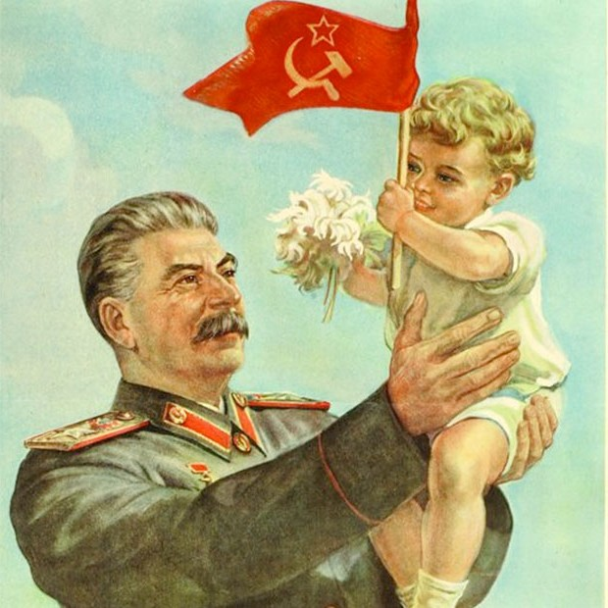
Starter
Notes:
Give me some adjectives describing the leader in this image?
Can you identify him? The country he leads?

Slide 3
Objective
Students will be able to explain how the Soviet Union was created and how Stalin gained power and maintained power there.

Slide 4
From Russia to the USSR
Beginning in 1920, a drought in Russia led to famine and agricultural collapse, which led to industrial collapse. Hoarding of food added to the crisis. Peasants would chant, “Down with Lenin and horse flesh, bring back the czar and pork”
Vladimir Lenin was forced to move away from war communism and adopt the capitalist New Economic Policy (NEP) to avert a complete economic disaster. Peasants were allowed to sell their crops, and some people were allowed to own their own small businesses.

Slide 5
The Soviet Union
Along with the NEP, the end of the drought brought economic recovery. Harvests improved. In 1922, Lenin renamed Russia the Union of Soviet Socialist Republics (USSR), or Soviet Union.
Lenin died in 1924, and a struggle for power in the Soviet Union began.

Slide 6
Worksheet
Worksheet: Lenin’s New Economic Policy
Write down the economic terms/definition.
Questions:
1) Why did Lenin implement the New Economic Policy
(NEP)?
2) Why were so many Communist Party members against the NEP?

Slide 7
Background
Lenin's death in 1924 led to a power struggle between Joseph Stalin and War Commissar Leon Trotsky. Trotsky wanted to end the NEP and focus on industrialization as well as worldwide communist revolution. Stalin used his post as general secretary of the Communist Party to gain complete control of the party, appointing officials who supported him, and removing or killing those who disagreed with him.
Stalin removed from government the Bolsheviks of the revolutionary era and created a rigid dictatorship. He shifted economic policy in 1928, ending the NEP and launching the first of several Five-Year Plans to promote industrialization.

Slide 8
Costs of Stalin’s Programs
Stalin focused on rapid industrialization. With that came horrible living conditions for millions of workers and families.
He also focused on rapid collectivization of agriculture (a system in which private farms were eliminated). Government owned the land and the peasants had to work it.
Famine occurred in 1932, resulting in around 10 million peasants dying.

Slide 9
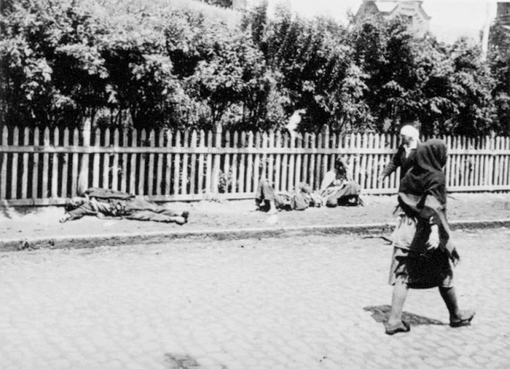
Notes:
Peasants lying off the street.

Slide 10
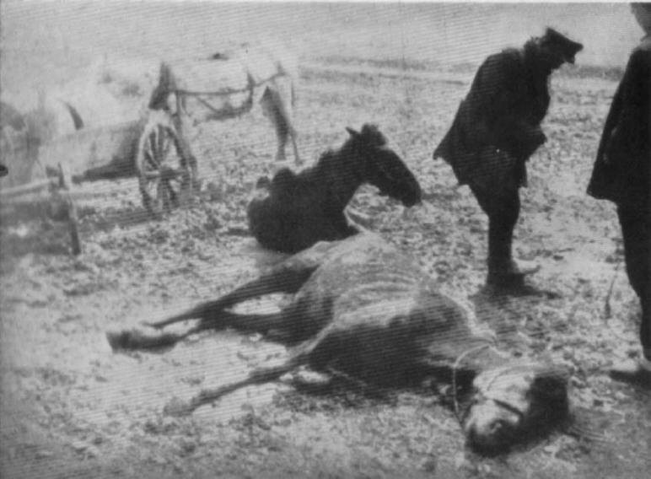

Slide 11
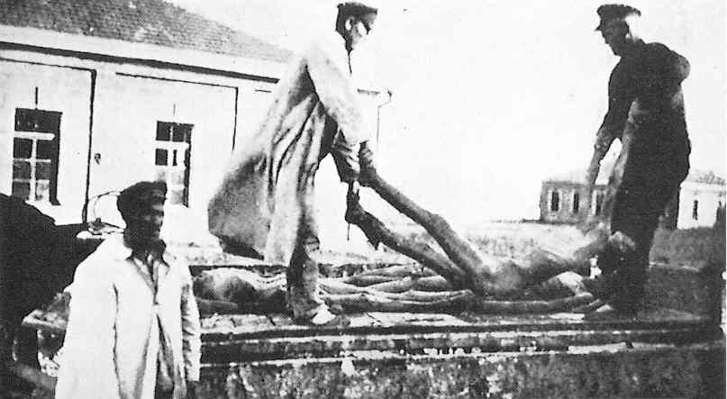

Slide 12
Purges
Stalin used secret police, torture, and bloody purges to force people to obey. Those who opposed Stalin were rounded up and sent to the Gulag, a system of brutal labor camps, in Siberia.
Fearing that rival party leaders were plotting against him, Stalin launched the Great Purge in 1934. Among the victims of this and other purges were some of the brightest and most talented people in the country.
About 8 million people were arrested. Millions were sent to forced labor camps in Siberia and never returned. Many others were executed.

Slide 13
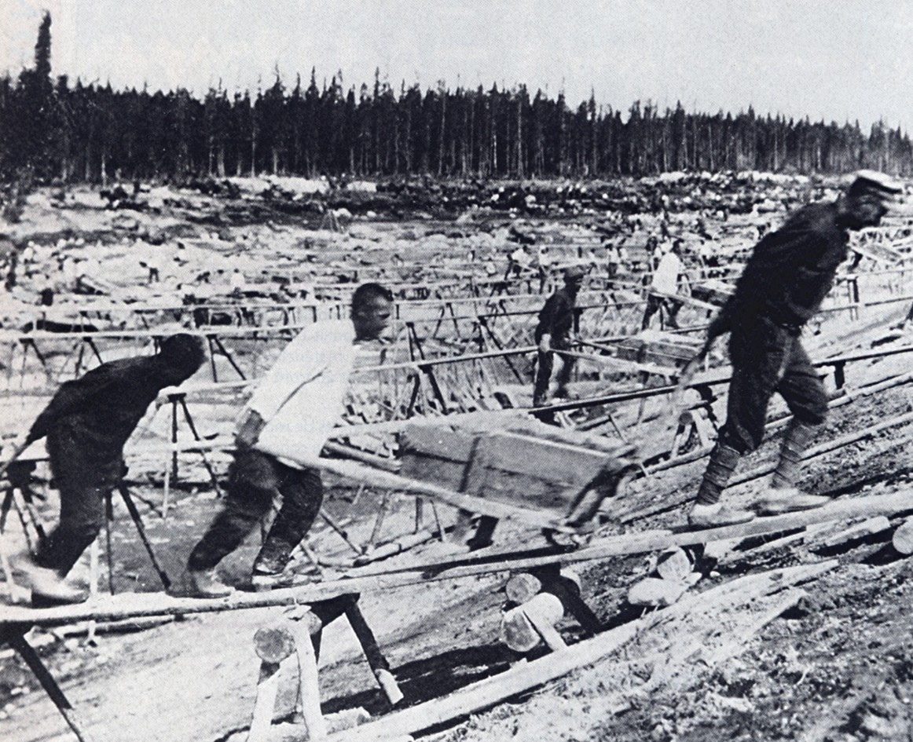

Slide 14
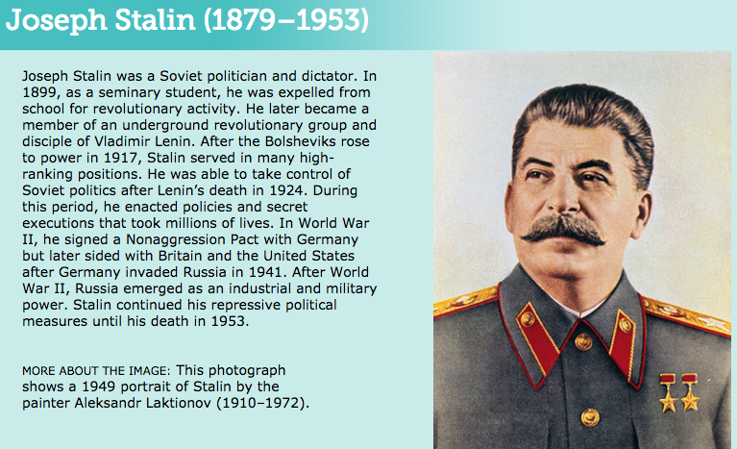
Bio

Slide 15
Stalin
Questions:
Describe Stalin’s leadership style?
How did Stalin cause millions of deaths during his time as dictator?
Notes:
1) (Joseph Stalin was a powerful but fearsome dictator. He used fear and repression to eliminate rivals and maintain his power).
2) (He enacted destructive policies and ordered secret executions).

Slide 16
Video
Stalin Purges
Second Video (mini-bio on Stalin)

Slide 17
Exit Ticket
Describe in one sentence who came to power in Russia after Lenin died and how did he rule his country.

