Slide 1
Hitler and Nazi Germany
Chapter 15
Lesson 3
Day 1

Slide 2
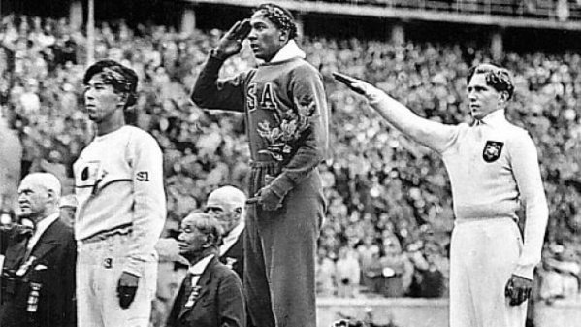
Starter

Slide 3
Starter
Notes:
A non-German (Owens) defeats a German.

Slide 4
Objective
Students will be able to
Explain how Hitler came to power in Germany; and
Explain how he was able to carry out his policies.

Slide 5
Question
What impressions or words come to mind when you hear the name Adolf Hitler?

Slide 6
Mini Bio Hitler
Mini BIO Hitler

Slide 7
Vocab
Nazi: shortened form of the National Socialist German Workers’ Party; a member of such party
Concentration Camp: a camp where prisoners of war, political prisoners, or members of minority groups are confined, typically under harsh conditions

Slide 8
Group Questions (305-306)
1. What was at the core of Hitler’s ideas?
2. What theory did Hitler emphasize in Mein Kampf?
3. How did the economic climate in Germany help the Nazis rise to power? When did this occur?
4. What year was the Enabling Act passed? How did it give Hitler control of Germany?
5. What did the Nazis do with their new power?
Notes:
Answer in the Answer Key p.

Slide 9
Answers
Racism, especially anti-Semitism, coupled with extreme nationalism, supported by anticommunism and Social Darwinism.
The right of superior nations to overtake lesser ones and the right of superior individuals to gain authoritarian leadership over masses.
Unemployment had increased dramatically between 1931 and 1932, increasing German dissatisfaction with the Weimar Republic. This occurred in 1933.
1933; It suspended the constitution so that Hitler no longer needed the Reichstag or the president to approve his actions.
Political parties other than the Nazi Party were abolished, and all Jews were removed from civil service. The Nazis set up concentration camps for people who opposed them.

Slide 10
Group Worksheet Questions
1. What happened to most workers’ real earnings after factories were closed? How did hyperinflation affect Germany’s economy after World War I?
2. How did Hitler use the economic climate to fuel racism, nationalism, and the rise of the Nazi state?
Economic Worksheet
Notes:
Answer: 1. The German government paid idle workers in rapidly inflating currency, which caused the workers’ real earnings to plummet to nothing. Germany already was financially ruined by war debt and war reparations; hyperinflation added yet another economic difficulty to the struggling nation.
2. Hitler appealed to the natural tendency of people to blame others for their economic troubles. By blaming the Jews, the Germans were able to feel superior, thus fueling racism and nationalism and allowing the Nazi state to gain power.

Slide 11
The Rise of Adolf Hitler
• Born in Austria in 1889
• In 1919, joined German Workers’ Party, later renamed National Socialist German Workers’ (Nazi) Party
• He was an extreme nationalist
• He promoted racism and bigotry
o Blamed Jews for Germany's defeat in World War I and its economic troubles
• In November 1923 staged armed uprising (Beer Hall Putsch) and was sentenced to prison; wrote Mein Kampf there which outlined his basic philosophy and ideas.

Slide 12
The Rise of Adolf Hitler
• After release from prison, expanded Nazi Party so that it could compete for votes
• Decline of German government leaders’ popularity in late 1920s and early 1930s due to economic problems (unemployment)
• Popularity of Hitler’s nationalist appeals, leading to Nazis’ becoming largest party in German parliament in 1932

Slide 13
Hitler’s Ideas
Racism, especially anti-Semitism, coupled with extreme nationalism, supported by anticommunism and Social Darwinism were at the core of Hitler’s ideas.
He also believed in the right of superior nations to overtake lesser ones and the right of superior individuals to gain authoritarian leadership over masses.

Slide 14
Rise of Nazism
Realizing that the Nazi Party would have to gain power by legal means, Hitler expanded it into a mass national party, attracting Germans who were disaffected by Germany's economic problems and were attracted by the Nazis' nationalism and militarism.
Hitler then gets appointed chancellor of Germany in 1933

Slide 15
The Nazis Take Control
After President Hindenburg allowed Hitler to become chancellor, the Nazi-dominated Reichstag passed the Enabling Act, legally allowing Hitler the power to ignore the German constitution for four years while he passed laws to deal with the country’s problems.

Slide 16
The Nazis Take Control
The Enabling Act made Hitler a dictator, and the Nazis quickly took control of all German institutions. Hitler purged the civil service of democratic elements and of Jews. He also abolished all political parties excepts the Nazi party and set up concentration camps for people who opposed him.
When Hindenburg died, Hitler became the sole ruler of Germany—the Führer.

Slide 17
Question
How did the Enabling Act contribute to Hitler’s rise to power?
Notes:
Answer: Gave the government the power to ignore the Constitution and HItler a legal basis for his later actions.

Slide 18
Hitler
Notes:
Germany needed to unite all Germans under one government – the Reich. This should be accomplished by force – the “sword.”

Slide 19
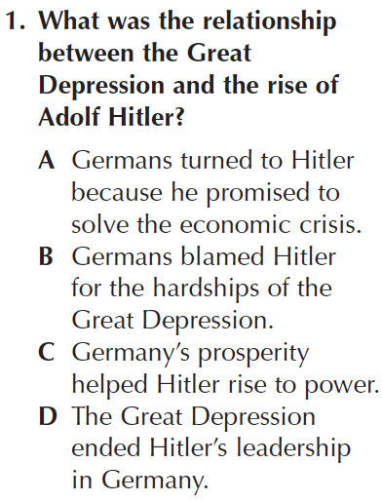
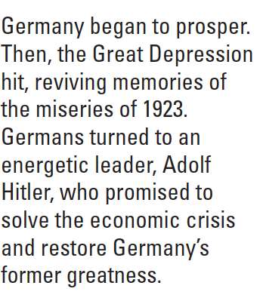
Quick Assessment
Notes:
Answer: A

