Slide 1
Hitler and Nazi Germany
Chapter 15
Lesson 3
Day 2
The nazi state

Slide 2
Objective
Students will be able to describe the Nazi state that developed under Hitler’s rule

Slide 3
Vocab
Aryan: term used to identify people speaking Indo-European languages; Nazis misused the term treating it as a racial designation and identifying the Aryans with the ancient Greeks and Romans and the 20th century Germans.

Slide 4
Group Questions
Hitler wanted to develop a ________ state.
How did Hitler manipulate the term “Aryan” for Nazi purposes?
How did Hitler use economic programs and the Schutzstaffeln (“SS”) to strengthen the Nazis’ power in Germany?
What were the Nuremberg laws?
What was Kristallnacht?
How did the Nazis promote their ideas?

Slide 5
Answers
Totalitarian
The Nazis misused the term to identify the Aryans with the ancient Greeks and Romans and twentieth-century Germans and Scandinavians.
The Schutzstaffeln, or secret police, were used to maintain order through terror. A massive rearmament program led to a drastic reduction in unemployment between 1932 and 1937, which induced people to accept Nazi power.

Slide 6
Answers
4. These racial laws excluded Jews from citizenship, stripped them of civil rights, and required them to wear yellow stars and carry cards saying they were Jewish. Jews were forbidden to marry German citizens.
5. Kristallnacht (or, the “night of shattered glass”) marked the beginning of a violent phase of anti-Semitism in which Jewish synagogues and businesses were destroyed, and 30,000 Jewish males were sent to concentration camps. Following this, Jews were barred from public buildings and transportation and prohibited from owning, managing, or working in any retail store. They were encouraged to emigrate from Germany.

Slide 7
Answers
6. They promoted the Nazi message through mass demonstrations, live spectacles, and the new mass media of radio and film.

Slide 8
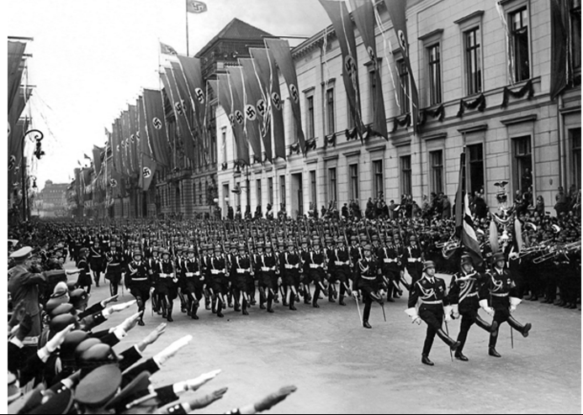
SS
Notes:
The SS (abbreviation for Schutzstaffel, or Guard Squadron) was an elite security force in Nazi Germany. Originally a group of bodyguards for Adolf Hitler, the organization grew to 250,000 men by 1939. Divisions of the SS included military troops, secret police, and administrators of concentration camps. Heinrich Himmler was the leader of the SS and ran it with ruthless efficiency.

Slide 9
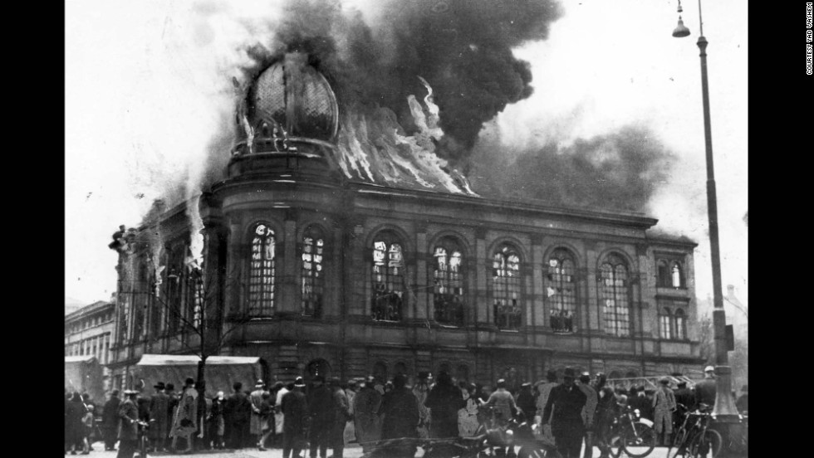
Night of Broken Glass

Slide 10
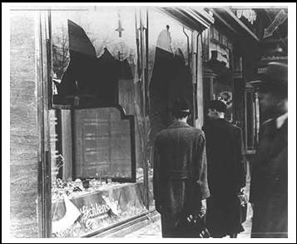

Slide 11
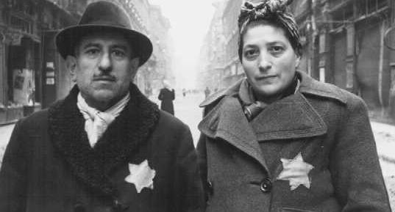
Yellow Star
Notes:
The Yellow Stars of David symbolized what? (They were Jews)

Slide 12
Primary Source (by Reinhard Heydrich to all State police offices)
“Regards: Measures against Jews tonight. . . . Only such measures may be taken which do not jeopardize German life or property (for instance, burning of synagogues; only if there is no danger of fires for the neighborhoods). Business establishments and homes of Jews may be destroyed but not looted. . . .In business streets special care is to be taken that non-Jewish establishments will be safeguarded at all cost against damage. . . .As soon as the events of this night permit the use of the designated officers, as many Jews, particularly wealthy ones, as the local jails will hold, are to be arrested in all districts.”
Notes:
What is being authorized here?
Which Jews were to be arrested?
Why would the Nazis want the richest Jews arrested first?

Slide 13
Media
How do you think the Nazi control of media such as radio and film helped keep the regime in power?
Notes:
Nazi medial control bombarded viewers and listeners with imagery and programs that pushed the Nazi ideology. Nothing presented alternative viewpoints.

Slide 14
Exit Ticket
Write one sentence answering the following: How did Hitler build a Nazi state?
Notes:
He used economic policy, mass spectacle, propaganda, and terror to build the Nazi state.

Slide 15
