Slide 1
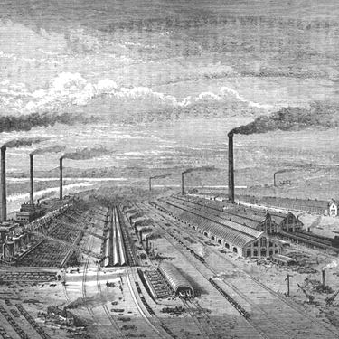
Industrialization and Nationalism
Chapter 10
Lesson 1

Slide 2
Objective
To understand the causes of the industrial revolution and its effects.
Question: What was the significance of the Agricultural Revolution in Great Britain? Why did the Industrial Revolution start in Great Britain?

Slide 3
Bellringer
Dickens’ Hard Times excerpt
Notes:
One way of approaching a historical period is through its literature. What do y’all know about Charles Dickens? (Students will probably be aware that Dickens was a British author who wrote popular fiction such as A Christmas Carol, Oliver Twist, and A Tale of Two Cities.)
Explain that Dickens's fiction frequently deals with the problems of the poor, the working class, and abused children.
Explain that this passage is from Dickens's novel Hard Times, which was first published in 1854. Read the passage aloud; have volunteers give their answers and explain their reasoning. Wrap up this activity by asking students “how they would characterize Dickens's view of the Industrial Revolution.” (Students will probably feel that Dickens would look upon the Industrial Revolution as a great danger to society.

Slide 4
Europe: 1800 - 1870

Slide 6
Industrial Revolution in Great Britain
Notes:
What is the first thing you notice about this picture? Give me some adjectives to describe this image? What do you think is going on in these buildings? Do you think this is a healthy environment? Contrast this with agricultural, agrarian life.

Slide 7
Industrial Revolution
**Began in Great Britain in 1780s**
Five factors contributed to making Great Britain the starting place.

Slide 8
Five Factors
1) Agricultural Innovations: good weather, improved transportation, new crops such as the potato all increased the food supply thereby allowing increasing the population
2) Population Growth: with population growth, England had a larger labor force to work the factories; also, **Parliament passed enclosure laws allowing landowners to fence off land forcing peasants to move to town to find work.
Notes:
**Draft the five factors on a circle chart on board.

Slide 9
3) Capital (money available for investment): Britain had money to invest in new machines and factories;
4) Natural Resources: country’s rivers provided power to factories; abundance of coal and iron ore;
5) Market access: Britain was an empire with colonies; they had a demand both abroad and at home for manufactured goods.

Slide 10
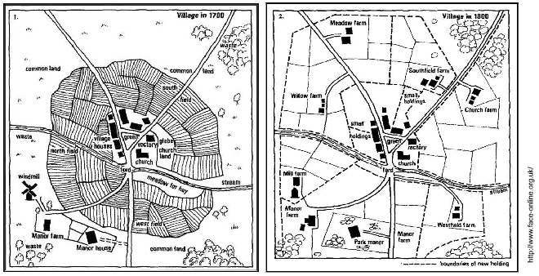
Enclosure Movement of the 1700s
Enclosure laws allowed landowners to fence off land formerly used as common pasture. The map on the left shows a British farming area in 1700; the shaded areas are common pastures. The map on the right shows the same area in 1800, with the common pastures eliminated by fences.
Notes:
How would a lack of access to common lands have changed the way farmers lived?
Students might state that without common pasturage, farmers could use only their own scattered plots for raising livestock. This would reduce the amount of land they had available for raising crops.

Slide 11
Enclosure Movement of the 1700s
Effects of enclosure laws:
• Landowners fence in common lands.
• Peasants move to towns to find work.
• Factories benefit from new labor supply.
• Remaining farms are larger, with increased crop yields.
Notes:
What choices do farmers have?

Slide 12
Cotton Production and New Factories
Before the IR, making cotton cloth was usually done in rural cottages.
Fast forward to 1780s, weaving cloth was done in factories near rivers and streams, then moved to cotton mills powered by the steam engine.
The steam engine, invented by James Watt, was a key component to the Industrial Revolution.

Slide 13
The Factory
The factory became a new concept during the IR.
It created a new labor system; work was around the clock; it was monotonous and rote; child labor was used.

Slide 14
Coal, Iron, and Railroads
**The steam engine relied on coal for power, which aided in the transformation of the iron industry.
**Puddling was developed; high-quality iron industry expanded, creating new machines.
**First steam locomotive was invented to move goods.

Slide 15
Inventions of the Industrial Revolution
• Puddling
o Produced bar iron without hammering
o Faster production of high quality iron
• Steam engine
o Transformed transportation and agriculture
o With James Watt’s improvements, enabled to drive machinery

Slide 16
Notes:
The Rocket locomotive; went 16 miles an hour.

Slide 17
Circle Chart

Slide 18
Question
Why did the Industrial Revolution start in Great Britain?
Notes:
Answer:

Slide 19
Review
1. The Agricultural Revolution increased the ________ supply, lowered ________ , and allowed ordinary people to spend money on manufactured goods.
2. Inventions such as the _________ helped increase ________ cloth production dramatically, causing it to become Britain’s most valuable product by 1840.
3. Coal and _______ industries boomed, and steam _______ helped move goods faster and cheaper.
Notes:
food; prices
Steam engine; cotton
Iron; locomotives

Slide 20
Video
Industrial Revolution

Slide 21
Guiding Question
What factors fed the spread of industrialization in both Europe and North America.?

Slide 22
Spread first to countries whose governments were ready for it: Belgium, France, Germany
Spread in America once population moved to cities from farms
Railway system was key factor in both Europe and United States

Slide 23
The Spread of Industrialization
By mid 1800s, Great Britain became the world’s first industrial nation; it also became the richest.
The Industrial Revolution spread to America. In 1800, 5 million people lived in the U.S. with 6 out 7 being farmers. By 1860, 30 million people lived in the U.S. and half were farmers.

Slide 24
U.S. Railroad
With the U.S. being such a large country, it had to develop a railroad system to move the manufactured goods, which it did.

Slide 25
Social Impact of Industrialization
Urbanization: famine and poverty were the two big factors that forced people to migrate from the countryside into cities to work in factories.
The rapid growth of cities led to pitiful living conditions.

Slide 26
London 1850
The London-road district, being the name given to that portion of the town under my direction, contains a population of about 30,000. It is bounded upon one side throughout its whole course (say the distance of a mile and a half) by the river Medlock, a black filthy ditch, into which the inhabitants upon its borders or the various manufactories in its course, consisting of dye and chemical works, pour all their superabundant filth. Innumerable privies, connected with the back of long terrace ranges of private dwellings, empty themselves into the same source; in fact, it is the eliminating channel for all who can reach its banks to pour off every nuisance, liquid or solid. The opposing side of the district is bounded by the Rochdale Canal, nearly throughout the same extent.
Notes:
How would you describe this district in London. Is it clean? Would you want to live there?

Slide 27
Social Classes
Industrial capitalism, an economic system based on industrial production or manufacturing, rose during the IR.
**This system produced a new middle-class group – the industrial middle class.
**The IR also created the industrial working class that faced terrible working conditions.

Slide 28
Conditions
Workday was around 12 – 16 hours; worked 6 days a week.
No security of employment and no minimum wage.
Men, women, and children all worked in factories, cotton mills, and coal mines.

Slide 33
Child labor description

Slide 36
Review
What country was the world’s first industrialized nation?
Why did so many people leave rural areas (in Great Britain) and move to cities during the industrial revolution?
What was this concept called where people migrated from rural town into the urban cities?
Notes:
Great Britain;
Students should mention that there were not enough jobs (also famine) in rural areas to support the growing population;
Urbanization

Slide 37
Objective
Students will be able to describe the working conditions of workers in the factory system.
Students will understand socialism and how the working conditions gave rise to the socialist movement.

Slide 38
Factory Act of 1833
Passed in Britain in 1833.
**This Act was the first attempt at limiting child labor.
It stated: no child workers under nine years of age; children of 9-13 years to work no more than nine hours a day; children of 13-18 years to work no more than 12 hours a day; children are not to work at night; two hours schooling each day for children

Slide 39
Excerpt from a Factory Inspector Report (1836)
My Lord, in the case of Taylor, Ibbotson & Co. I took the evidence from the mouths of the boys themselves. They stated to me that they commenced working on Friday morning, the 27th of May last, at six A.M., and that, with the exception of meal hours and one hour at midnight extra, they did not cease working till four o'clock on Saturday evening, having been two days and a night thus engaged. Believing the case scarcely possible, I asked every boy the same questions, and from each received the same answers. I then went into the house to look at the time book, and in the presence of one of the masters, referred to the cruelty of the case, and stated that I should certainly punish it with all the severity in my power. Mr. Rayner, the certificating surgeon of Bastile, was with me at the time.
Notes:
What is this author describing in his factory inspector report? Give me the claim (do not use the word because in the claim); give me the citation; give me the clarification.
Example: In his report, the author is describing children working long hours in the factory. According to the report, children worked continuously for two days. Given this evidence, children labored for long hours in the factory.

Slide 40
Socialism
The terrible working conditions created by the industrial revolution led to socialism, a system in which society usually in the form of the government, owns and controls means of production.
Socialism Video

Slide 41
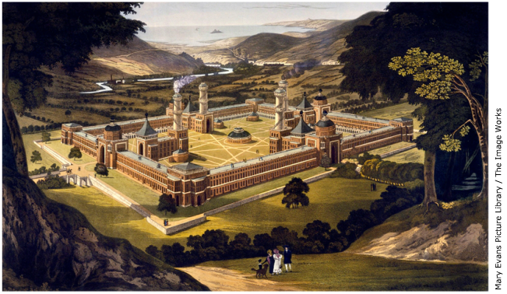
Early Socialist Utopia
Proposed design for Robert Ower's utopian community at New Harmony, Indiana
Notes:
New Harmony would later fail; most people refused to work.

Slide 42
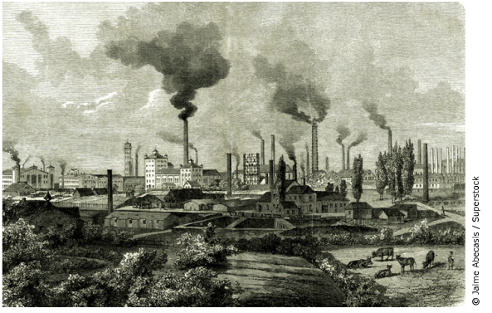
Early Socialist Utopia
Krupp factory in Essen, Germany

Slide 43
Early Socialist Utopia
What ideals were the early socialists striving for?
• Wealth could be distributed evenly if government controlled factory production.
• Everyone’s basic needs—food, shelter, clothing—would be met.
• Workers would be fulfilled by using their skills.

Slide 44
Review
Most important to the development of an effective American transportation system was the ______ .
The Industrial Revolution spurred __________ , as people left the countryside in search of work.
Two new social classes emerged during the Industrial Revolution: an industrial ________ class and an industrial _________ class that faced wretched working and living conditions.
The Factory Act of 1833 limited _____ labor.
In the economic system of _______ , the government controls the means of_______ , like utilities and factories.
Notes:
Railroad; urbanization; middle and working; socialism and production
Question 2 vocab sheet: Industrial capitalism, an economic system based on industrial production, made some people rich but created a working class that suffered horrible working conditions: long hours, low wages, no job security, and often dangerous and unhealthy conditions. Socialism was a reform movement that responded to the abuses of the capitalist system by suggesting that the government should own and control society’s means of production, resulting in a fairer distribution of wealth.

Slide 46
Crash Course
Industrial Revolution

Slide 47
Industrial Revolution Worksheet
Worksheet

