Slide 1
World War I and the Russian Revolution
Chapter 14
Lesson 1

Slide 2
Bellringer
Notes:
Question: What might happen if a member of one alliance went to war with a member of the other alliance?
Answer: If a member of one alliance went to war against a member of the other alliance, all six countries could become involved in a war.

Slide 3
Objective
Students will be able to identify the factors that contributed to the start of WWI.

Slide 4
Video
WWI Causes

Slide 5
Vocabulary
Conscription: military draft.
Mobilization: the process of assembling troops and supplies and making them ready for war.

Slide 6
**Factors Leading to World War I**
Imperialism;
Nationalism;
Militarism (the aggressive preparation for war); and
Alliances.

Slide 7
*Imperialism
European powers competed for decades over land in Africa and Asia.
- This lead to increased competition, suspicion, and aggravated existing rivalries among European states.

Slide 8
*Nationalism
Each European nation-state was determined to advance its own interests, even by means of war.
Ethnic groups without their own national states wanted independence (e.g., Poles in the Russian Empire; Slavic minorities in the Balkans).

Slide 9
*Militarism
Industrialization spurred the mass production of weapons that could kill at faster rates, and from longer distances, than ever before.
National pride among the “Great Powers” of Europe started an unofficial competition among government to see who could produce the best weapons.
Conscription was established as a a regular practice.

Slide 10
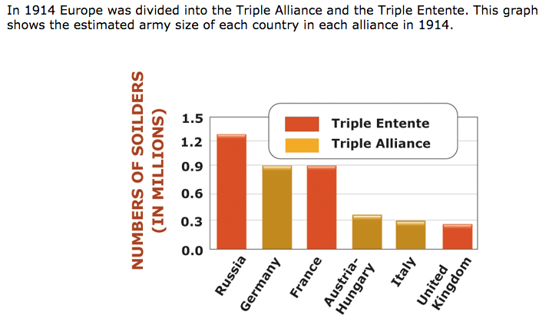
Militarism

Slide 11
*Alliances
The Great Powers of Europe formed two alliances: the Triple Entente and the Triple Alliance.

Slide 12
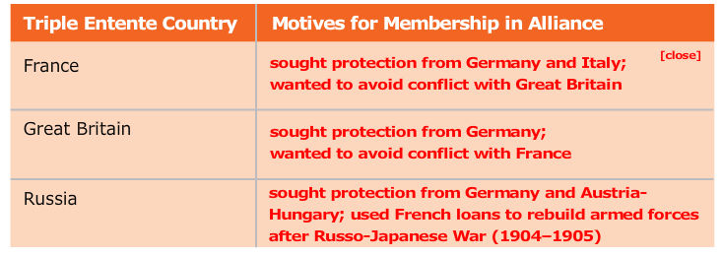
Triple Entente

Slide 13
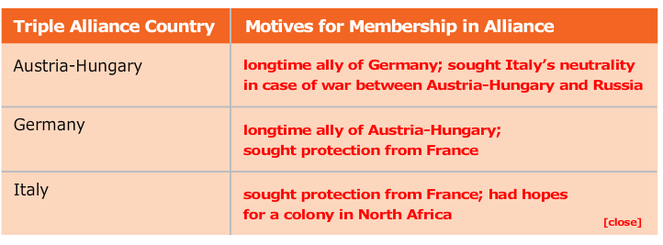
Triple Alliance

Slide 14
Questions (Group)
Main Idea: Nationalism, alliances, imperialism, and militarism, contributed to the start of World War I.
1. What nations formed the Triple Alliance and the Triple Entente?
2. What did the Irish, the Poles, and Slavic minorities in the Balkans and Austria-Hungary have in common?
3. How did industrialization contribute to militarism in Europe?
4. How did European imperialism contribute to the start of World War I?

Slide 15
Answers
A.1. Germany, Austria-Hungary, and Italy formed the Triple Alliance. France, Great Britain, and Russia created the Triple Entente.
A.2. They were ethnic groups that did not have states of their own.
A.3. Industrialization led to new methods of shipbuilding, use of iron, steel, and chemicals for weapons, and the growth of mass armies in Europe.
A.4. Competition for colonies led to conflict among European rivals.

