Slide 1
World War I Begins
Chapter 14
Lesson 1 (Day 2)

Slide 2
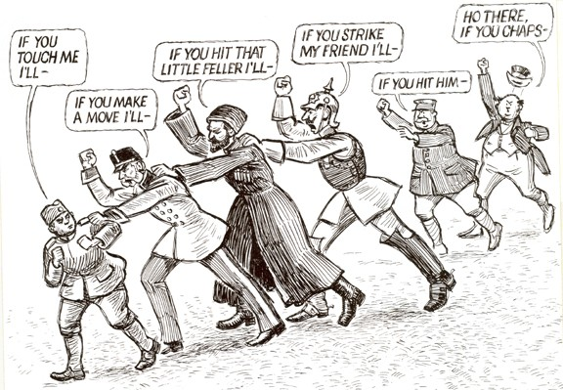
Bellringer
Notes:
What do you think the people in this cartoon represent? What emotions are represented in the cartoon? What is the message of the cartoon?

Slide 3
Objective
Students will be able to explain how the assassination of Archduke Ferdinand in Sarajevo sparked the outbreak of WWI.

Slide 4
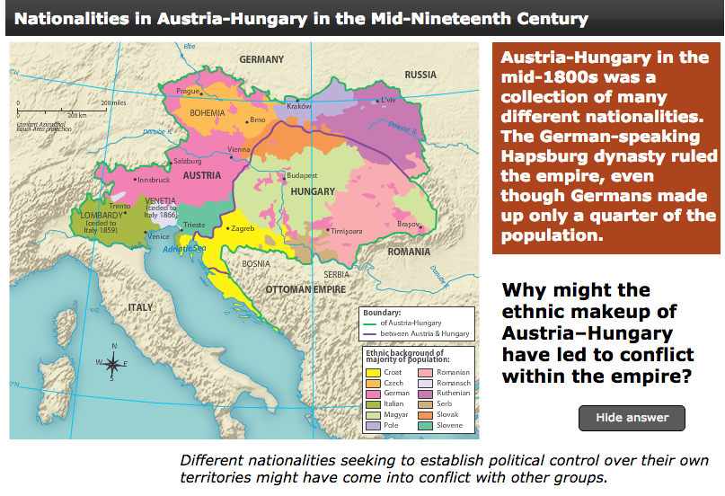
The Outbreak of War

Slide 5
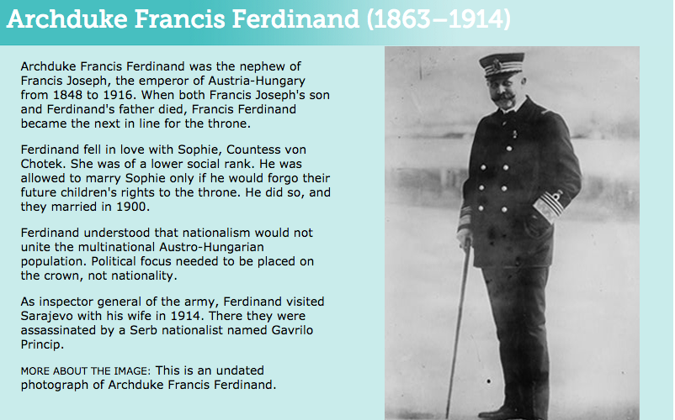
The Outbreak of War
Notes:
Why did Ferdinand oppose nationalism when most of Europe embraced it? Answer: Austria-Hungary was a country made up of citizens of various nationalities. Nationalism did not work there because Austria-Hungary was not a nationstate. In fact, Ferdinand knew that it would result in internal dissent if one nationality was given preference over another.
Why would a Serb nationalist want to assassinate Ferdinand? Answer: Because Ferdinand was against nationalism and wanted to maintain Austro-Hungarian control of its Serbian population, a Serb nationalist would consider Ferdinand an enemy.

Slide 6
The Outbreak of War
**The event that sparked WWI was the assassination of the future emperor of Austria-Hungary, Archduke Francis Ferdinand, in Sarajevo (in Bosnia).**
This setoff a chain reaction whereby the prewar alliances realigned into slightly different groups against one another, specifically the Allies (England, France, Russia, and Italy) and the Central Powers (Germany, Austria-Hungary, and the Ottoman Empire)

Slide 7
Question
What do you think the assassin hoped to achieve by killing the archduke?
Notes:
Answer: he hoped to attract attention to the cause of Serbian nationalism.

Slide 8
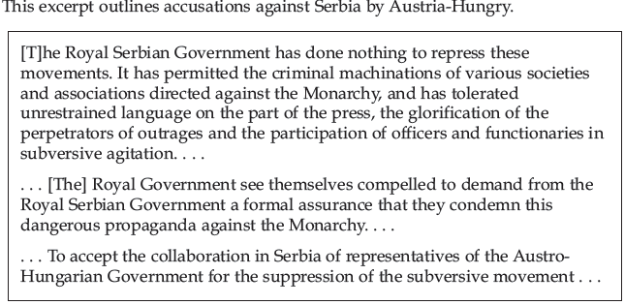
Excerpt
Notes:
Question: What accusations did Austria-Hungary make against Serbia?
Question: What two demands did Austria-Hungary make on Serbia?
Answer: the Austrian ultimatum accused Serbia of doing nothing to control groups that were criticizing and acting against the Austrian monarchy. The Austrian government demanded that the Serbian government condemn the propaganda against Austria and work with the Austro-Hungarian government to investigate and suppress the “subversive” groups in Serbia.

Slide 9
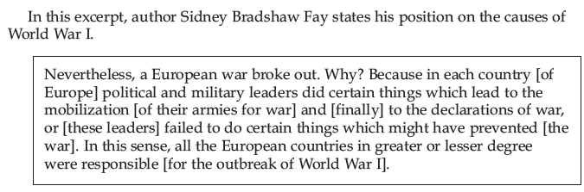
Excerpt
Notes:
Question: According to the author, who was responsible for the outbreak of WWI? What did he cite as evidence to support his claim?

Slide 10
Answer

Slide 11
Mobilization
After the assignation in 1914:
Austria-Hungary declared war on Serbia;
Russia supported Serbia and mobilized its military;
Germany then declares war on Russia and France (activating the Schlieffen Plan, whereby the German army would rapidly invade France)
Great Britain then declares war on Germany once Germany sends troops through neutral Belgium to invade France.

Slide 12
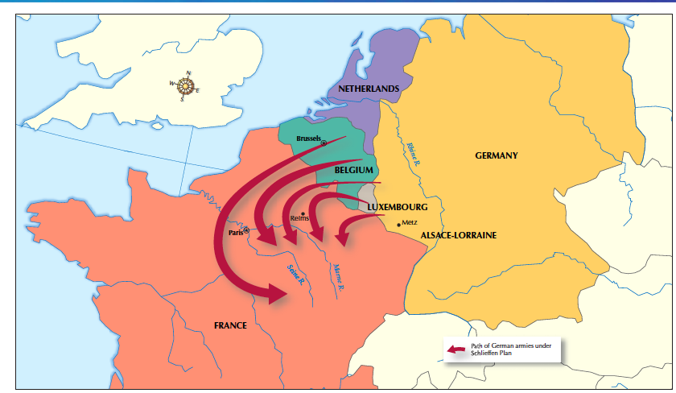
Germany’s Schlieffen Plan

Slide 13
Question
What role did the system of alliances play in transforming a fight for independence (Serbs from Austria-Hungary) into a world war?

Slide 14
Answer
The commitments of the alliances assured that other countries would become involved in the conflict.

Slide 15
Group Worksheet
Section Summary Worksheet

