Slide 1
The Russian Revolution
Chapter 14, Lesson 3

Slide 2
Bellringer
Notes:
Answer: That Russians wanted the war to end and wanted land to farm and food to eat.
What does this slogan indicate about Russia at the time: It indicates that there was great hardship and discontent; it implies that people were tired of war, were poor and hungry, and wanted reform.

Slide 3
Objective
Students will be able to:
describe the goals of Lenin and the Bolsheviks in the November revolution; and
understand how the Communists defeated their opponents in Russia’s civil war.

Slide 4
Background to Revolution
The Russian czar faced internal problems while conducting WWI.
The Russian military lacked competent military leaders and adequate weapons for the war.
Russia experienced high casualties during the war (2 million killed and 4-6 million wounded).

Slide 5
Background to Revolution
What events caused the czar to step down?
March 1917 revolution
• 10,000 women strike in response to bread rationing.
• Strike shuts down all factories in Petrograd.
• Soldiers refuse to fire on demonstrators.
• Duma meets.
• Provisional government urges czar to step down.
• Czar Nicholas II abdicates (to formally give up control of a country or state).

Slide 6
Collapse of the Romanov Dynasty
What factors led to the collapse of the 300-year-old dynasty and its replacement with a provisional government?
• World War I was going badly for Russia.
• Russian government was autocratic and out of touch.
• Food prices increased.
• Czar lost support of army and aristocrats.
• Duma formed provisional government and pressured czar to resign.
• Aleksandr Kerensky led provisional government that replaced czar.

Slide 7
Lenin and the Bolsheviks
**Vladimir Lenin was the leader of the Bolsheviks, a Marxist political party in Russia.
The Bolsheviks were dedicated to violent revolution to destroy capitalism in Russia.

Slide 8
Notes:
Question: What are three possible influences on Lenin’s work as a revolutionary?
Answer: His brother’s death, his experience working for the poor as a lawyer, and Marxist associates may have influenced Lenin’s revolutionary career.

Slide 9
Goals of the Bolsheviks
End the Russia’s involvement in WWI;
Redistribute all land to peasants;
Transfer factories and industries from capitalists to committees of workers;
Transfer government power to the soviets (Russian councils composed of representatives from the workers and soldiers).

Slide 10
Questions (page 282)
**Bolshevik forces overthrew the provisional government during the night of ___________ .
**To keep a promise of peace, Lenin signed the _________, ending Russia’s involvement in the WWI, but giving up eastern Poland, Ukraine, Finland, and the Baltic provinces.
Notes:
III. A. November 6, 1917
III.B. Treaty of Brest-Litovsk

Slide 11
Treaty of Brest-Litovsk
• Lenin signed The Treaty of Brest-Litovsk with Germany on March 3, 1918
• The treaty allowed the Germans to withdraw from World War I. However, peace came at a cost.
• Russia gave up a considerable amount of territory.
o Ukraine and Georgia became independent.
o Finland, Poland, and the Baltic provinces were ceded to the Central Powers

Slide 12
Civil War
A civil war erupted in Russia in 1918 b/w the Communists (formerly the Bolsheviks) and anti-Communists.
The czar and his family were held prisoner and later murdered.

Slide 13
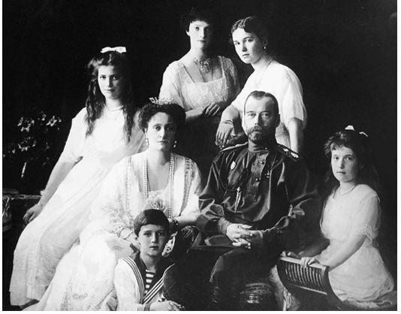
Notes:
Czar and his family.

Slide 14
Triumph of the Communists
The Communists triumphed over __________ forces because of a well-disciplined fighting force, a single-minded sense of purpose, ________ zeal, and strong convictions.
A secret police, known as the ________ , began a __________ , whose aim was to destroy all those opposed to the new regime and keep anti-Communist forces from gaining ground within Russia.
Notes:
V.A. anti-Communist (or White), revolutionary
V.B. Cheka, Red Terror

Slide 15
By 1921, the Communists were in total command of Russia
Russian Revolution

Slide 16
Group Worksheet
Section Summary Worksheet

