Slide 1
World War I Ends
Chapter 14
Lesson 4

Slide 2
Bellringer
Notes:
Answer: He calls Germany's submarine attacks "warfare against mankind" and "nothing less than war against the government and people of the United States

Slide 3
Objective
Students will be able to:
Describe the various goals of the Paris Peace Conference;
Explain why Germany was dissatisfied with the Treaty of Versailles;
Understand the costs/legacy of WWI.

Slide 4
Vocabulary
Armistice: a truce or an agreement to end fighting;
Reparation: a payment made to the victor by the vanquished to cover the costs of war;
Mandate: a territory temporarily governed by another country on behalf of the League of Nations.

Slide 5
Last Year of the War
Russia negotiated its exit from WWI with Germany in November 1917. This lead Germany to only have to fight on the Western Front.
After one last push, on September 1918, Germany would lose its last battle and seek peace.

Slide 6
Peace Settlements

Slide 7
Group Work
See the chart on page 285;
Identify the national interests or goals of each of the “Big Three” countries as it approached the Paris Peace Conference. What did each nation hope to accomplish with the peace settlement.
You will need to read the section on peace Settlements (page 287).
Notes:
France: desire for revenge and security from future attacks;
Britain: desire to make Germany pay;
U.S.: prevent future wars and allow national self-determination.

Slide 8
Peace Settlements
What factors influenced the peace treaties that ended World War I, and how did people react to the treaties?
1) **The Allies wanted to punish Germany and the Central Powers.**
2) **The United States came to the negotiations wanting to create a lasting peace and offer Eastern Europeans self-determination (the right of each people to have their own nation).
Result: Germans were shocked at the reparations they were faced with.

Slide 9
Big Three
British Prime Minister David Lloyd George,
French Prime Minister Georges Clemenceau, and
U.S. President Woodrow Wilson met at the Paris Peace Conference after the war ended to determine the peace settlement.
- The victorious Allied leaders were known as the “Big Three.”

Slide 10
The Paris Peace Talks
The Big Three met with the leaders of the other Allied countries to discuss the fate of Europe, the former Ottoman empire, and various colonies.
The Central Powers and Russia were not allowed to take part in the negotiations at the conference.

Slide 11
**Goals of the Allies at the Paris Peace Conference
 | Woodrow Wilson | “Peace without victory” based on the Fourteen Points; reduction of militaries/weapon
 | David Lloyd George | Money to rebuild & improve Britain; wanted Germans pay for the war
 | Georges Clemenceau | A weakened Germany; sought revenge and security
 | Vittorio Orlando | Lands promised to Italy in secret treaties
People of Eastern European empires |  | National states of their own

Slide 12
In June 1919, the Allies forced Germany to sign the *Treaty of Versailles.*
The German delegates were horrified because the Allies:
Forced Germany to accept full blame for the war Imposed reparations of $30 billion on Germany Severely limited the size of the German military Took land and overseas colonies from Germany
Notes:
The Treaty of Versailles ended the war b/w Germany and the Allies. Germans resented the treaty; their currency plummeted; the new government was too frail to deal with the economic crisis.

Slide 13
The Allies drew up separate treaties with the other Central Powers and redrew the map of Europe.
The Allies applied the principle of self-determination to former German, Russian, and Austrian lands in Eastern Europe.
German and Russian empires lost considerable territory in eastern Europe.
The Austrian-Hungarian Empire disappeared.
New nation-states emerged from the lands of these empires: Finland, Poland, Latvia, Lithuania, Estonia, Czechoslovakia, Austria, Hungary, and Yugoslavia.

Slide 14
Dissolution of the Austro-Hungarian Empire
• The empire’s citizens were weary and disenchanted because of World War I.
• One by one, ethnic groups revolted and became independent.
• The empire was replaced by the independent republics of Austria, Hungary, and Czechoslovakia, along with the large monarchical state of Yugoslavia.

Slide 15
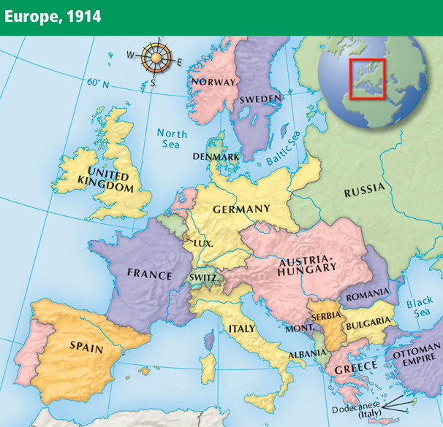
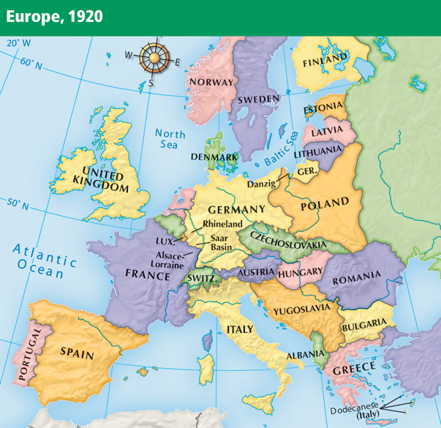
Notes:
15

Slide 16
The treaties did not apply self-determination to European colonies in Asia and Africa.
Instead, former German and Ottoman lands became mandates administered by Western powers.
In theory, the mandates were to be held until they were ready to stand alone.
In practice, they were treated as colonies.
Britain controlled the Iraq and Palestine mandate.

Slide 17
Many of President Wilson’s Fourteen Points were not implemented in the treaties.
Germany, the other Central Powers, and other countries and colonies were angered by their treatment.
**German resentment of the Treaty of Versailles would later spark World War II.

Slide 18
Wilson did succeed in establishing the League of Nations, a group of more than 40 countries formed to negotiate disputes in an effort to avoid future wars.
Because of opposition to the League, the United States Senate refused to ratify the Treaty of Versailles.
The United States never joined the League of Nations.
Although it promised collective security, the League proved ineffective in preventing future wars.

Slide 19
The League of Nations
• Woodrow Wilson wanted a league, or worldwide association, of nations for international peacekeeping.
• **The league's purpose was to prevent future wars.**
• Wilson believed the league would correct any unfair settlements made at the Paris Peace Conference.
• The U.S. Senate did not ratify the Treaty of Versailles.
• Thus, the United States did not join the League of Nations.

Slide 20
Question
Should Germany have been held responsible for the cost of the war? Why or Why not?
What were some of the legacies of WWI; what will people remember about it?

Slide 21
Legacy of the War
New nations emerged (the map of Eastern Europe was redrawn);
Empires disappeared (Austria-Hungary and Ottoman);
Countless deaths; cities needed to be rebuilt.

Slide 22
World War I was devastating for all of the nations involved.
More than 8.5 million men died and more than 16 million were wounded fighting in the war.
Many of the wounded were disabled for life.
Six to thirteen million civilians also died.
Many others became refugees.
A World War I cemetery in Belgium

Slide 23
Buildings all over Europe had been bombed into rubble.
Countries faced huge war debts and the cost of reconstruction.
Refugees had to rebuild their lives.
The influenza pandemic of 1918 added to the devastation, killing 20 million people worldwide.

Slide 24
Video
WWI Takeaway

