Slide 1
Enlightenment and Revolution
Beginning in the late 1500’s, new discoveries and the use of reason in Europe during the Scientific Revolution and the Enlightenment led to changing ideas about government and society. Influenced by Enlightenment ideas, British colonists in North America established a new nation- the United States.

Slide 2
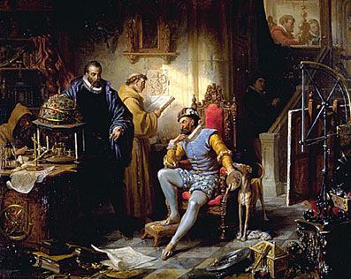
Section 1- The Scientific Revolution
New Ways of thinking led to remarkable discoveries during the Scientific Revolution

Slide 3
Reading Focus
What changes led to the dawn of modern science?
What discoveries occurred in astronomy, physics, and math during the Scientific Revolution?
How did early scientists advance knowledge in biology and chemistry?
How did scientific ideas move beyond the realm of science and affect Society?

Slide 4
Objectives:
1.3 understand the ways in which individuals and groups contributed to changes in social conditions.
2.2 recognize the importance of technologies for economic development.
5.11 understand the importance of major trends and movements in world history.

Slide 5
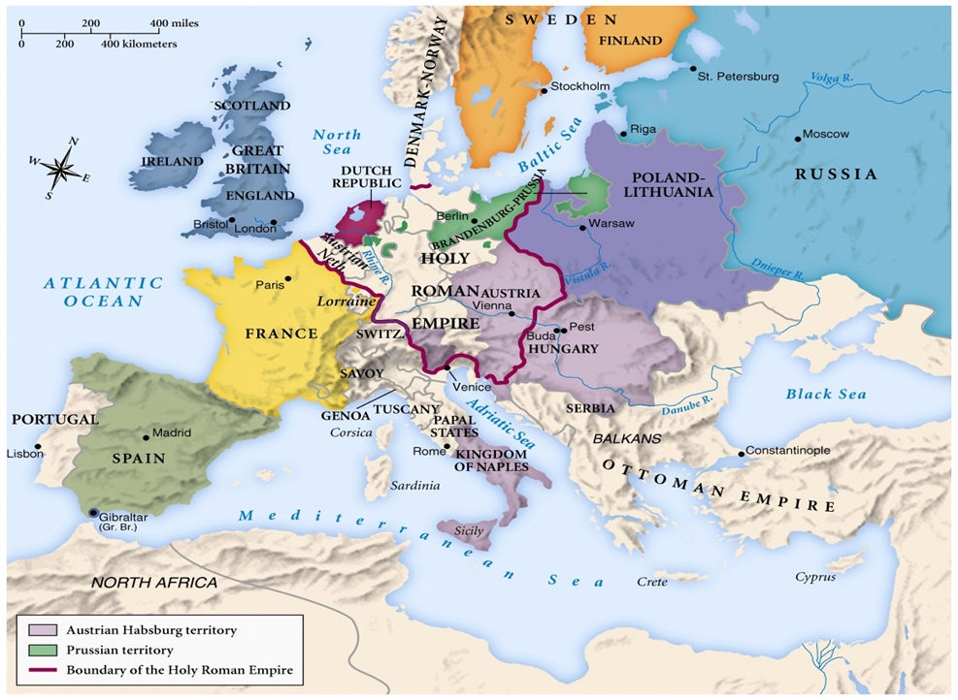
Map of Europe 1715

Slide 6
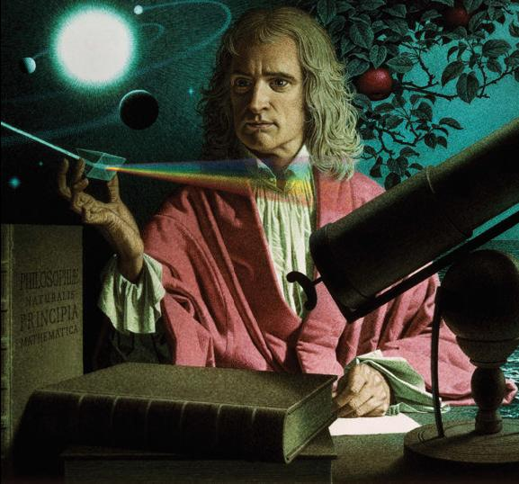
Key Terms and Names
Geocentric Theory
Scientific Revolution
Rene Descartes
Nicolas Copernicus
Heliocentric Theory
Galileo Galilei
Isaac Newton

Slide 7
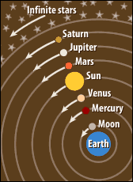
Dawn of Modern Science
Geocentric View as proposed by Aristotle in 300 BC
Ptolemy expanded idea in 200 BC and the Church expanded on and taught that God put the earth at the center of the universe.

Slide 8
New View Points
1500’s- People began to challenge the traditional Geocentric Views.
Period became known as the Scientific Revolution.
Europeans open to new ideas because of exploration.
Exploration led to analyzing the natural world more closely.
Needed more accurate instruments to cross the vast oceans.
The more people examined the natural world, the more they found that it did not match ancient beliefs

Slide 9
The Scientific Method

Slide 10
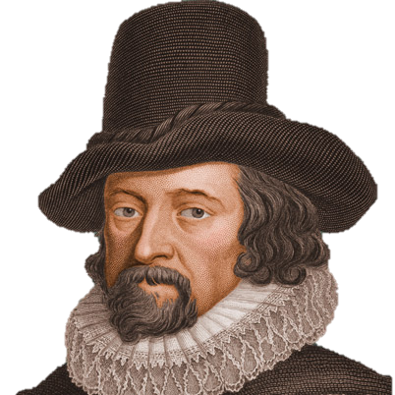
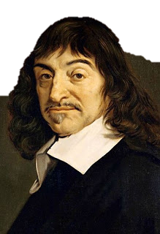
The Scientific Method
Francis Bacon and Rene Descartes (day-KAHRT)
Francis Bacon wrote in 1620 that the only true way to gain scientific knowledge was through experimentation-observing, measuring, explaining, and verifying.
Descartes place more emphasis on reason- everything should be doubted until it could be proven by reason.
- Relied on mathematics and logic to prove basic truths.

Slide 11
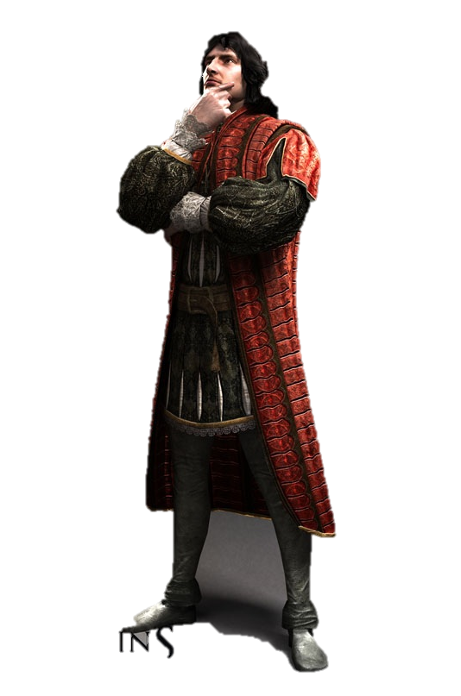
Discoveries in Astronomy, Physics, and Math
Nicolas Copernicus 1500’s
Polish Astronomer
Geocentric Theory did not explain the movements of the Sun, Moon and planets accurately.
Proposed that the sun was the center of the universe.
Theory is called the Heliocentric theory.
Used math to prove theory
First to complete model of solar system that combined physics, astronomy, and mathematics.

Slide 12
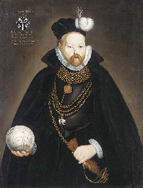
Brahe and Kepler
Tycho Brahe (brah) 1572
Danish astronomer
Identified the first observed supernova (exploding star)
King Frederick II of Denmark gave money to build two observatories.
Believed that the sun revolved around the earth but the remaining planets revolved around the sun.
Hired Kepler as an assistant after moving to Prague.

Slide 13
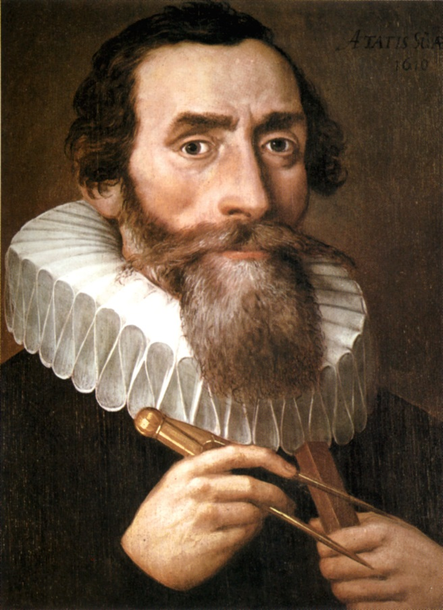
Brahe and Kepler
Kepler published the result of Brahe’s measurements after his death.
Kepler solved the problems that Brahe’s theory had.
Copernicus assumed that the planets orbited the sun in a circle.
Kepler proved that the planets orbited in a an oval pattern.
Brahe had wanted to prove Copernicus wrong but his measurements led Kepler to prove that the heliocentric theory was right.

Slide 14
Reading Focus
Why did Copernicus not publish his work until the last year of his life?
What set Copernicus's work apart from that of previous scientists?
Based on Frederick II’s actions, what role do you think rulers and patrons played in the Scientific Revolution?

Slide 15
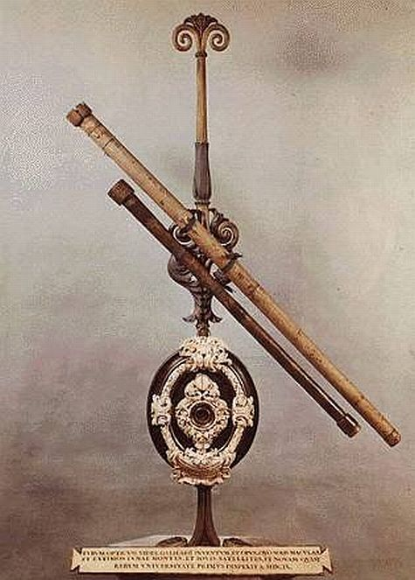
Galileo
Italian scientists who supported Copernicus
Built the first telescope in 1609
First to observe Saturn, craters on the moon, sunspots and the moons of Jupiter
Discovered that the Milky Way was made up of stars.
1610 book Starry Messenger

Slide 16
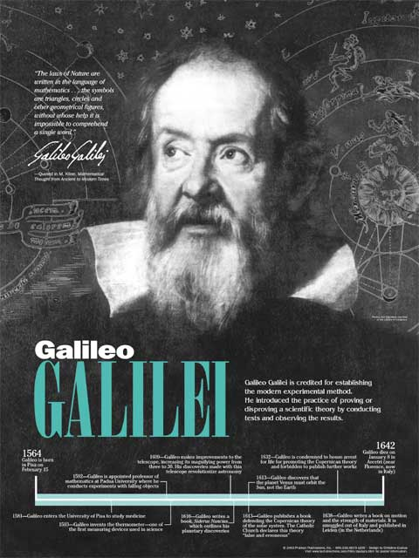
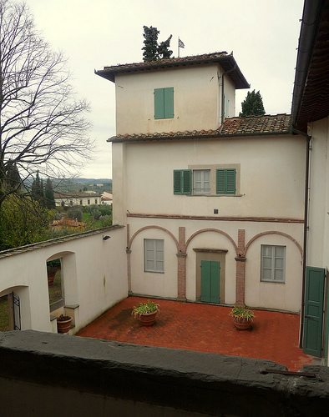

Slide 17
Sir Isaac Newton
English Scientist
Astronomy, Physics, and Mathematics
Wondered “Does gravity affect the universe the way that it affects objects on earth”
1687 The Mathematical Principles of Natural Philosophy
Explained law of Universal Gravitation- gravity affects objects in the universe as well as on earth.
Gravity keeps the planets in their orbits
Developed a new kind of math called Calculus
Gottfried von Leibniz independently developed calculus at the same time causing a controversy of which both accused the other of plagiarism
Three laws of motion
Reflecting telescope
Actually wrote more on theology than science

Slide 18
Reading Focus
What valuable contribution did Kepler make?
Why were Galileo’s books so controversial?
What do you think was Newton’s most important discovery? Why?

Slide 19
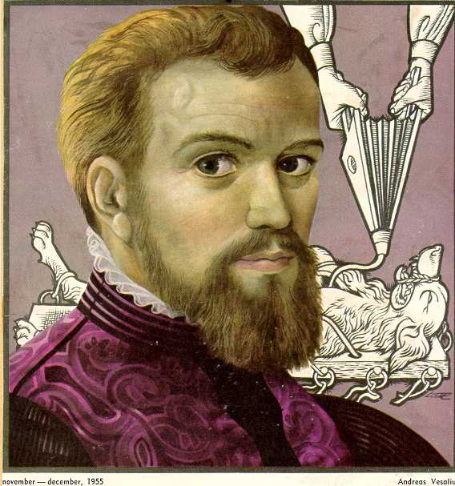
Biology
Andreas Vesalius
Flemish Doctor
Known for his work in Anatomy
1539 gained access to bodies of executed criminals from a sympathetic judge for dissection.
Hired artists to produce accurate drawings
1543 On the Workings of the Human Body

Slide 20
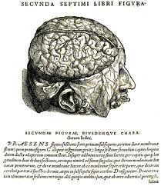
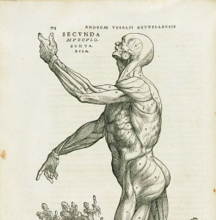
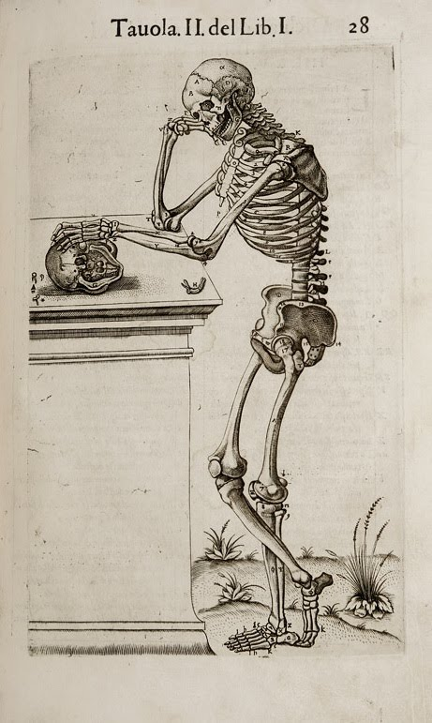
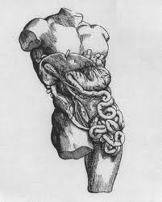
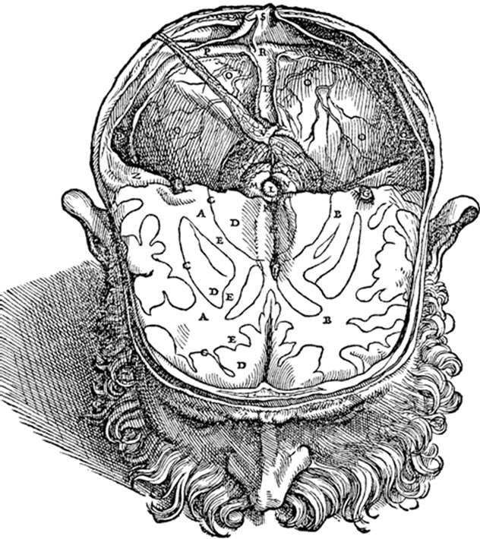

Slide 21
Chemistry
Robert Boyle called the father of modern chemistry
First to define an element
The Sceptical Chemists (1661) described matter as a cluster of tiny particles (now called atoms or molecules)
Boyle’s Law- describes how temperature, volume, and pressure affect gases.
Antoine-Laurent Lavoisier
Developed methods for precise measurements
Law of Conservation of Mass- proved that matter could not be created or destroyed
Recognized and named oxygen
Introduced the metric system of measurements
Invented first periodic table with 33 elements

Slide 22
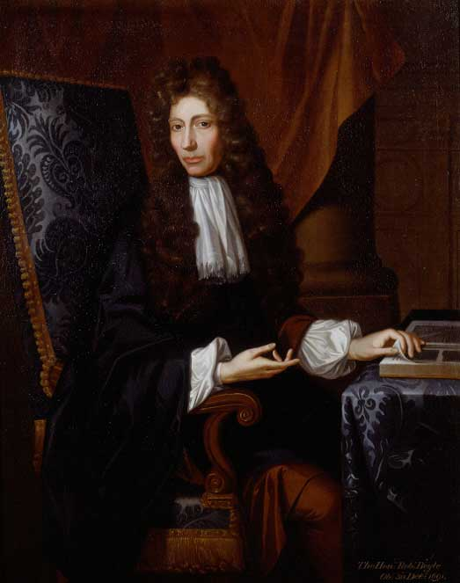
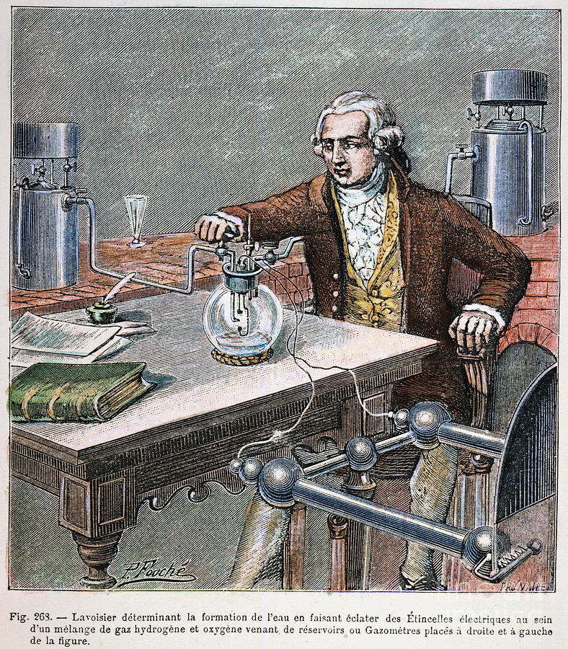
Robert Boyle A. L. Lavoisier

Slide 23
Reading Focus
How did Vesalius record information learned from his dissections?
What impact do you think Vesalius’s work have on the medical community?
What were Lavoisier’s achievements?

Slide 24
Science and the Church
Most scientists were Christian and did not want to challenge the role of Christianity in society.
Conflicts did arise
-Church- explained the world through inspiration and revealed truth.
-Science- looked to explain the world through the accumulation of facts of logical reasoning
-Galileo’s theory’s brought him into direct conflict with the church
-1633 Galileo stood trial before the inquisition

Slide 25
Reading and Focus
How did the basis of Christianity differ from the basis of science?
How did Renaissance artists combine science and religion?
What were some of the long term effects of the Scientific Revolution?
How might other parts of society be affected by the ideas of the Scientific Revolution?

