Slide 1
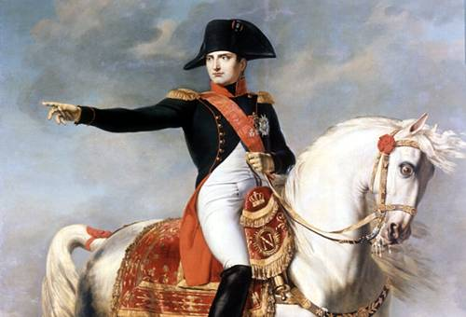

Slide 2
Chapter 20 Section 3
Main Idea: Napoleon Bonaparte rose through military ranks to become emperor over France and much of Europe.

Slide 3
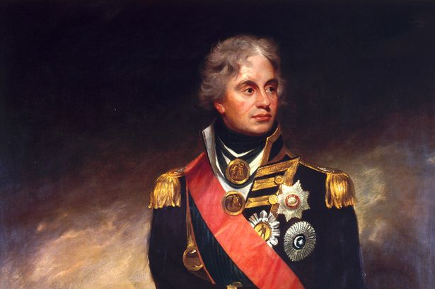
Key Terms and Names
Napoleon Bonaparte
Admiral Horatio Nelson
Coup D’etat
Plebiscite
Continental System
Nationalism
Standard Number:
4.0 Governance and Civics
Standard:
Governance establishes structures of power and authority in order to provide order and stability. Civic efficacy requires understanding rights and responsibilities, ethical behavior, and the role of citizens with in their community, nation, and world.

Slide 4
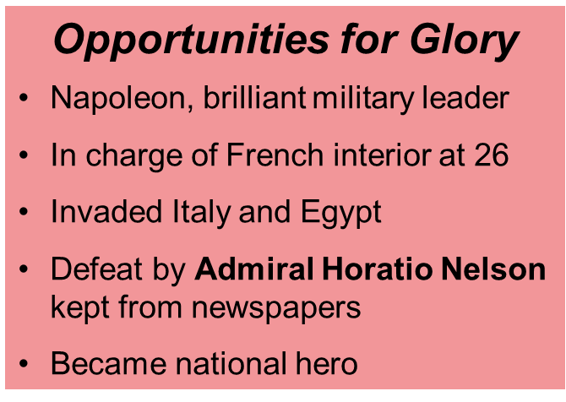
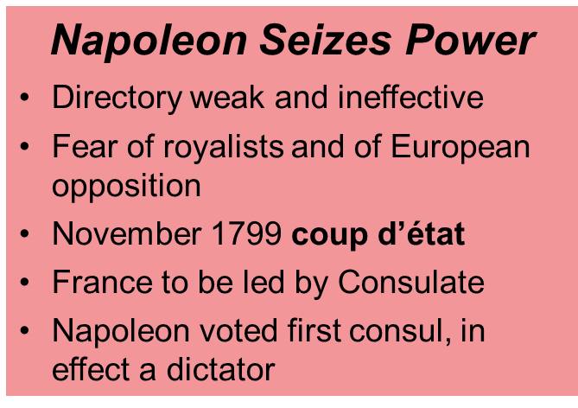
Napoleon’s Rise to Power
Napoleon Bonaparte, ruthlessly ambitious, rose from army captain to ruler of France in a very short time. He took advantage of the turmoil of the French Revolution.
Napoleon promised order and stability, pledging to uphold key reforms. The French gave up some freedoms for peace and prosperity.

Slide 5
Summarize What events led to Napoleon’s rise to power?
Answer(s): stopped royalists from regaining power, defended French interior, won battles in Italy, kept borders secure, won territory for France, covered up Battle of Nile, coup d'état

Slide 6
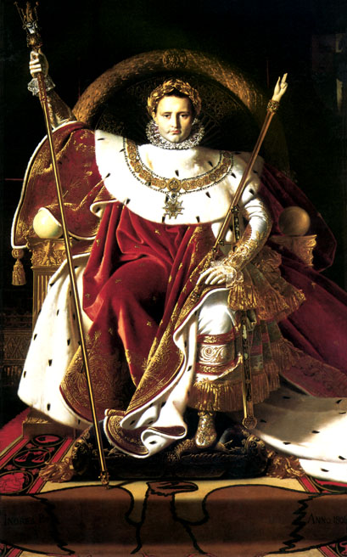
Emperor Napoleon
Once France under control, Napoleon turned to Europe
Napoleon crowns himself
Submitted a plebiscite before voters
Emperor Napoleon I
Desire for empire
Wanted to rule Europe and the Americas
French expedition to Saint Domingue (Haiti today) failed
Napoleon sold Louisiana Territory and turned his focus to Europe

Slide 7
Quest to Conquer Europe
Napoleonic Wars Begin
Extension of wars fought during the French Revolution, would last a decade
France dominant power in Europe
French empire grew rapidly, but fell apart more quickly
Nelson and British navy won Battle of Trafalgar off coast of Spain
Napoleon defeated Russian and Austrian troops at Austerlitz

Slide 8
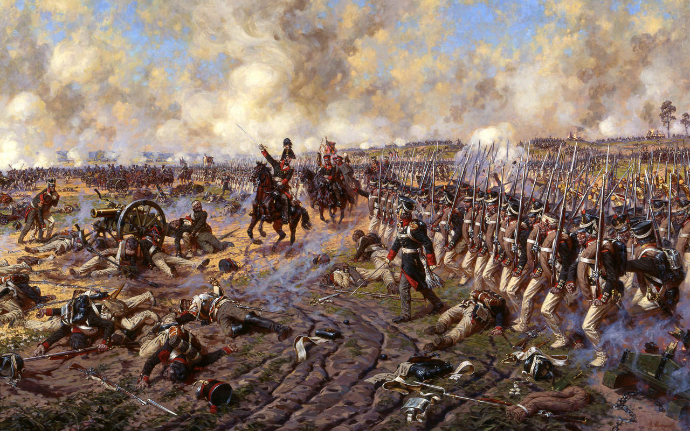

Slide 9
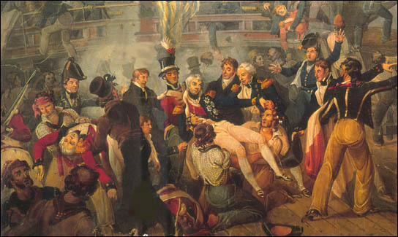

Slide 10
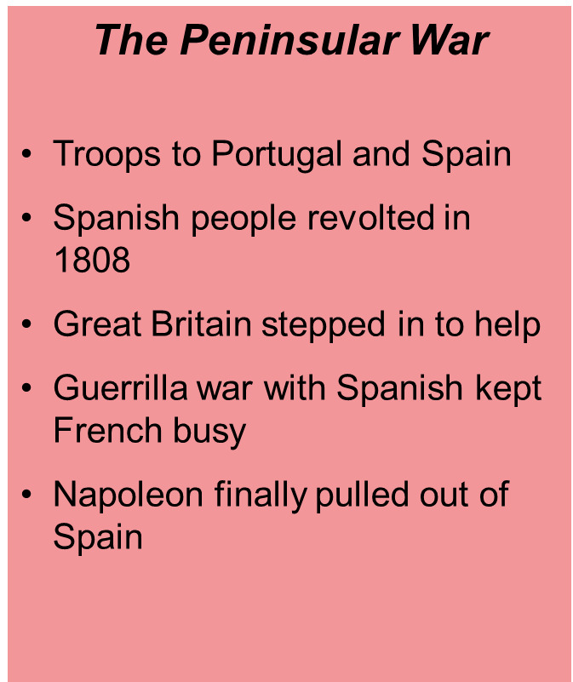

Slide 11
Napoleon Dominates Europe

Slide 13
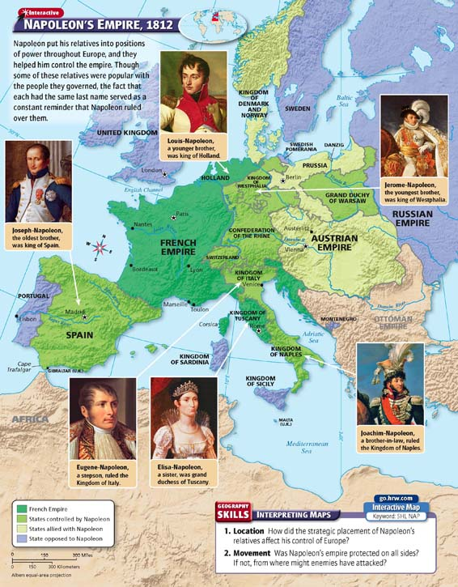

Slide 14
Summarizing What regions of Europe did Napoleon dominate?
Answer(s): all nations except Great Britain, Sweden, and the Ottoman Empire

Slide 15
Napoleon’s Policies

Slide 16
Identify Cause and Effect How did Napoleon’s reforms affect French society?
Answer(s): Napoleon made some basic revolutionary ideas part of the French government

Slide 17
