Slide 1
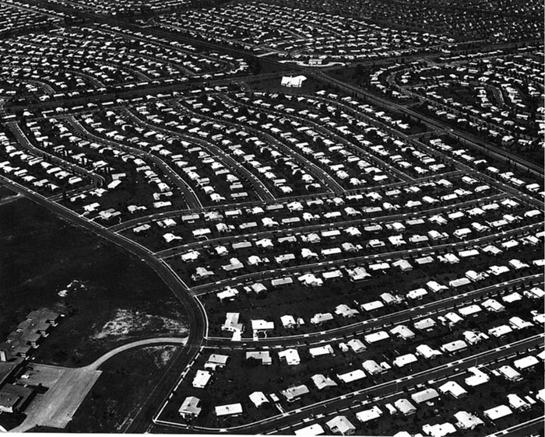
Levittown The Imperfect Rise of American Suburbs

Slide 2
Objectives
Students will be able to understand the history of suburbanization in the U.S. following World War II through the study of Levittown

Slide 3
Levittown Article Questions

Slide 4
Travel Brochure

